Slide 1
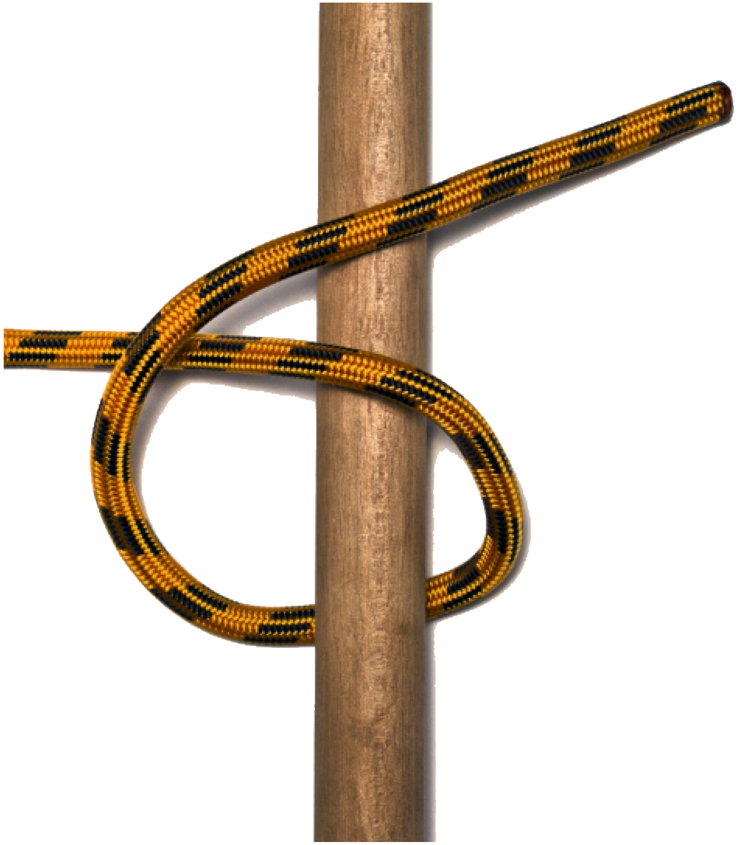
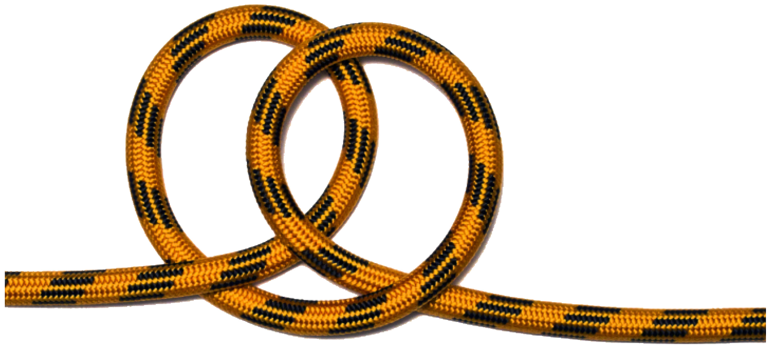
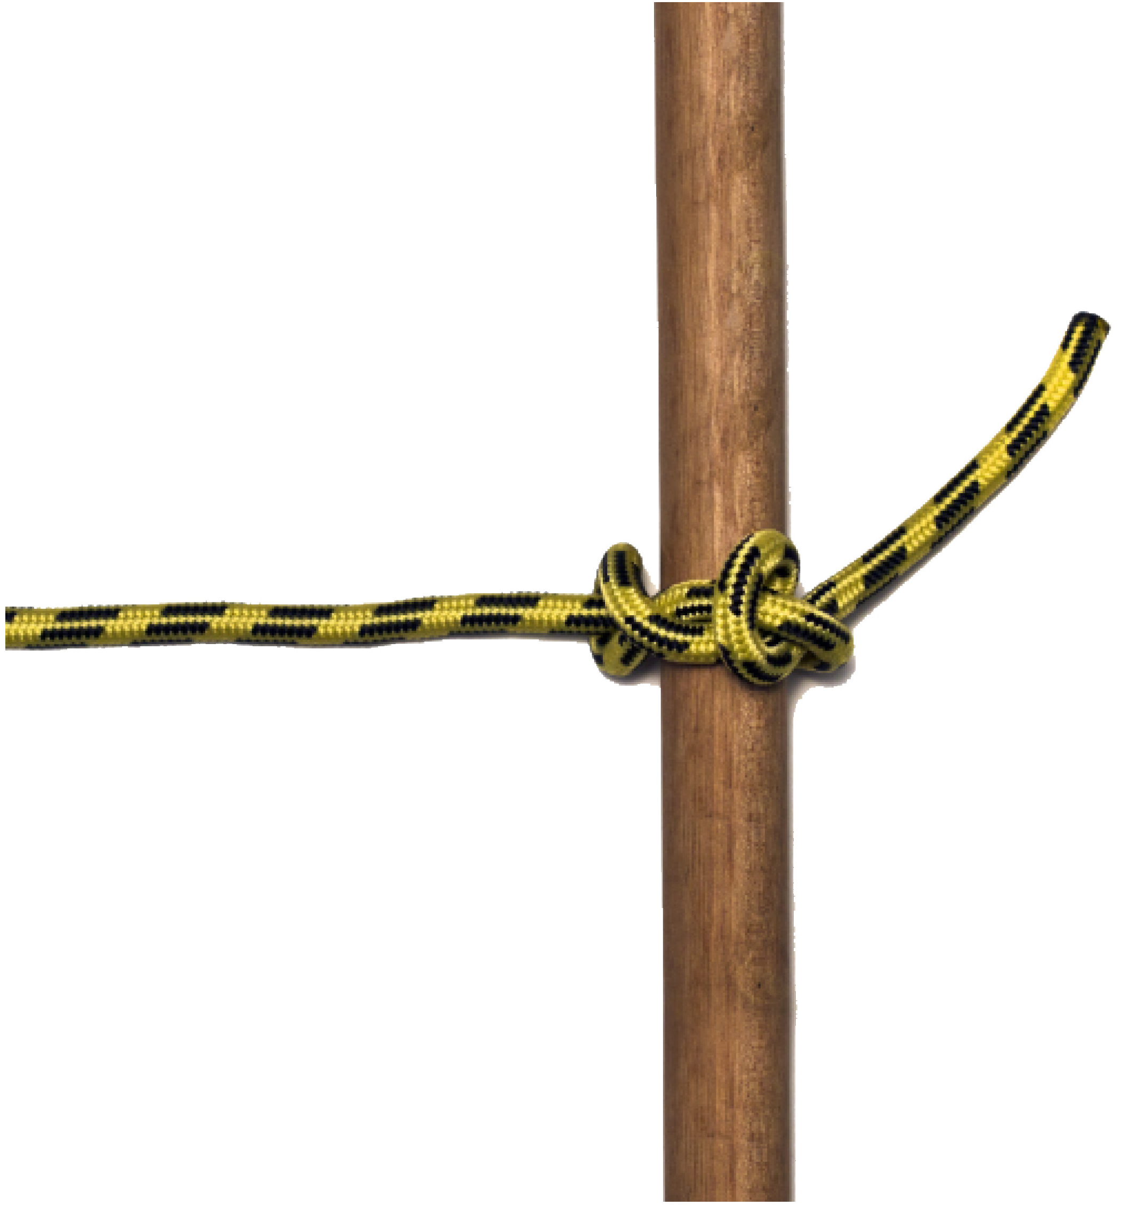
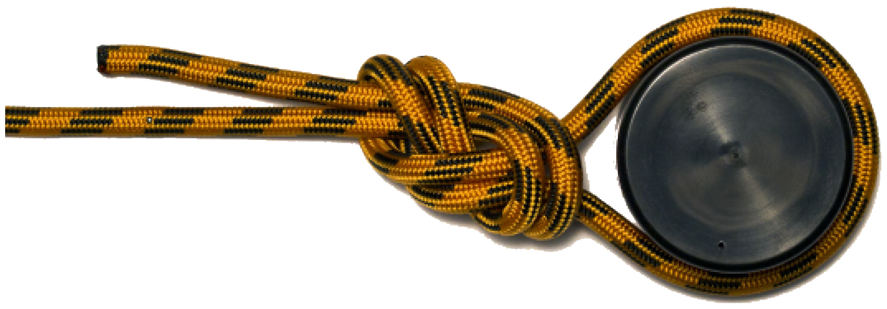

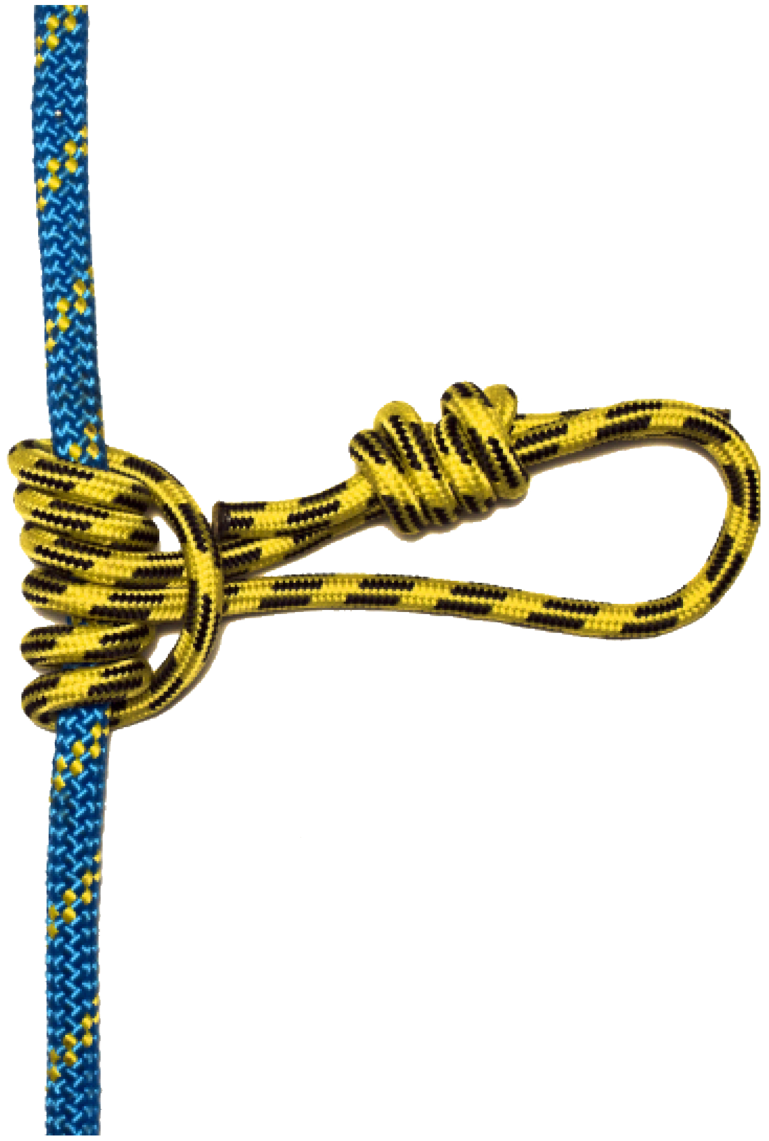
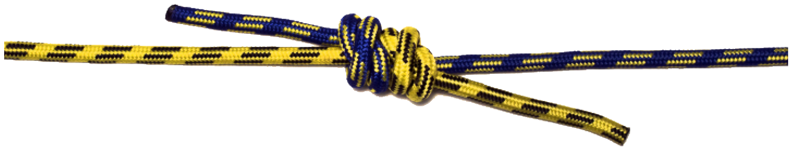
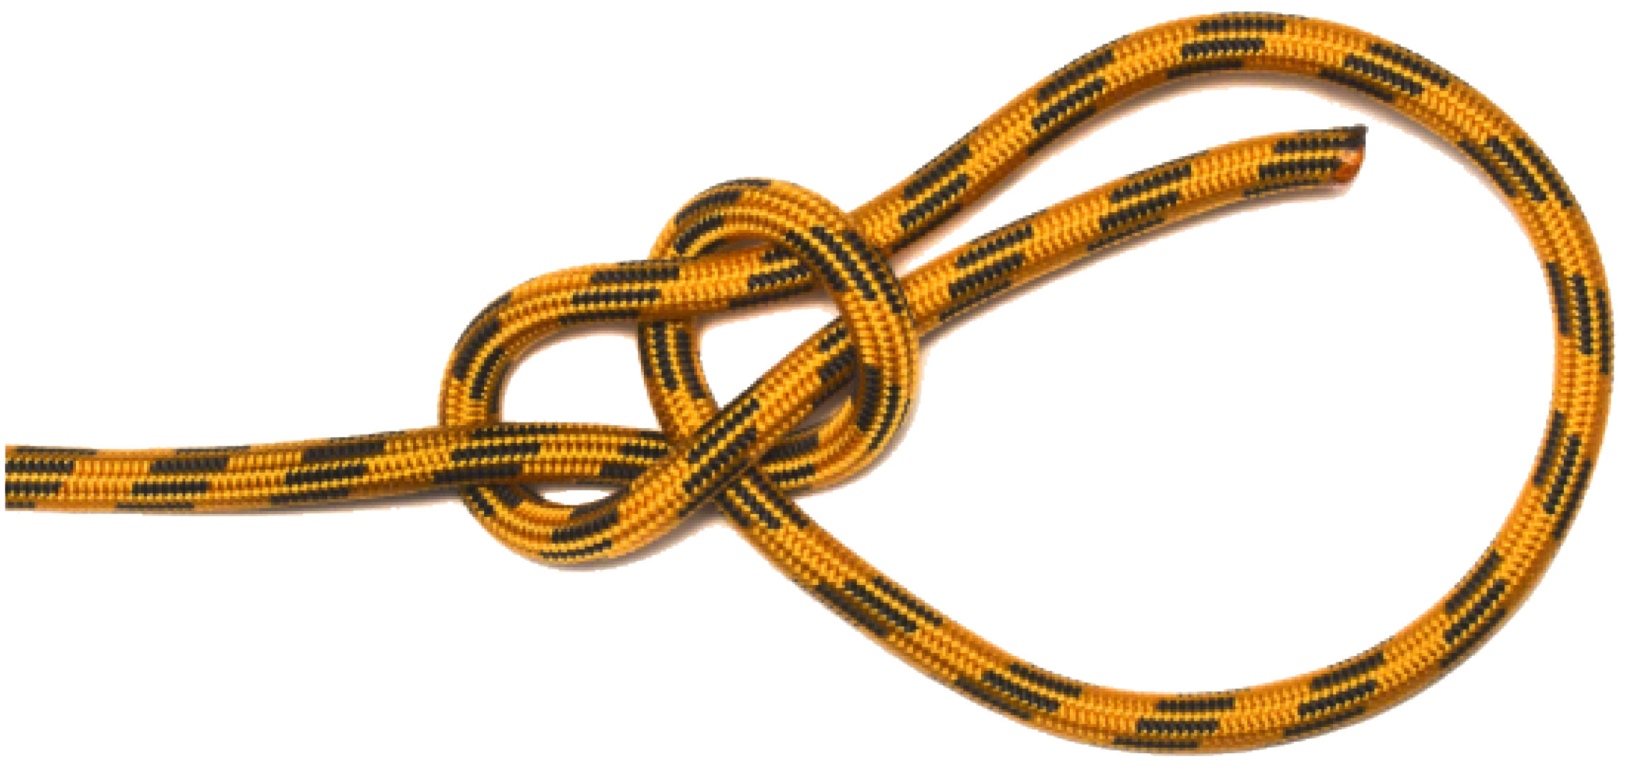
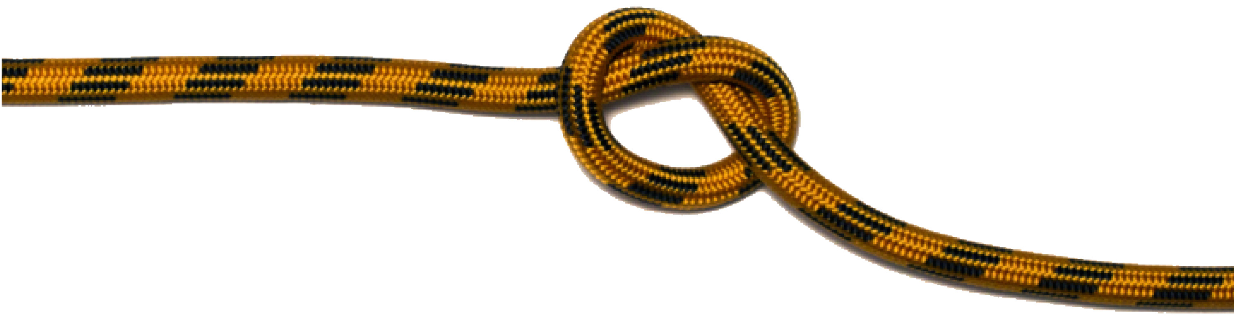
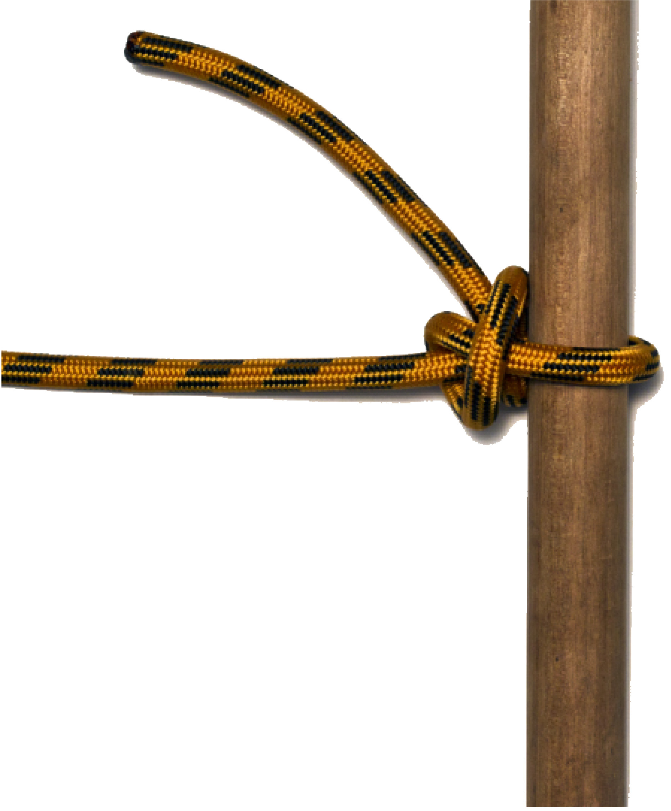
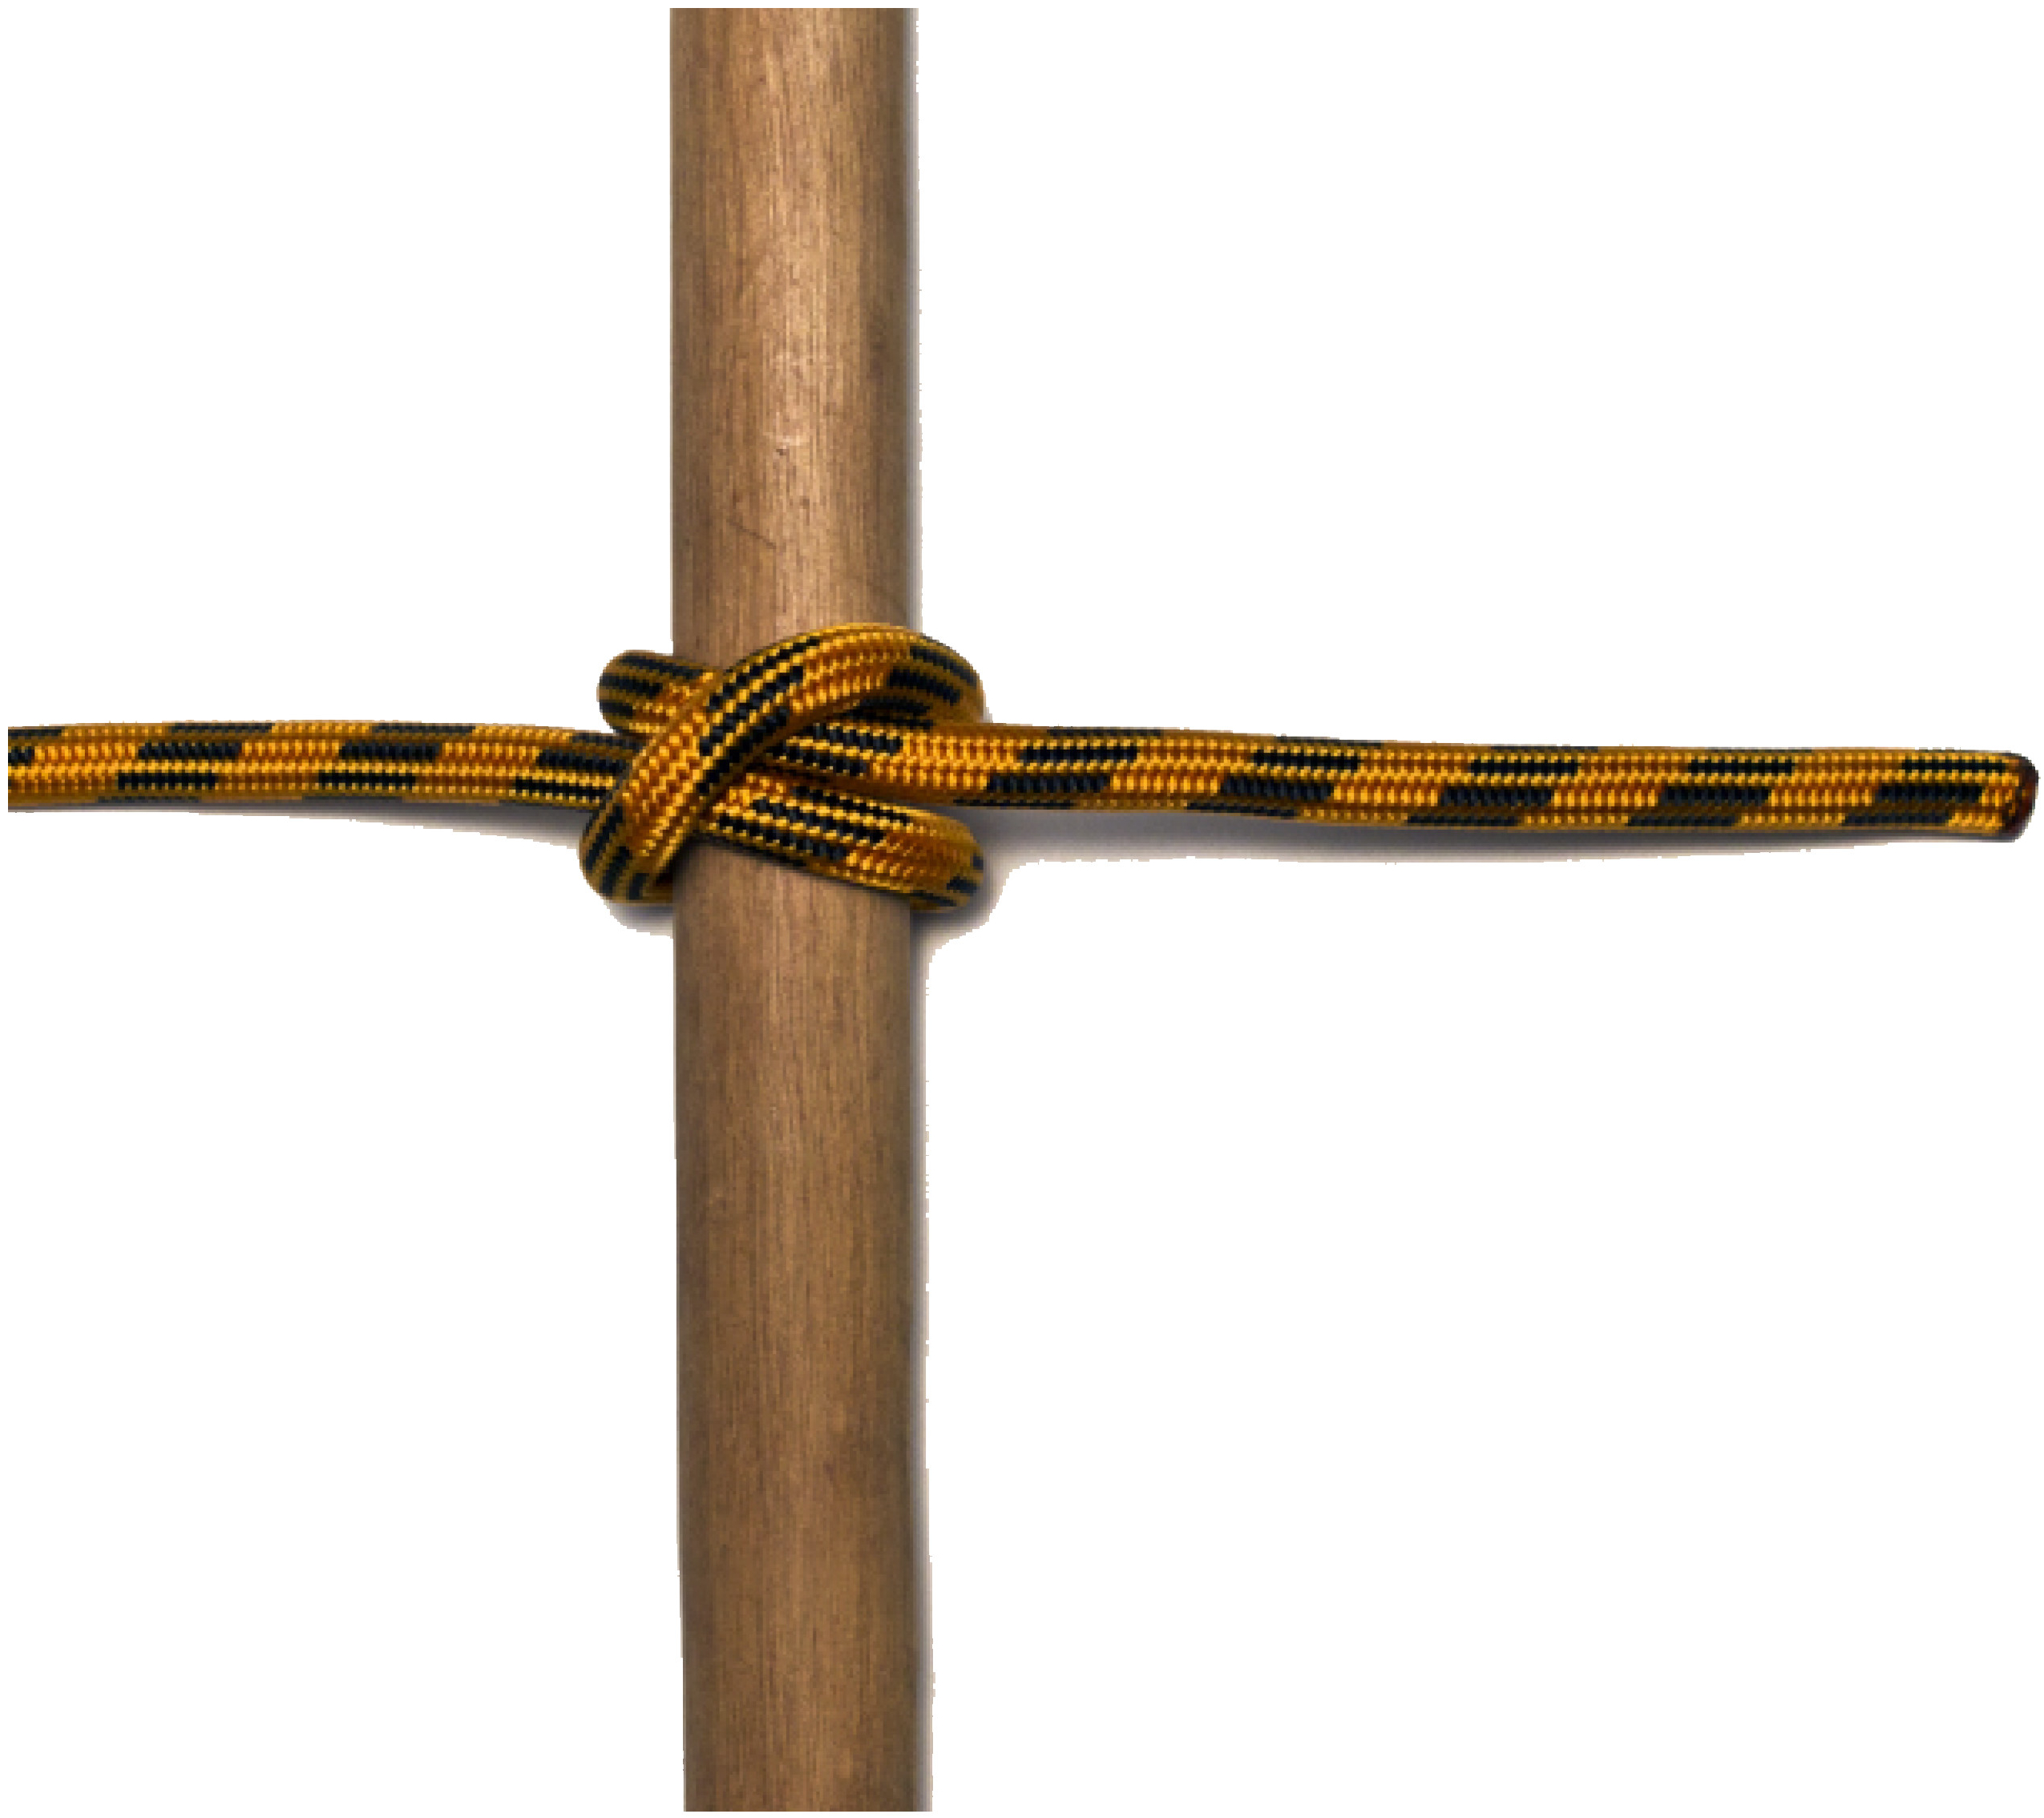
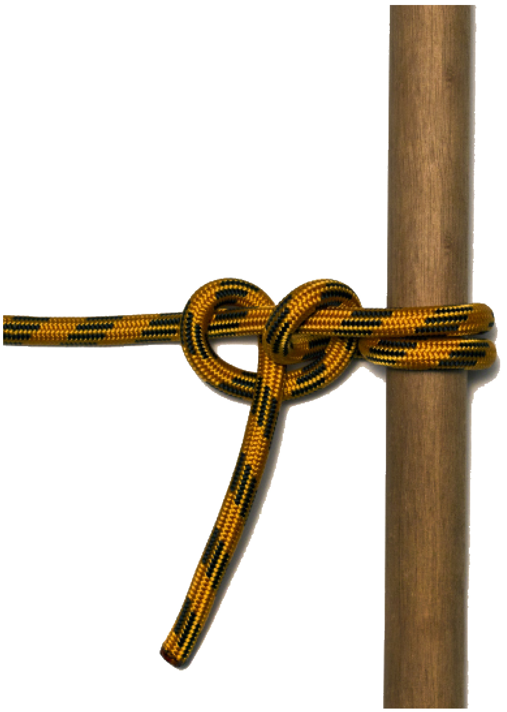
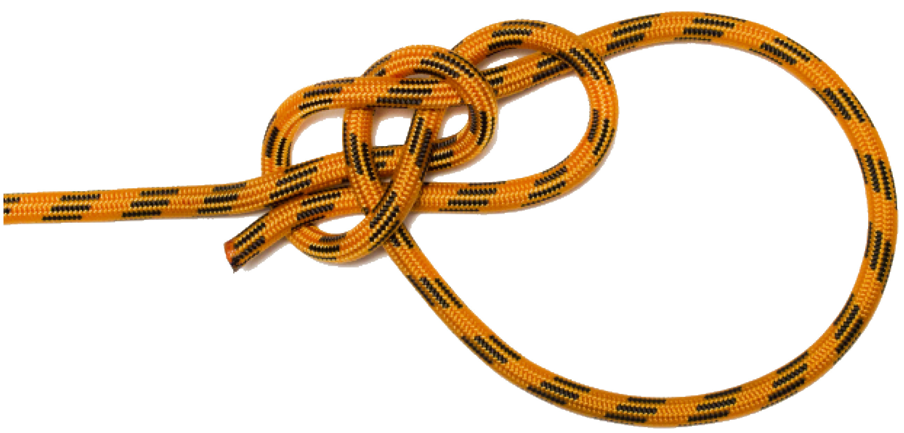
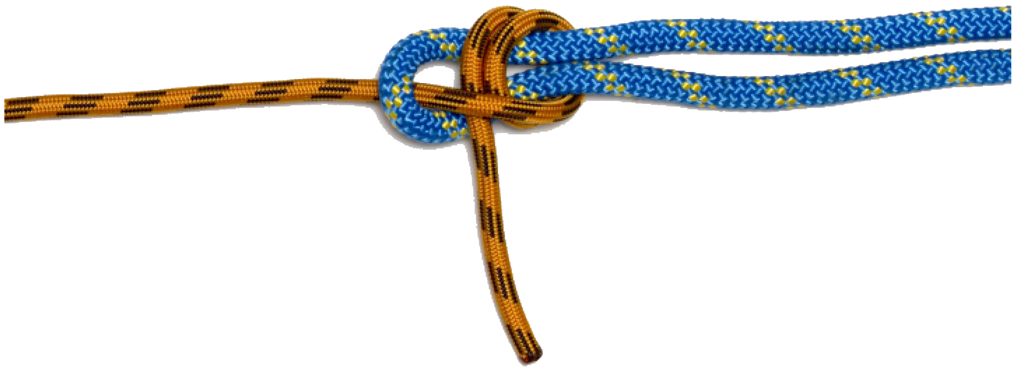
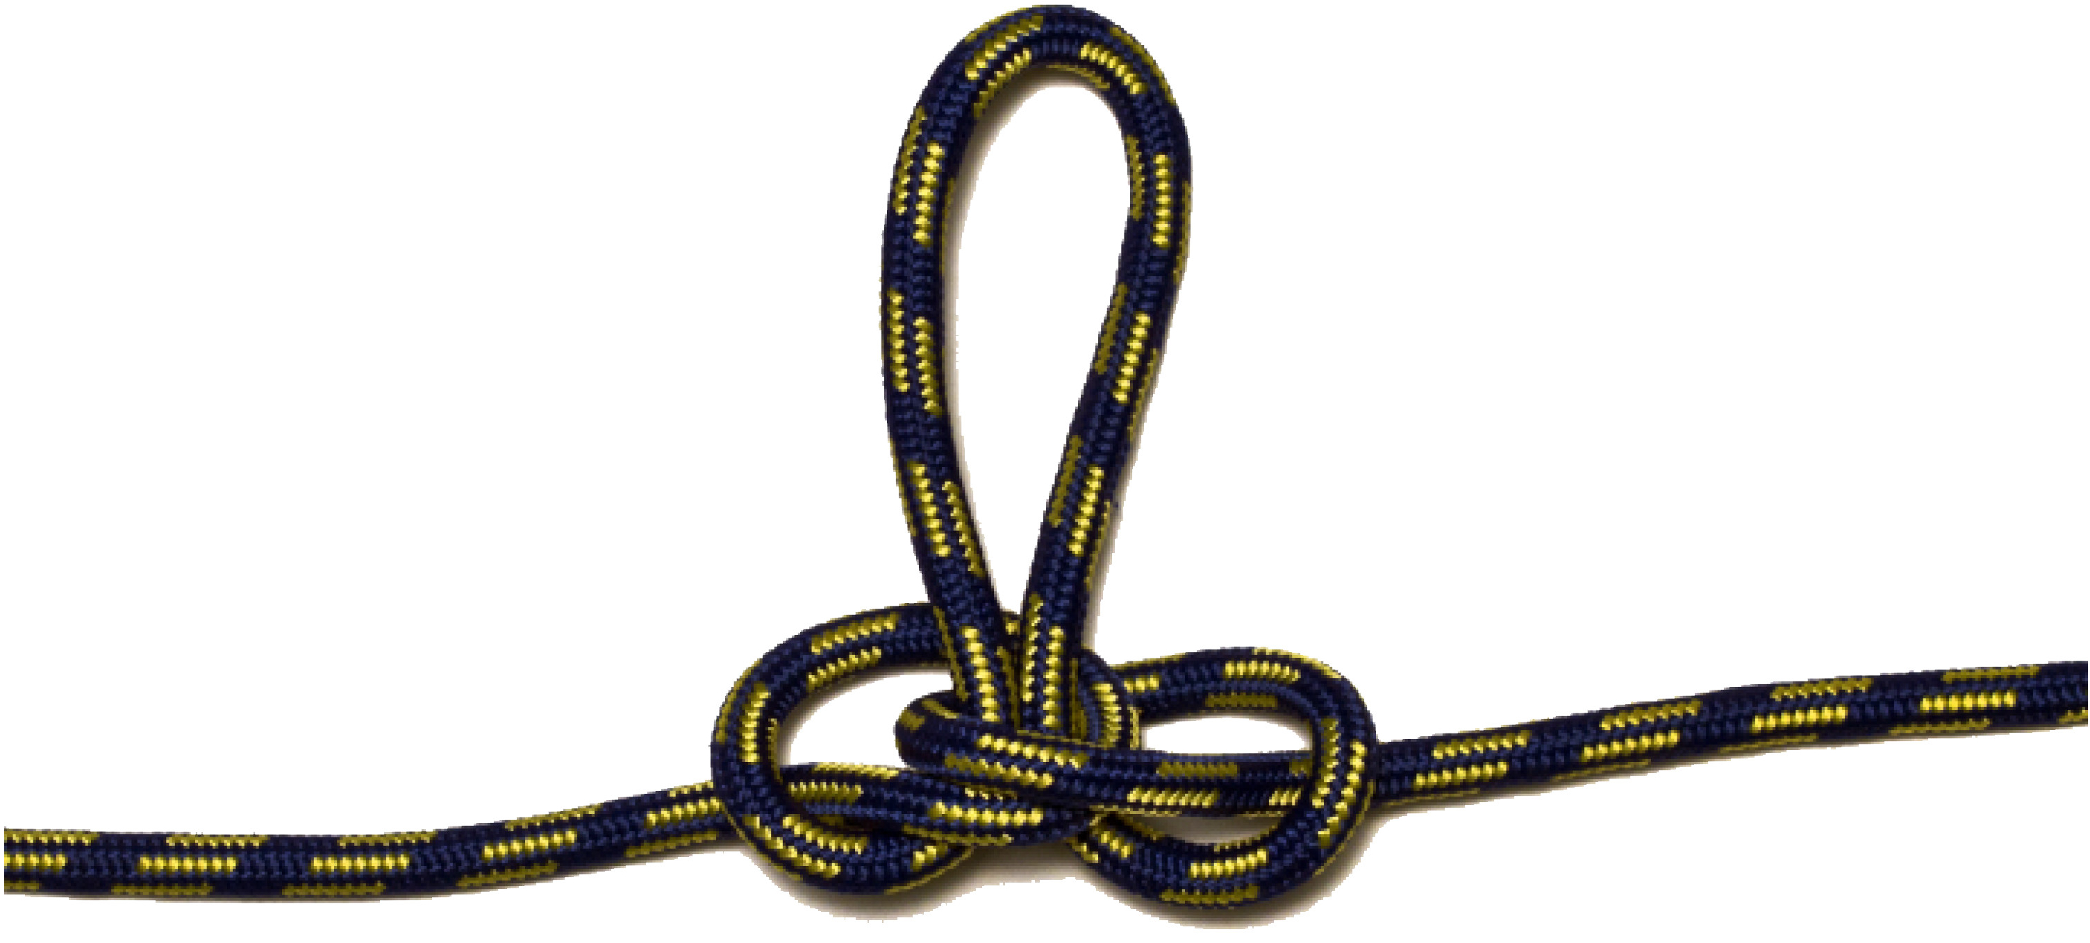
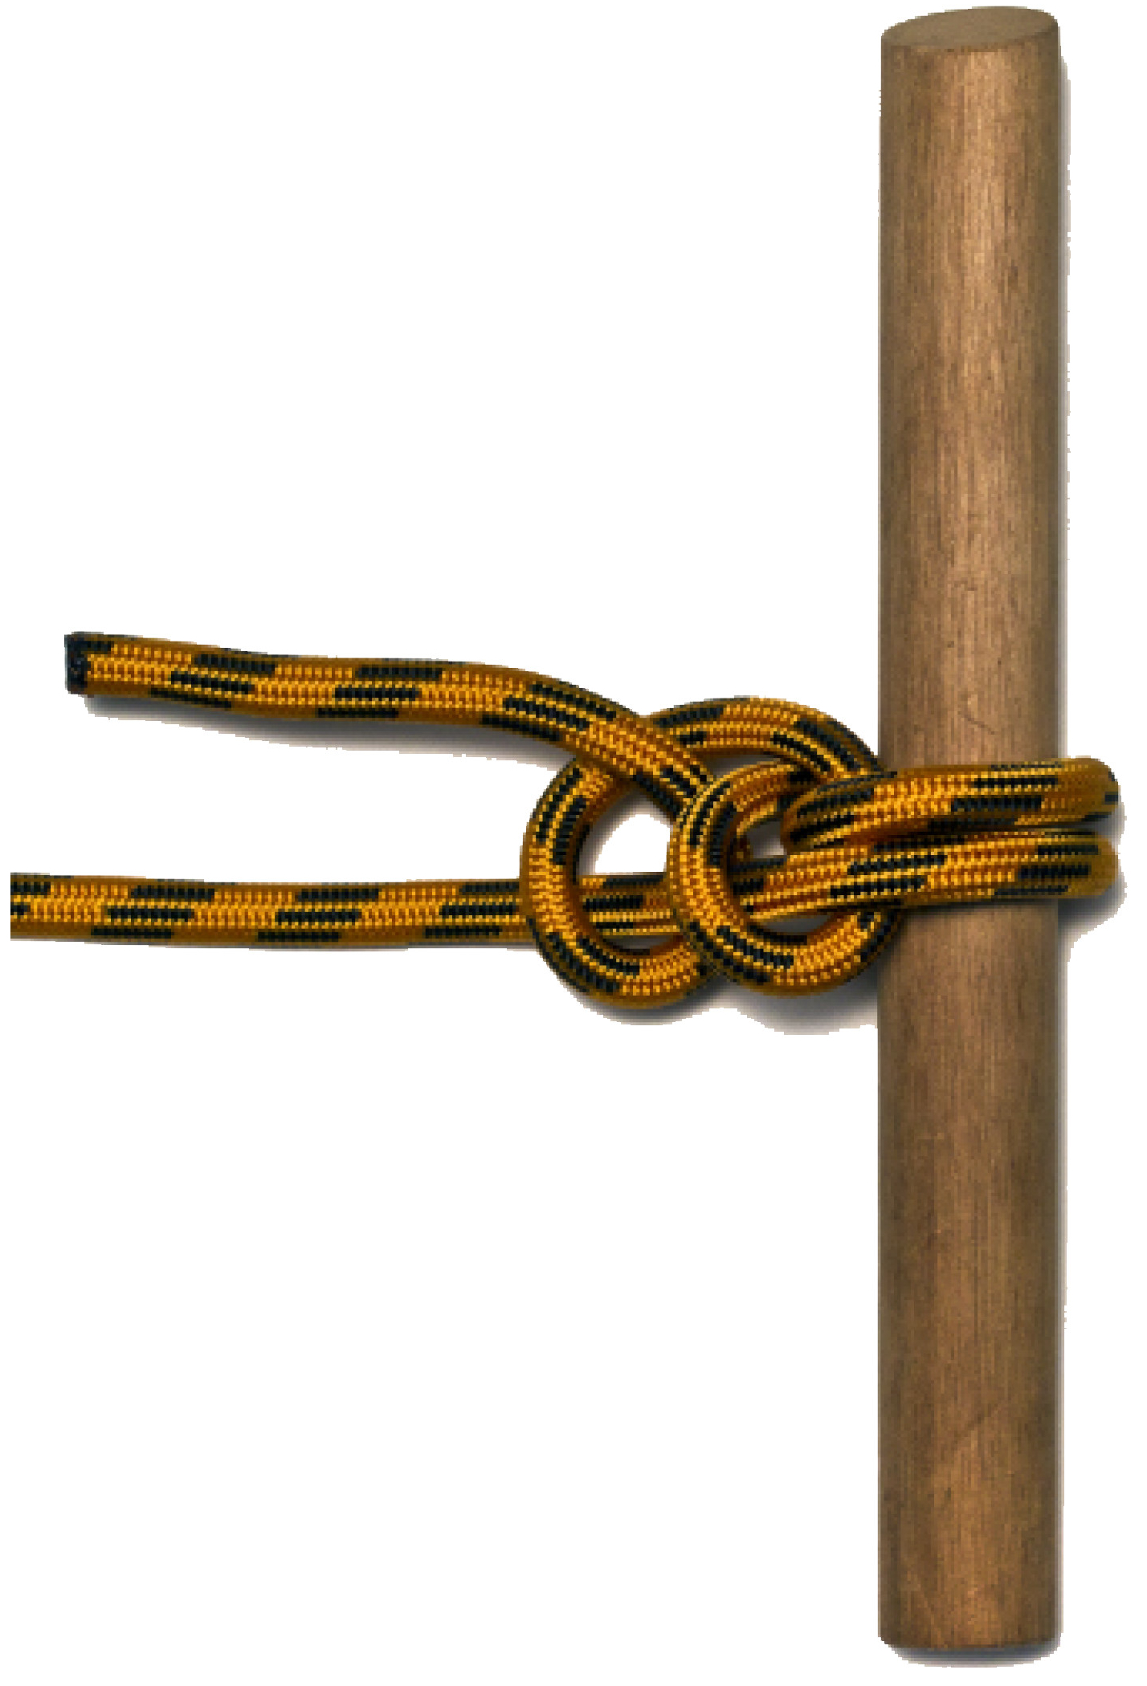
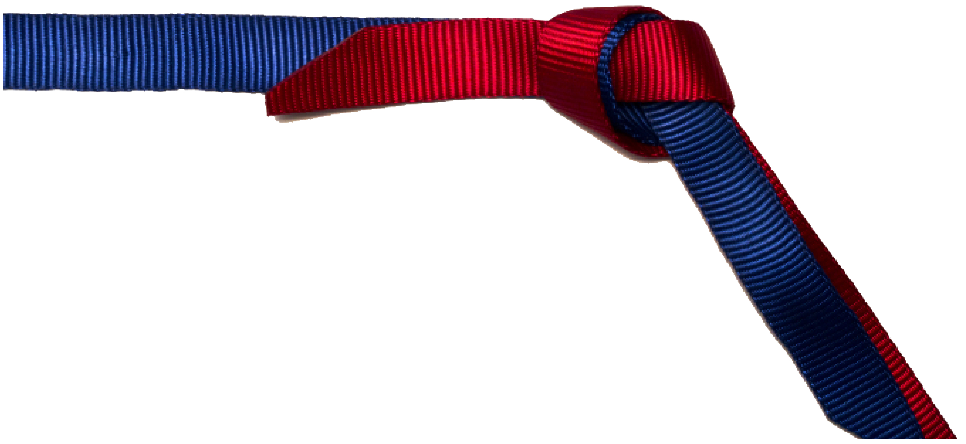
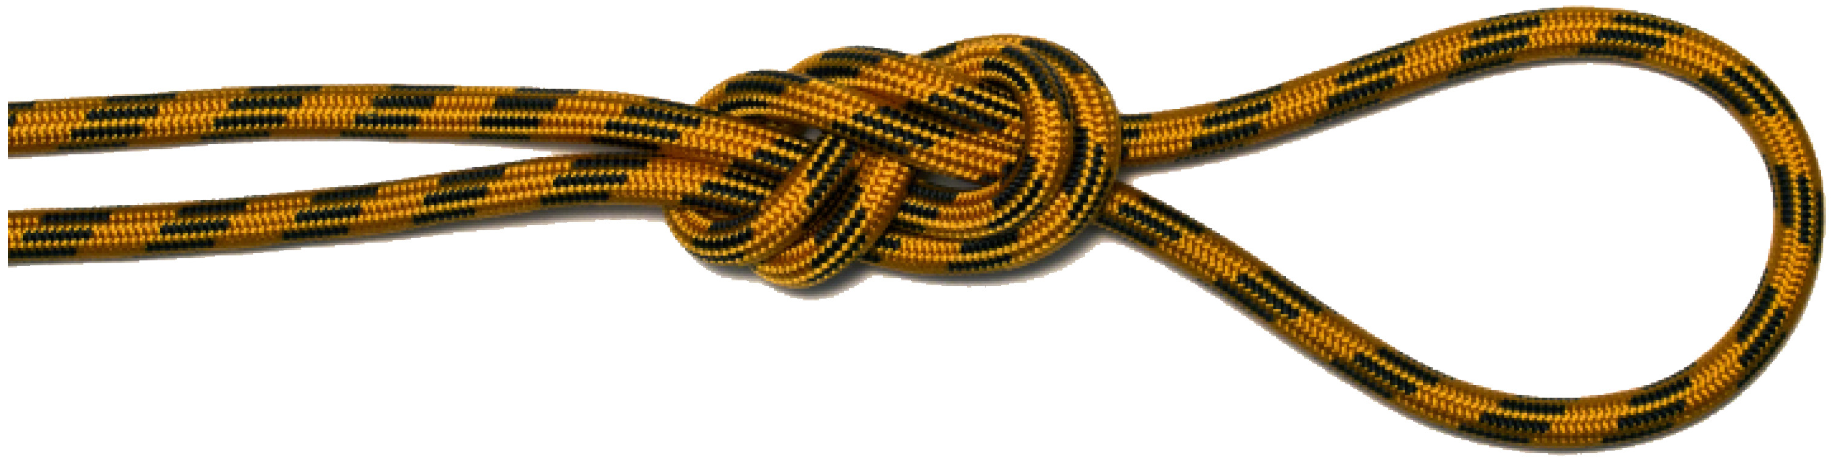
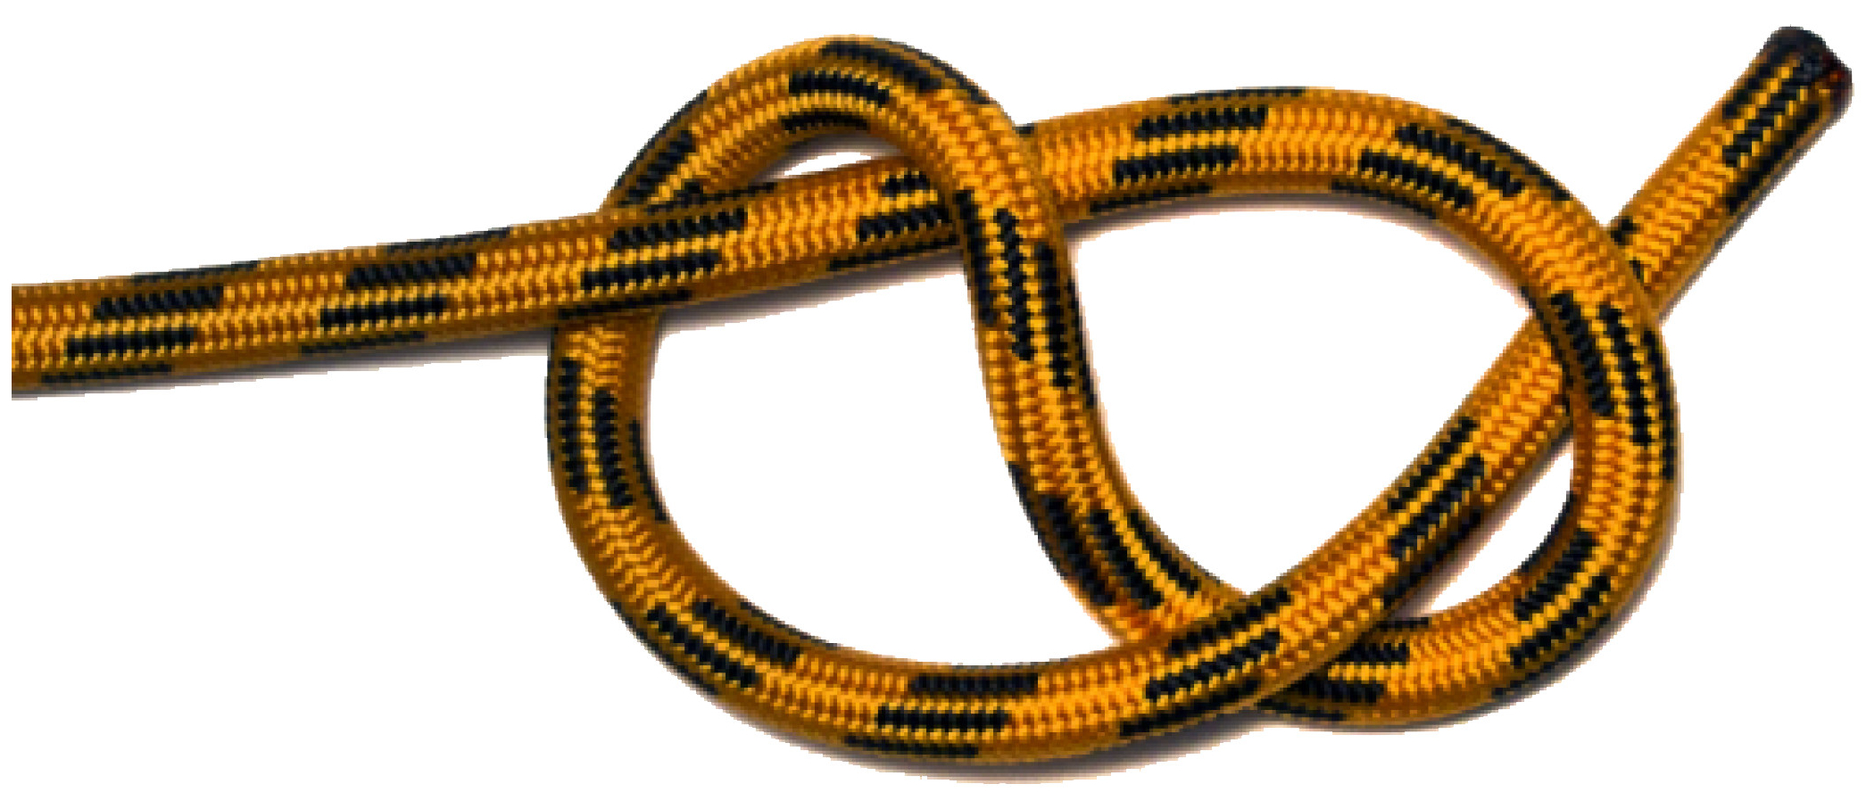
KNOTS

Slide 3
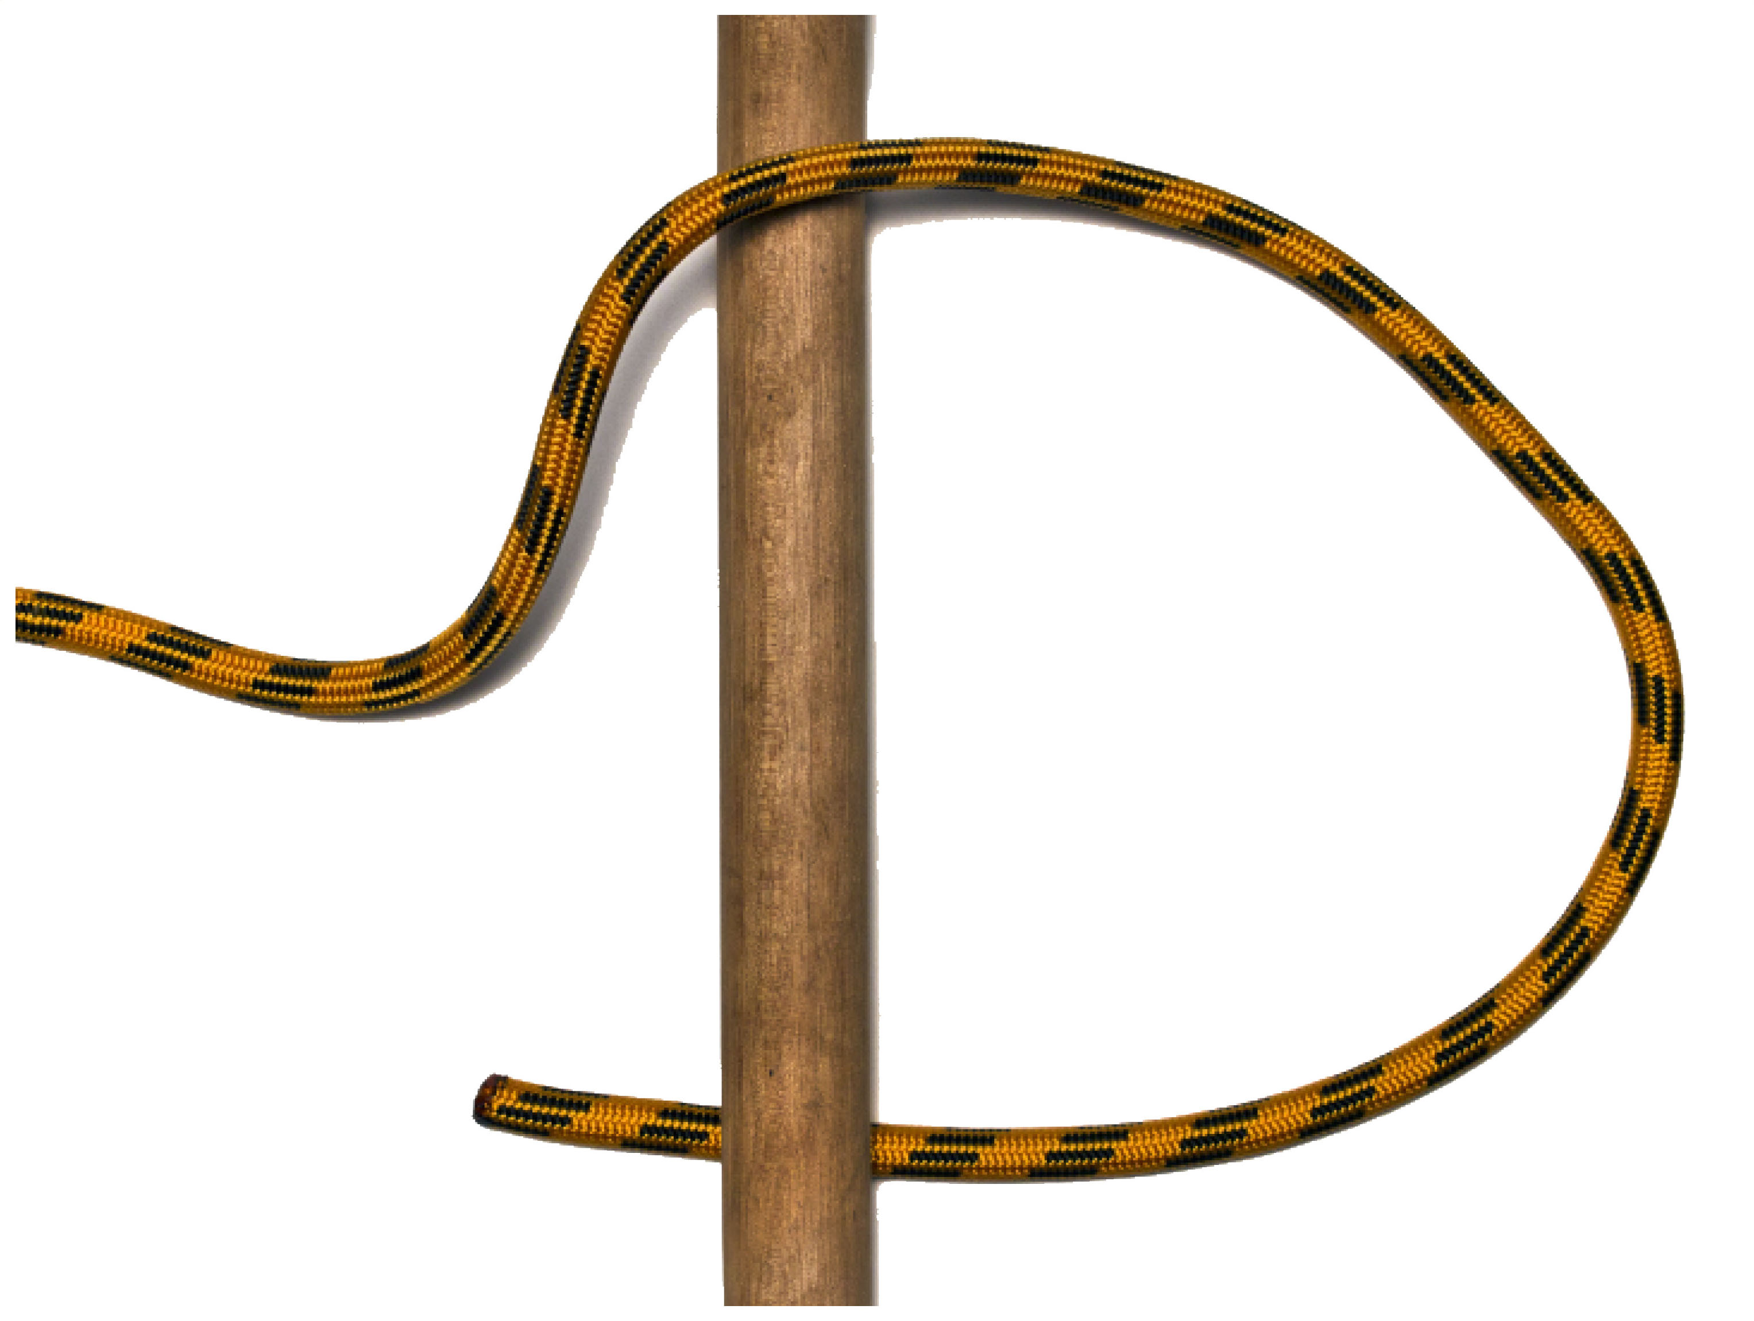
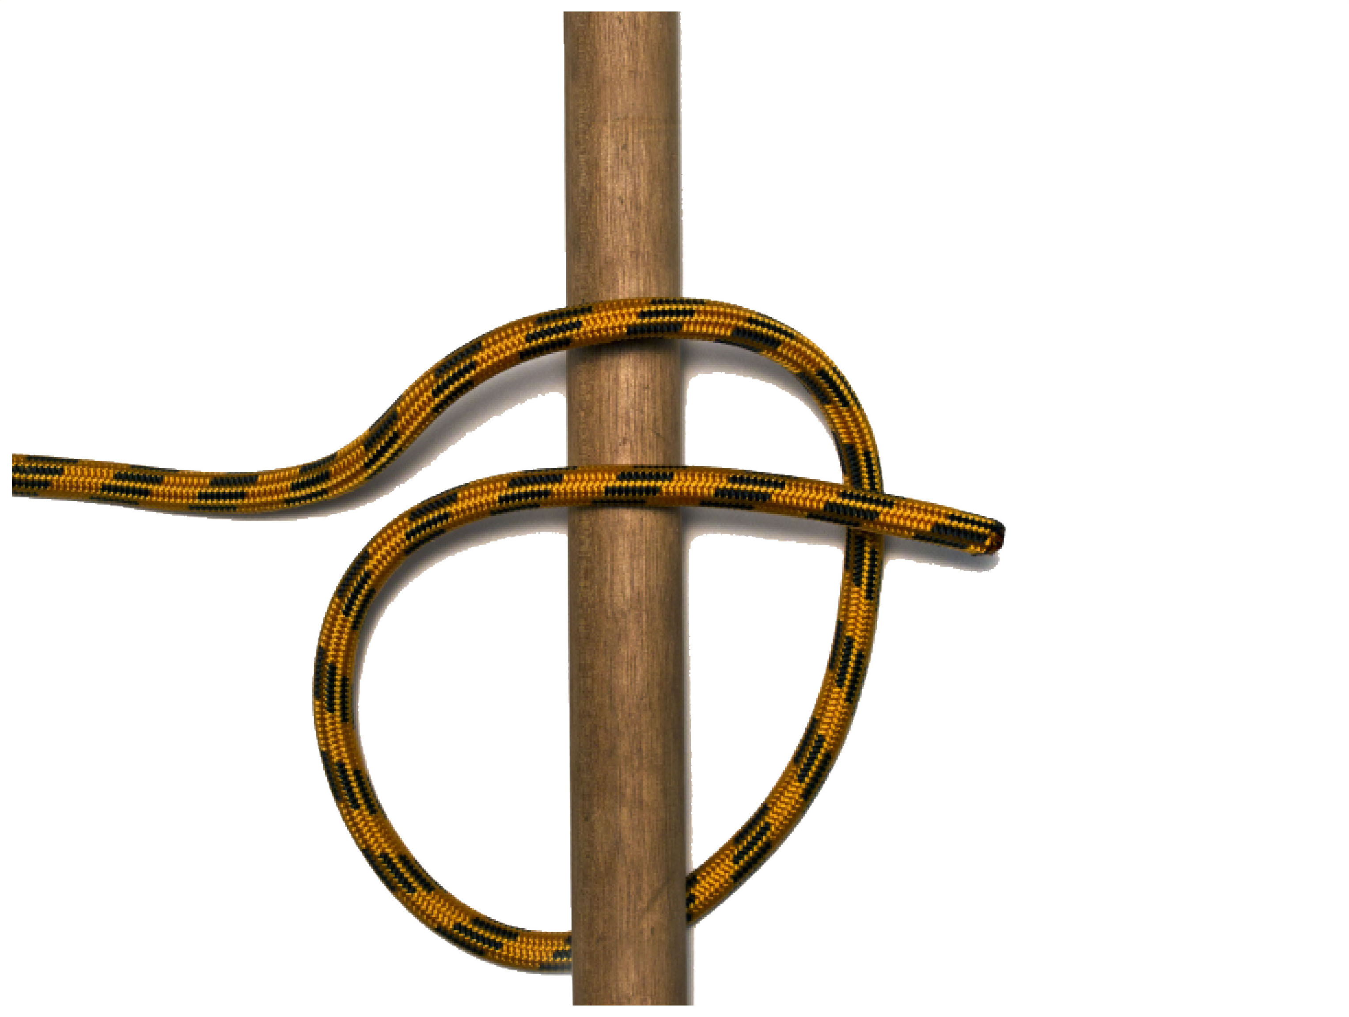
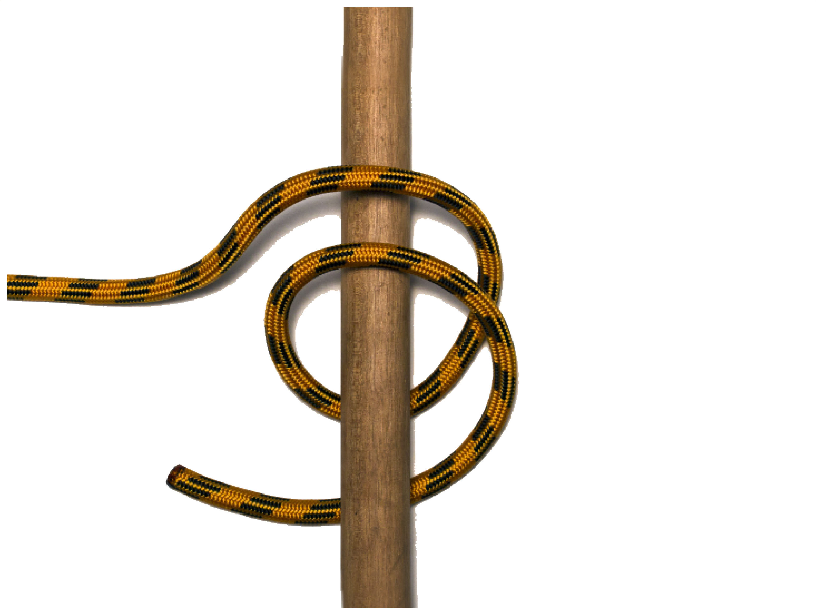
ROUND TURN
Benefits and uses
• The round turn can be used to keep tension on the rope holding a person on a stretcher.
• The rope runs around the object to provide 360-degree contact which then distributing the load over the anchor.
The rope has to completely go around the anchor twice with both ends of the rope finish on the starting side of the anchor. Bring the rope around the anchor so that the rope wraps around the rear of the anchor twice, and one in the front with the rope not crossing over itself.
Problems
• A round turn must have constant tension on it at all times.

Slide 4
ROUND TURN AND TWO HALF HITCHES
Benefits and uses
• Used for tying a rope at right-angles to a pole, a fixed object or tensioning tarps.
• Can be tied and adjusted when the rope is under tension for example, tarping.
• Ideal to tie a rope to a smooth, moveable, or irregularly shaped object, because it does not rely on friction between the rope and the object
This knot is used to secure the running end of a rope to a pole or ring. Form the knot with a round turn on the pole or ring, with two half-hitches on the standing part of the rope. It has the great advantage of adjusting the load by the round turn and then securing it with two half-hitches on the standing part.
Problems
• Can be hard to untie when wet and tight
• When tying the half hitches, the end should keep passing around the standing rope in a consistent direction, (i.e. to form a clove hitch around it). This reduces the tendency of the second half hitch to loosen.

Slide 5
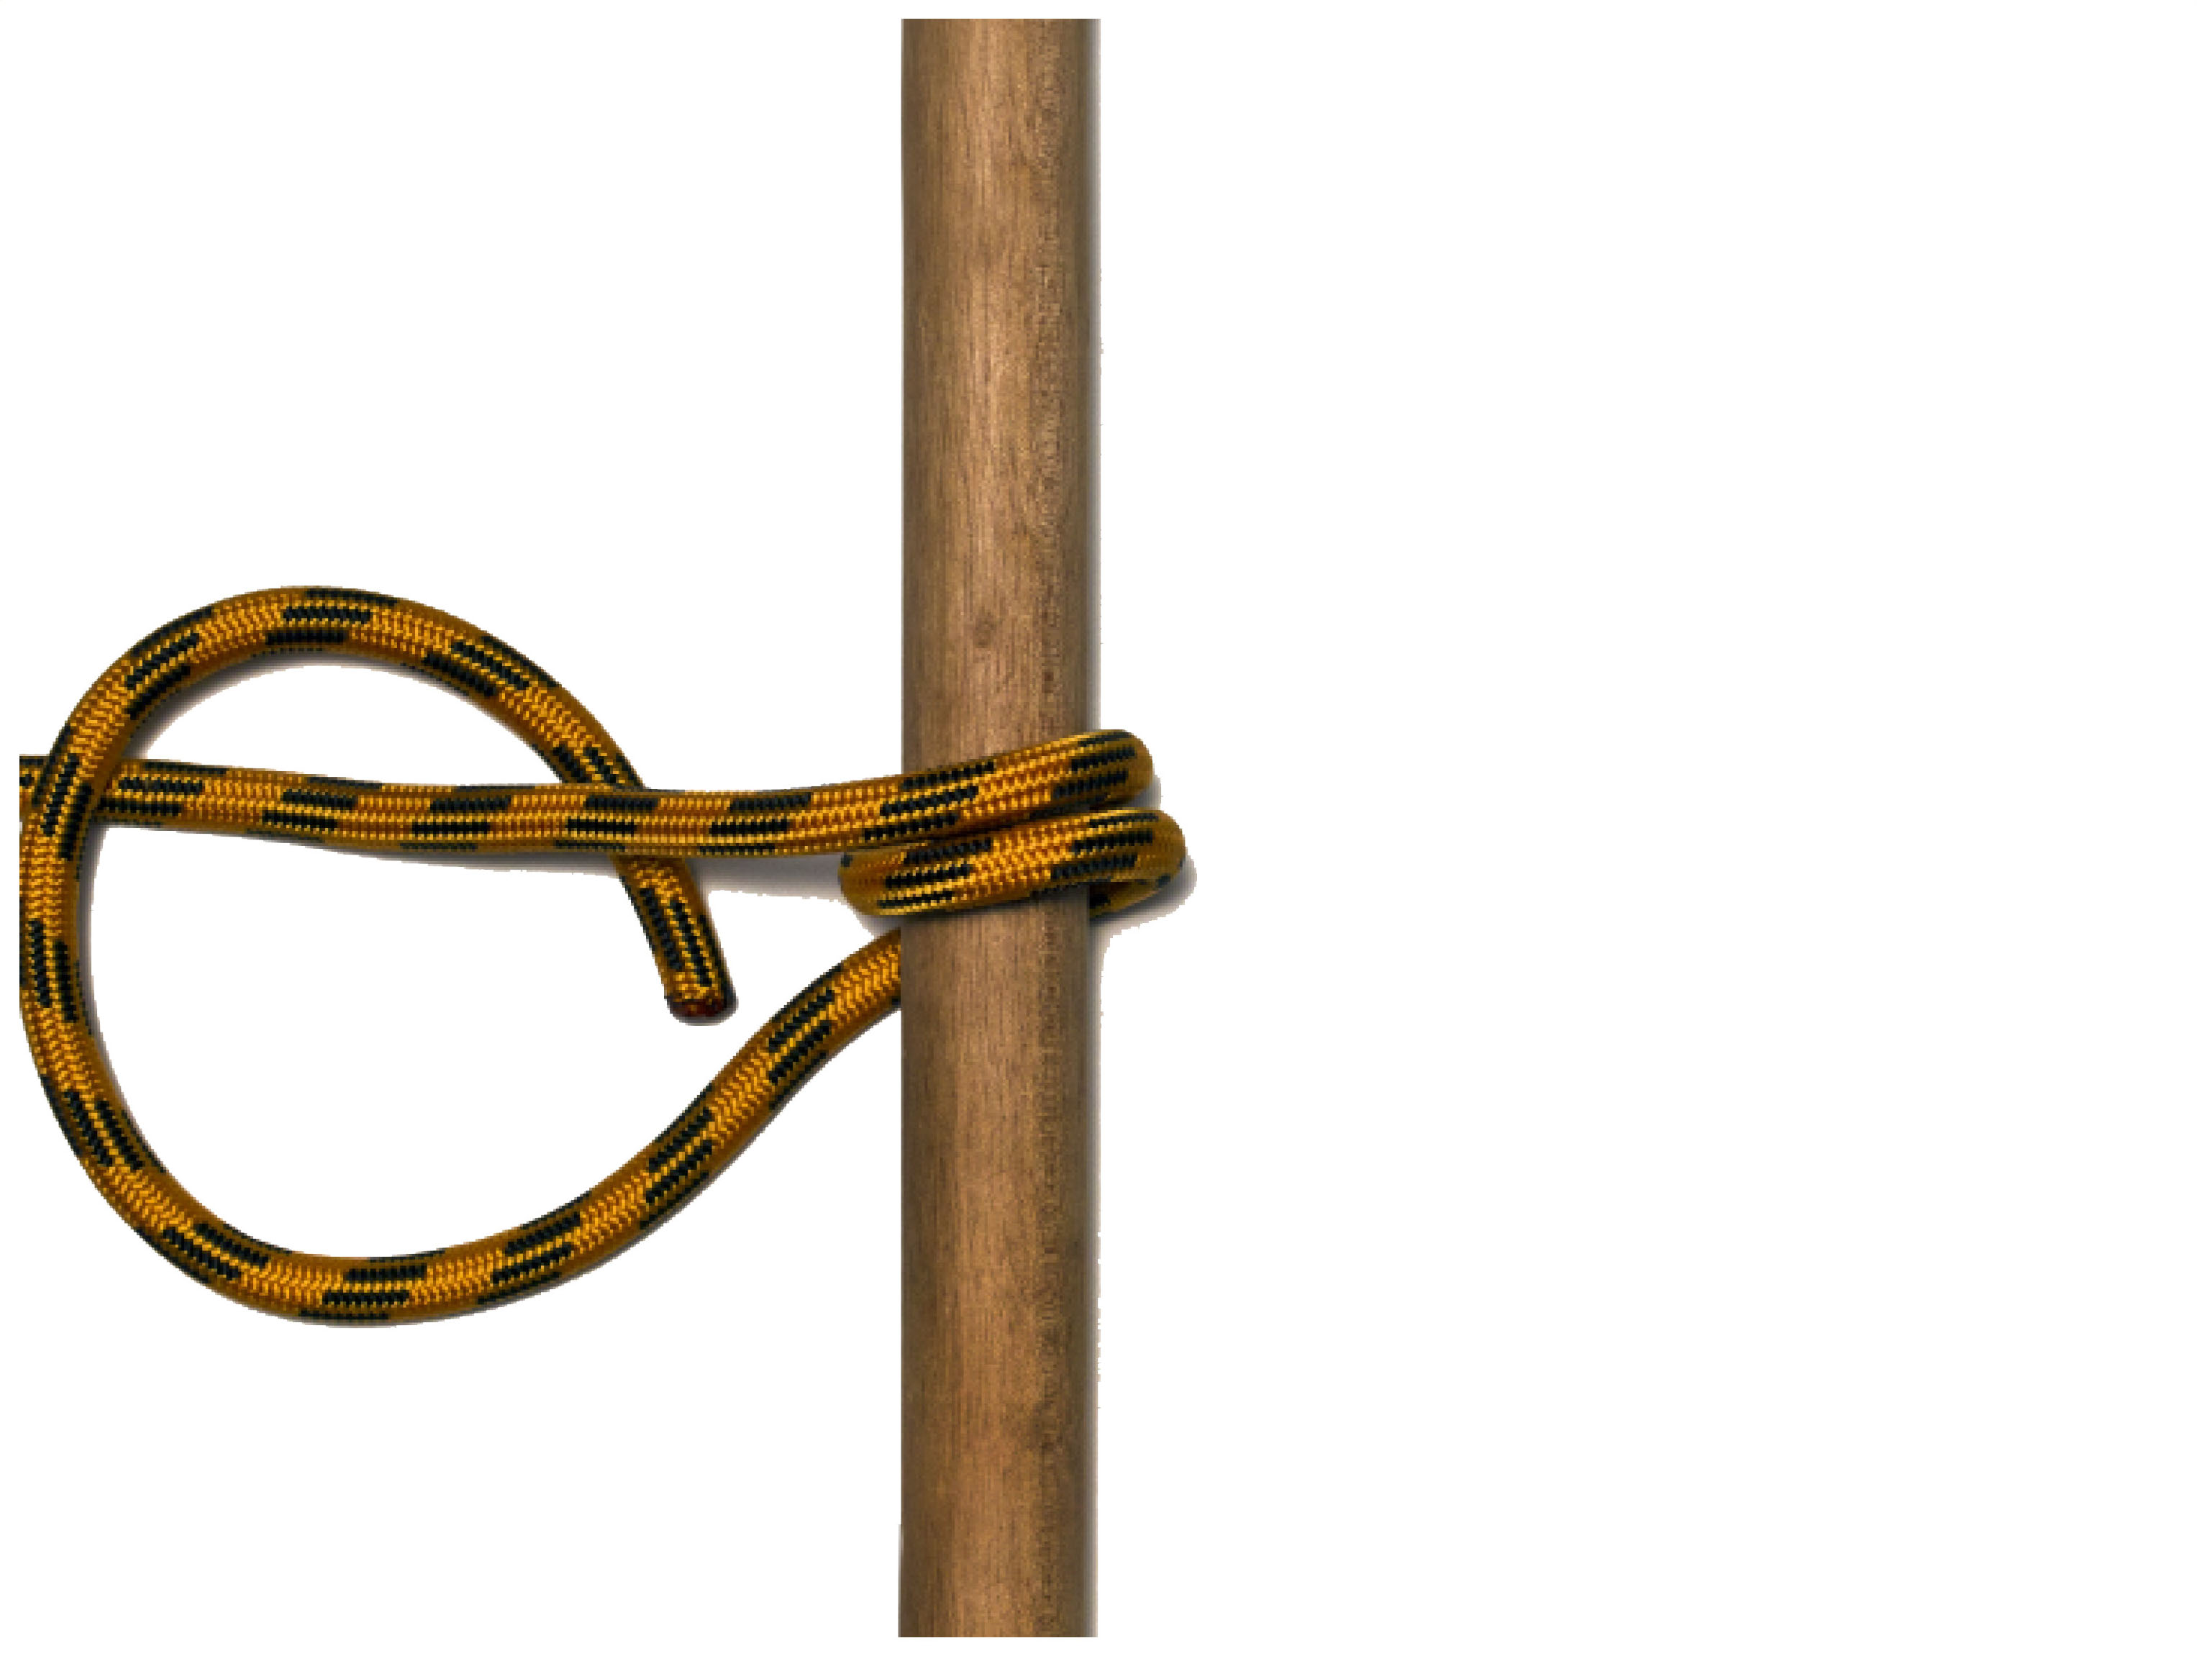
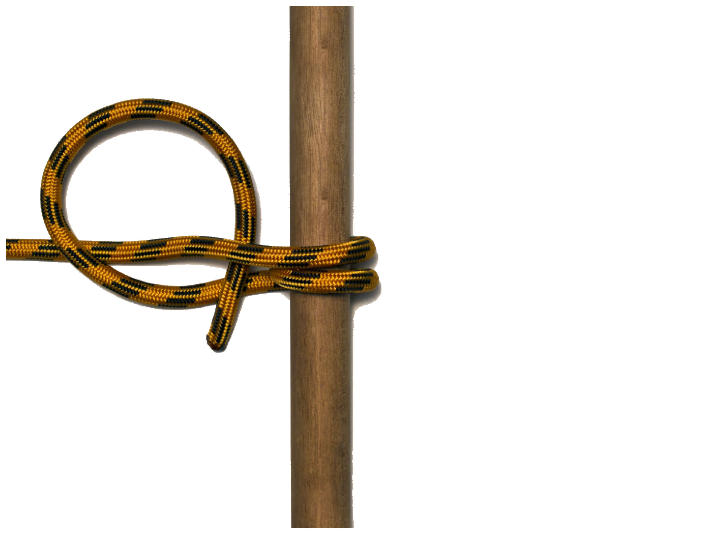
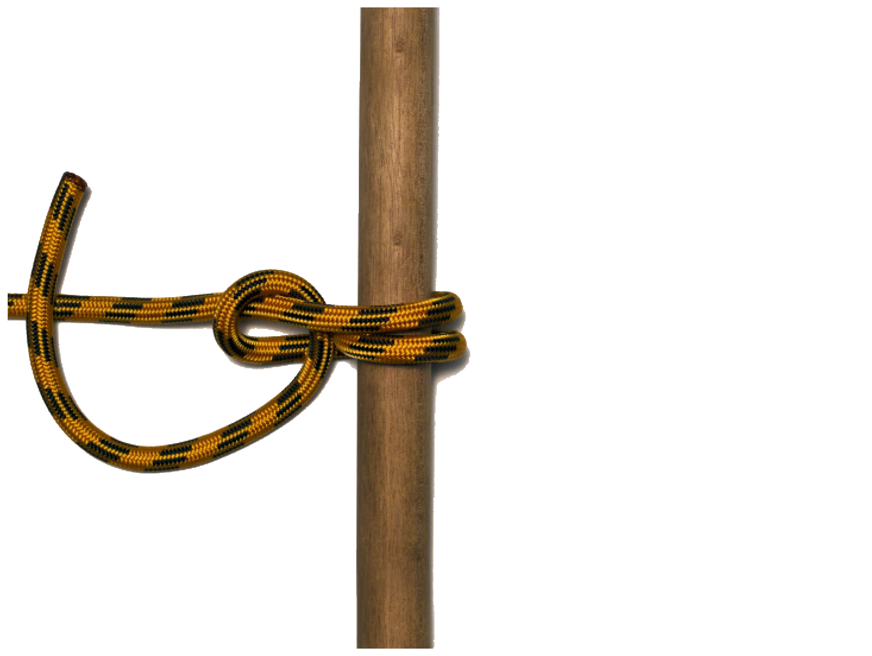
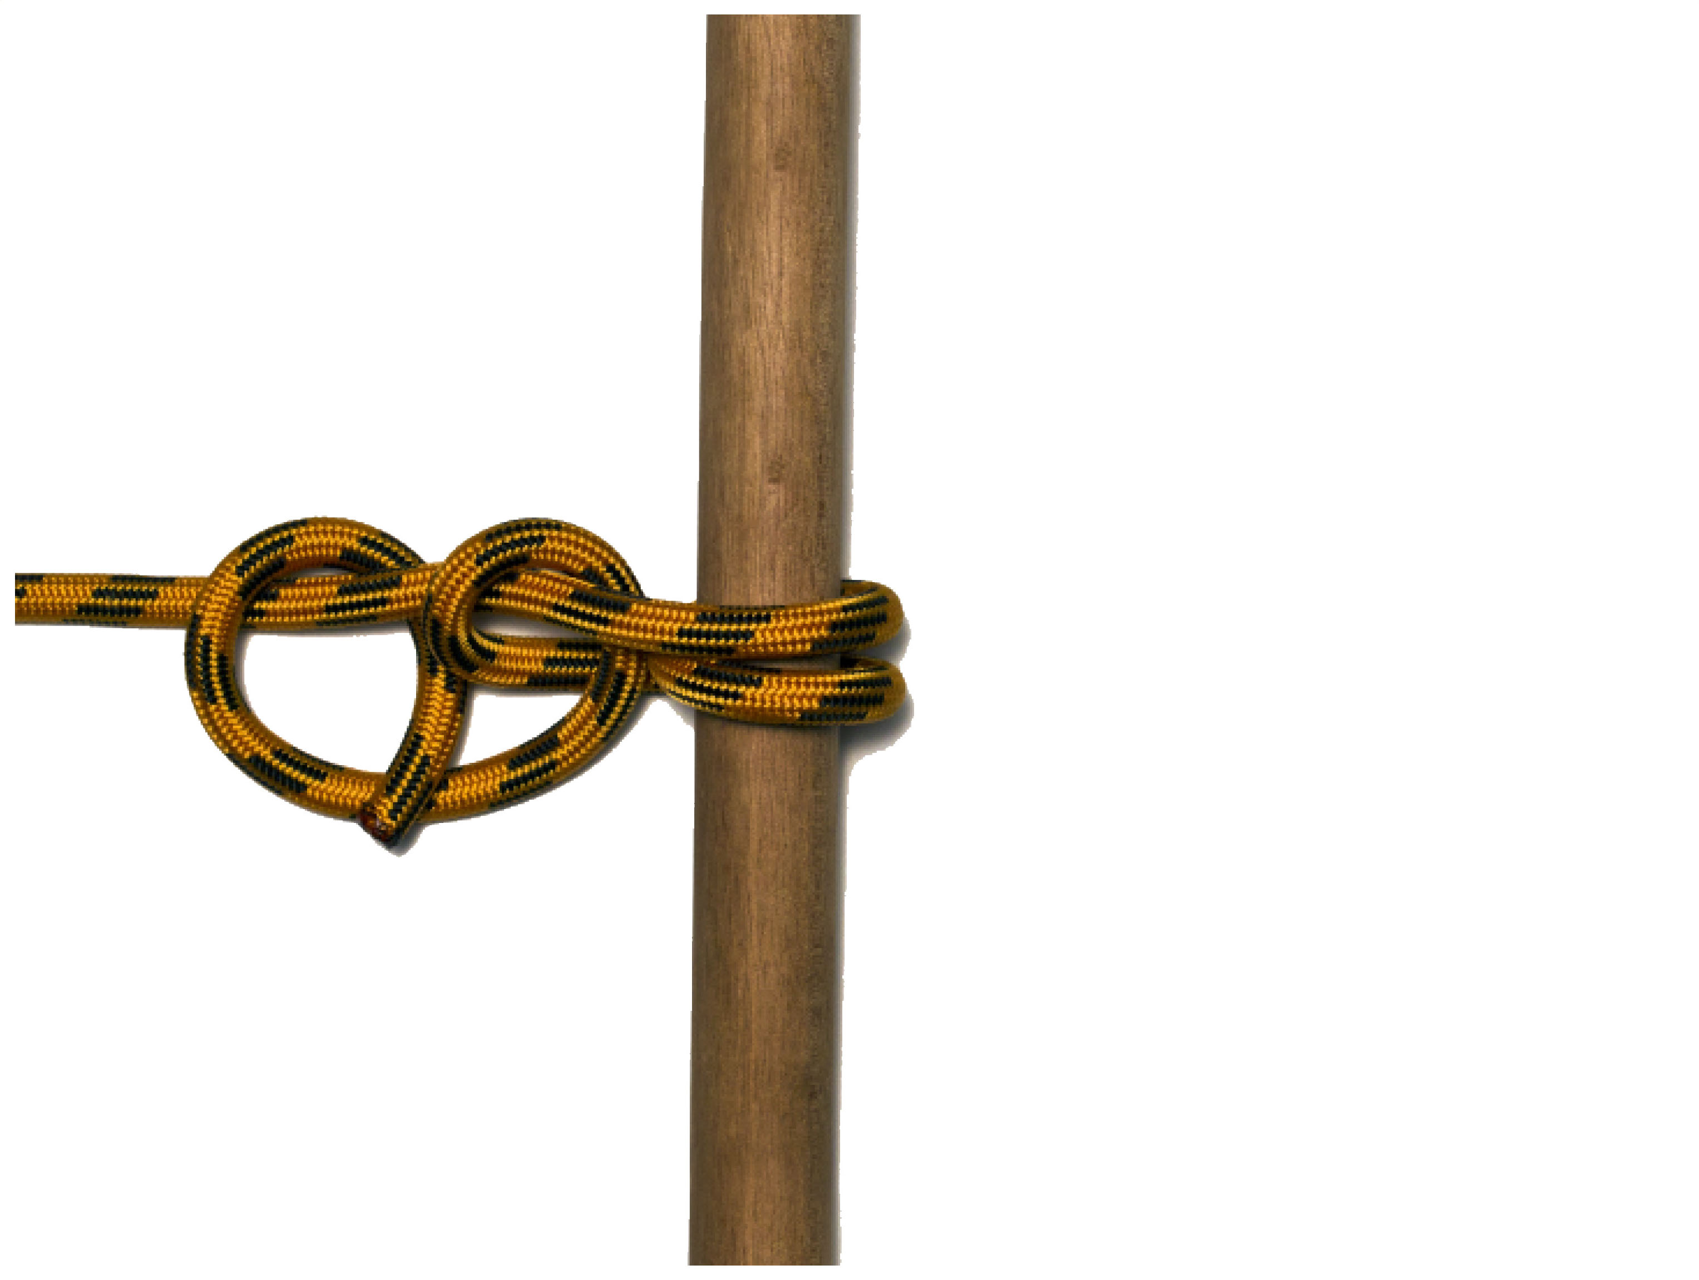
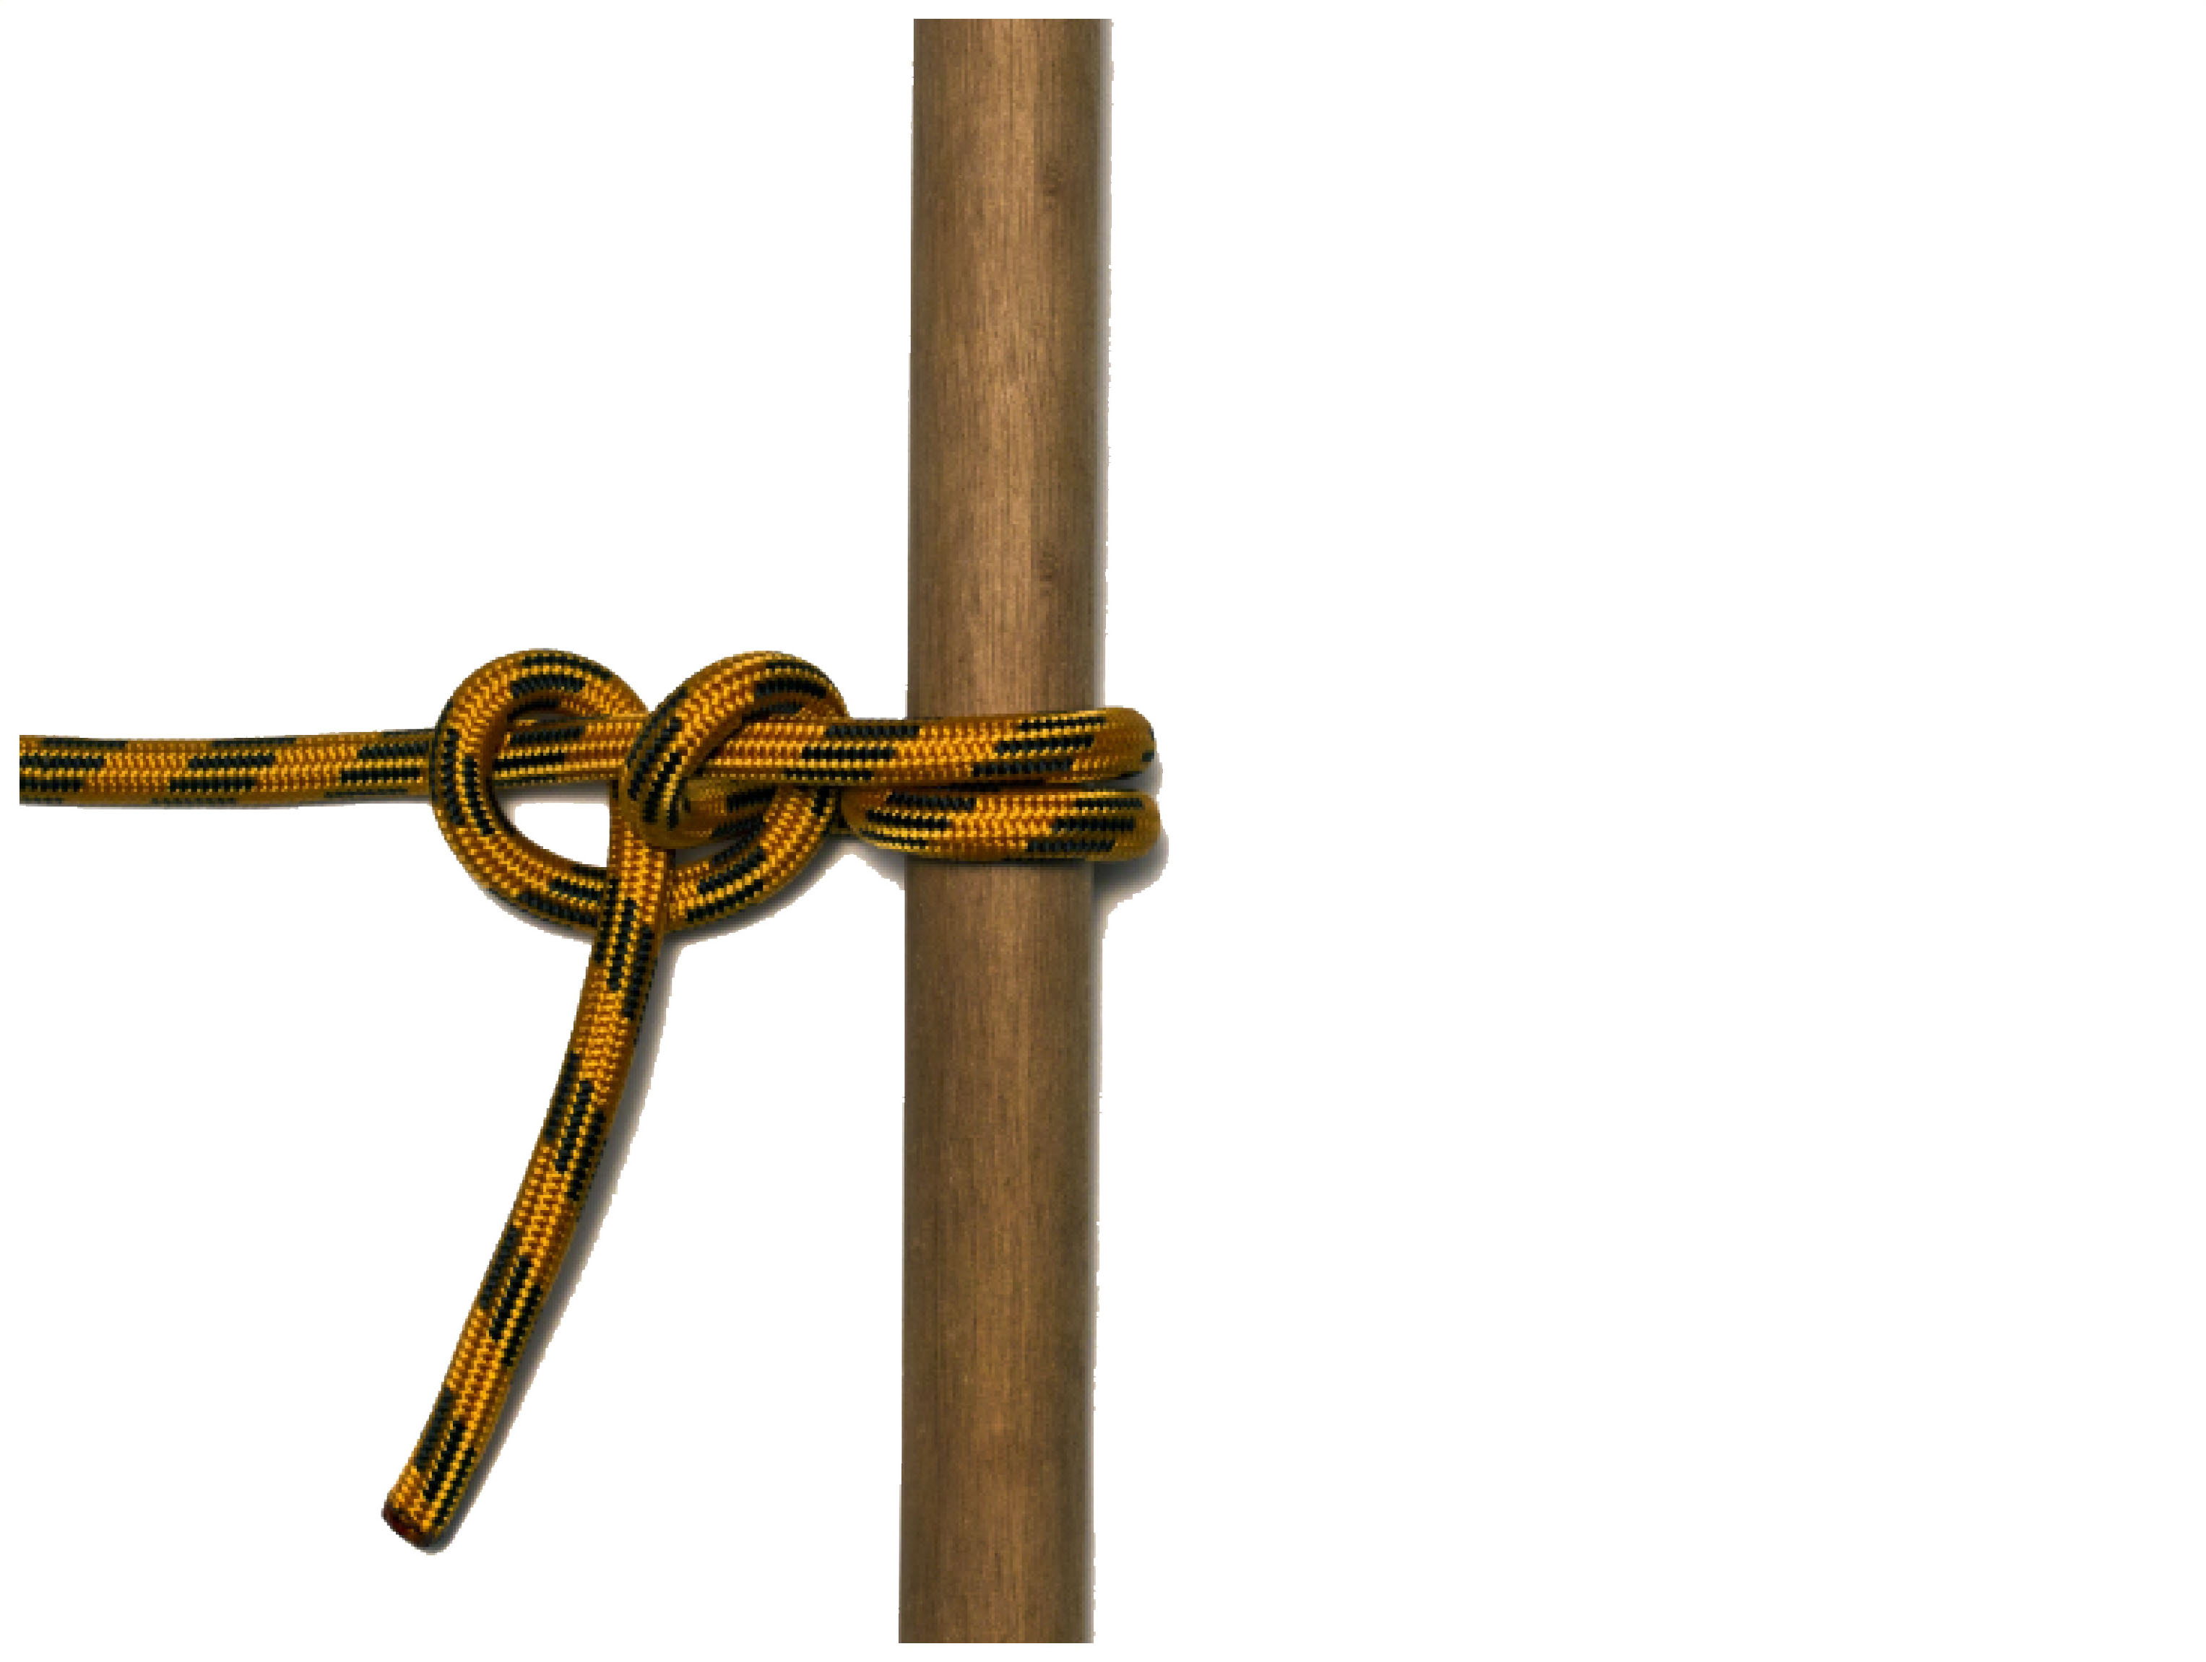
ROUND TURN AND TWO HALF HITCHES

Slide 6
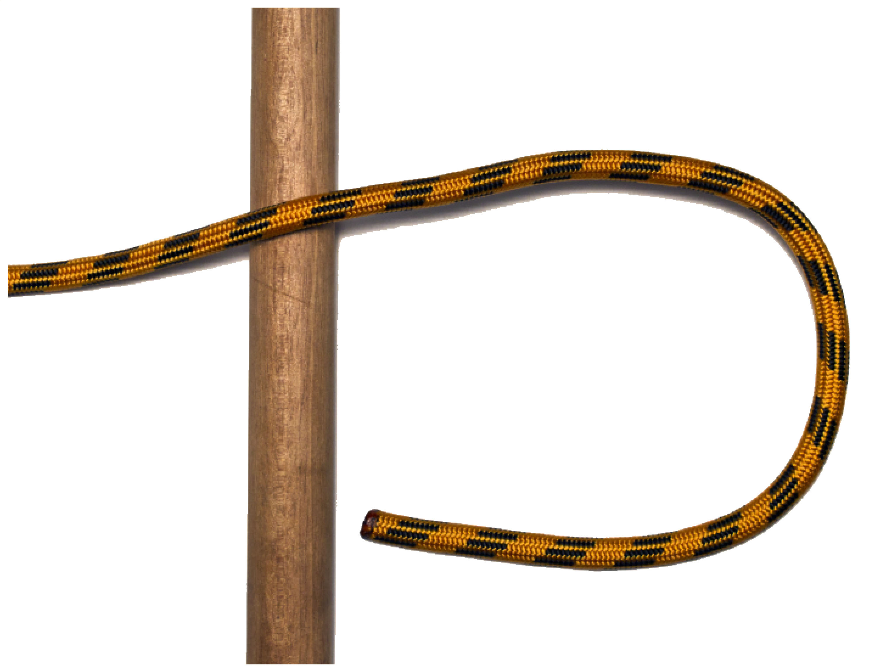
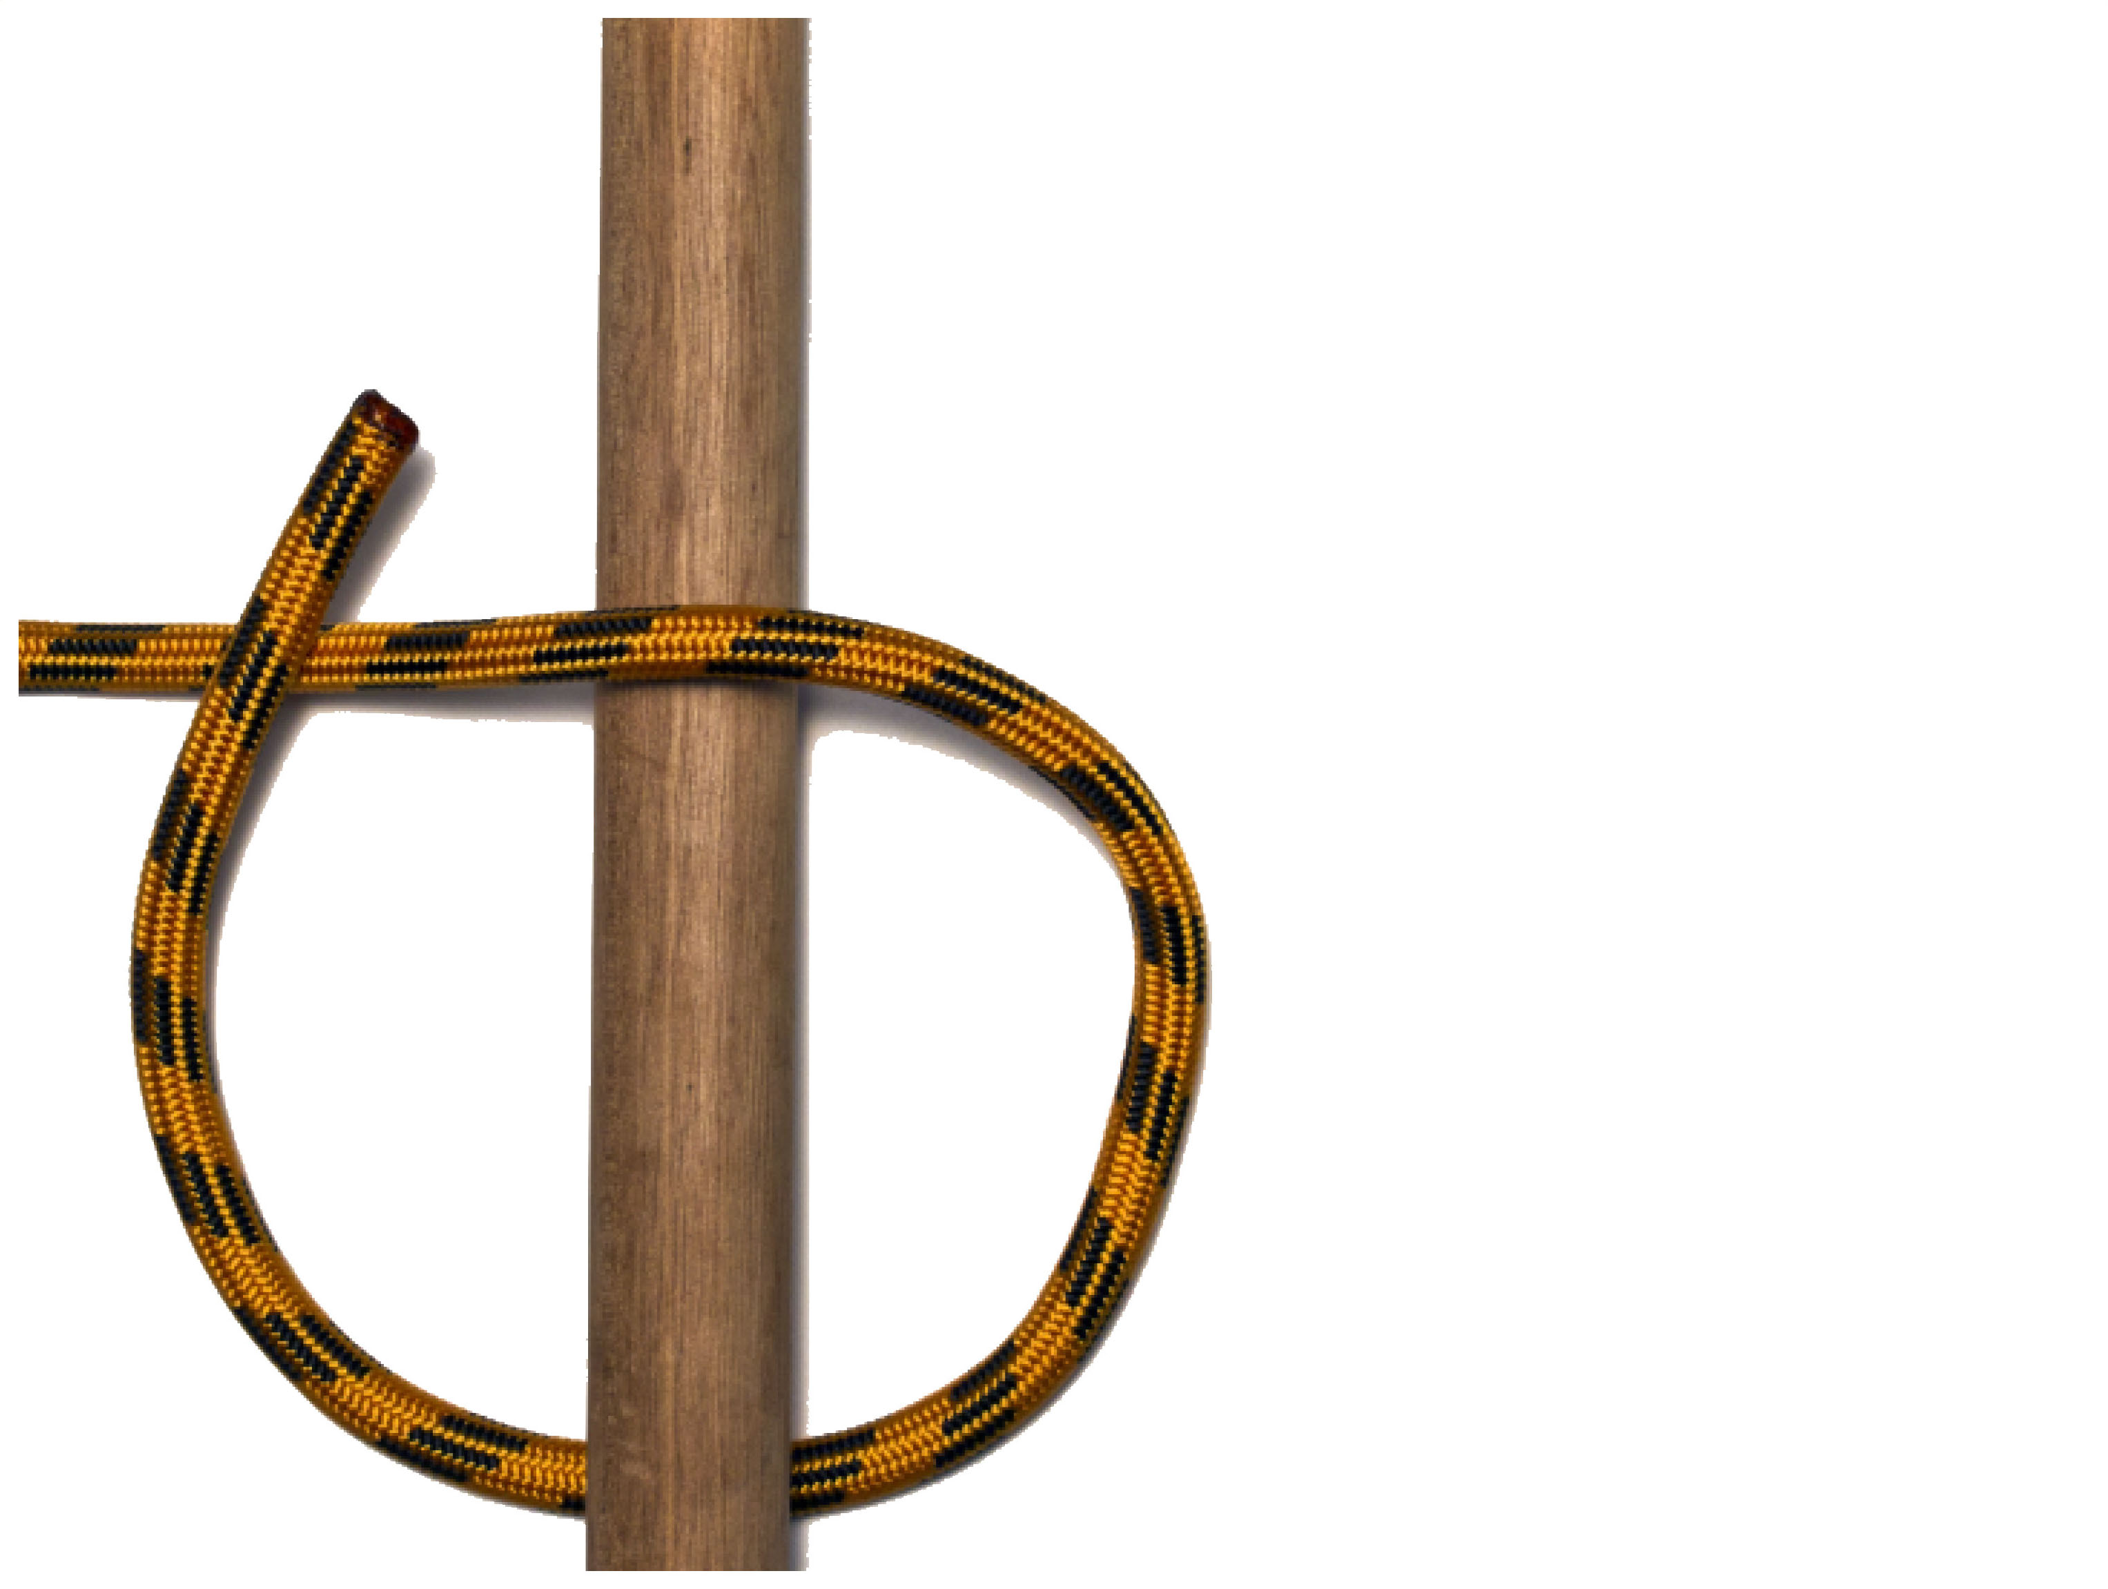
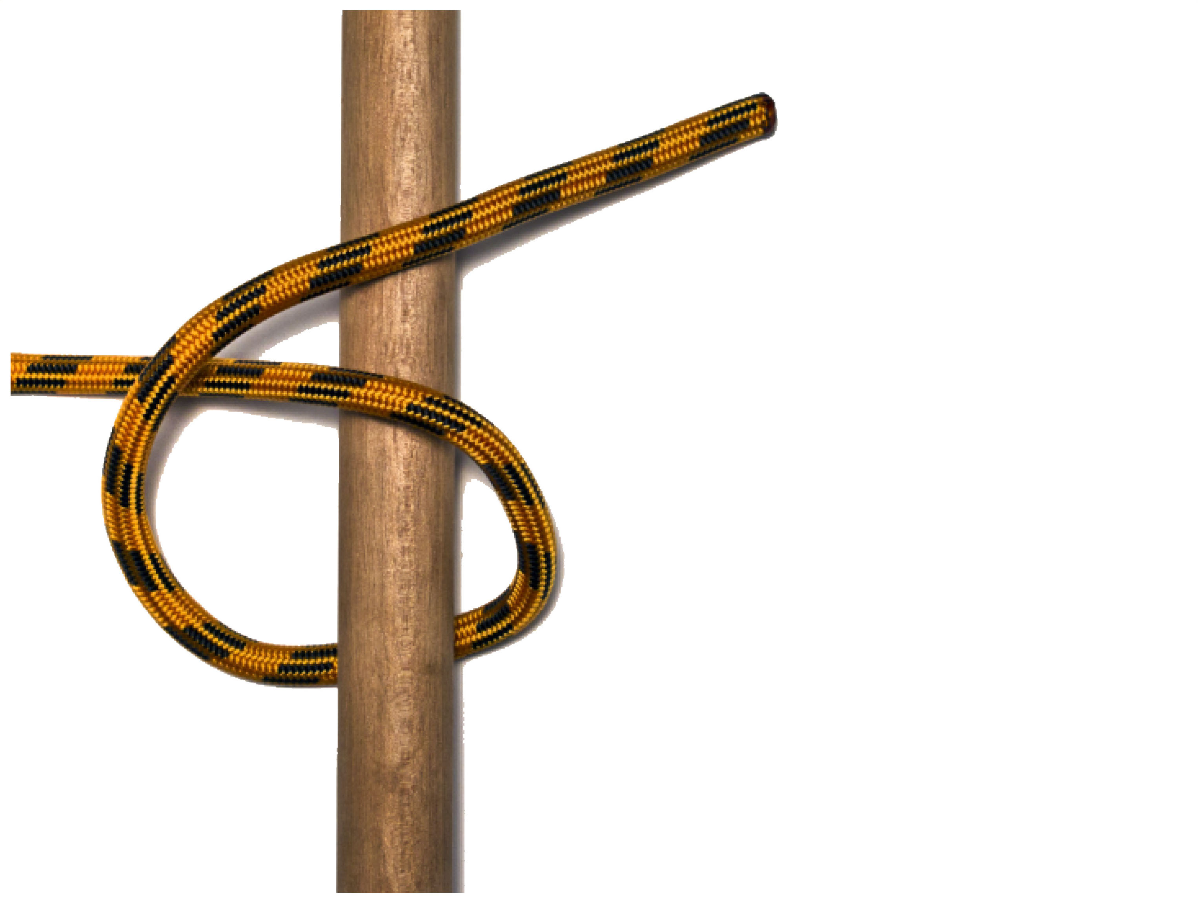
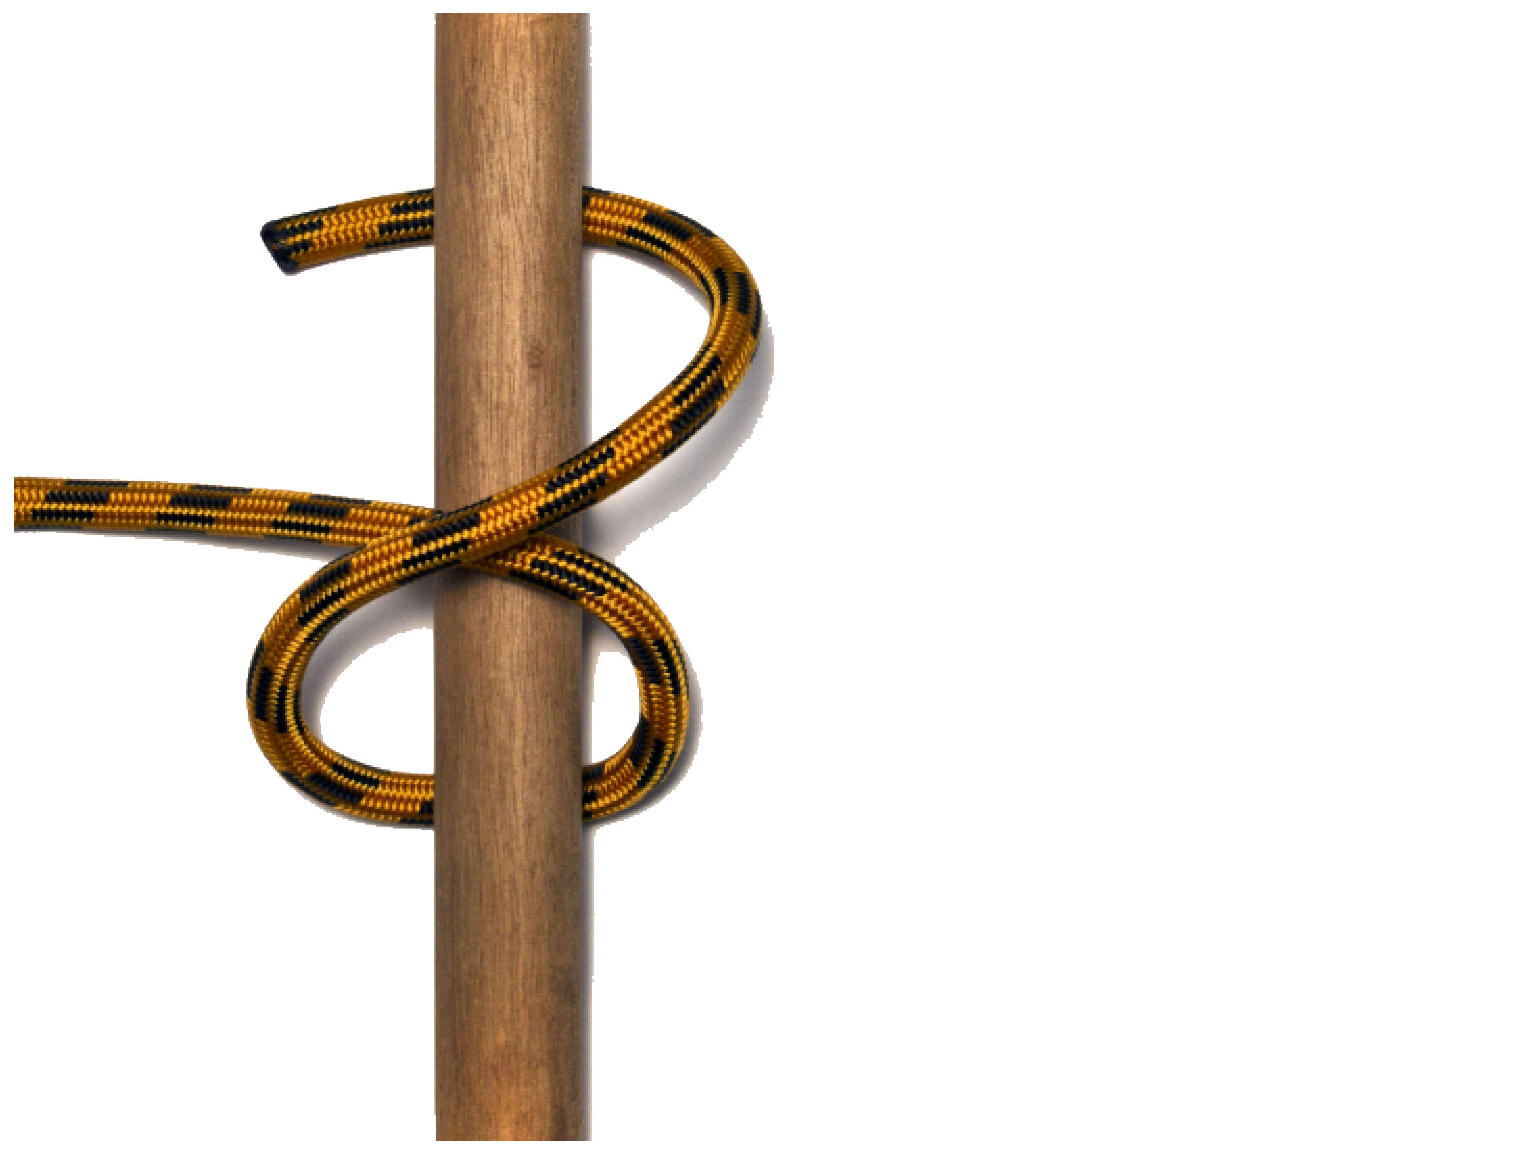
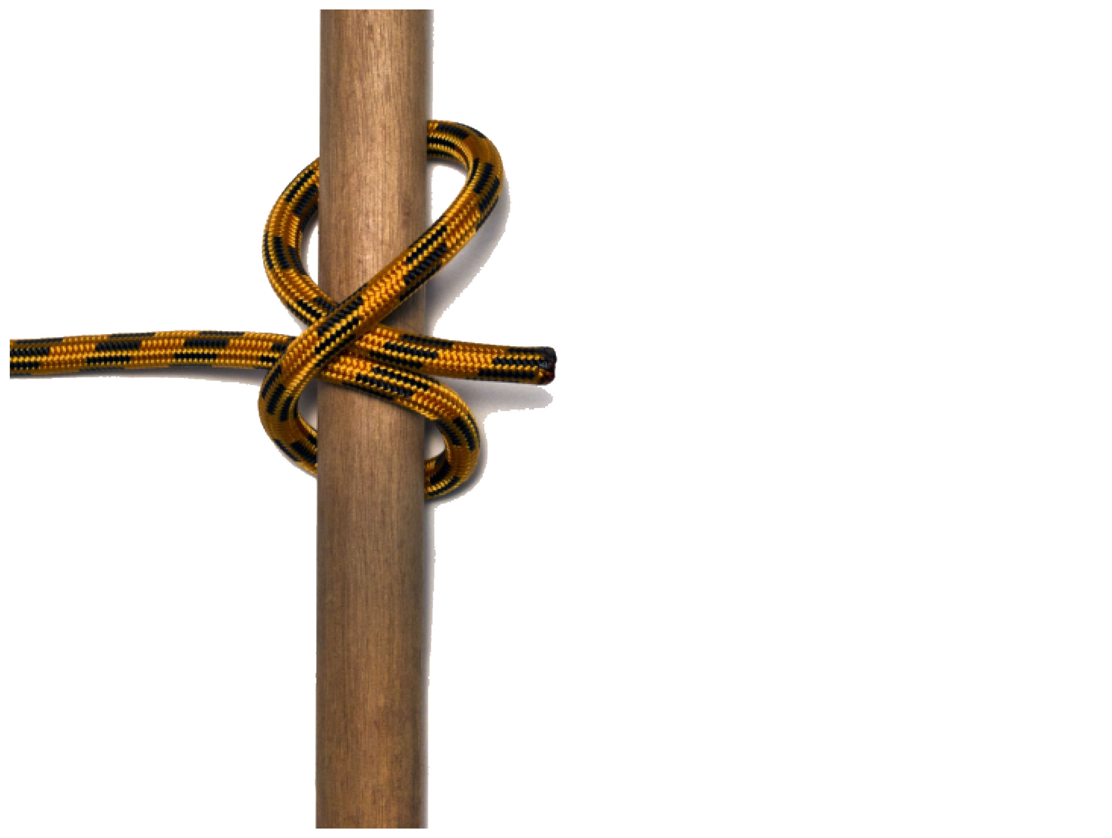
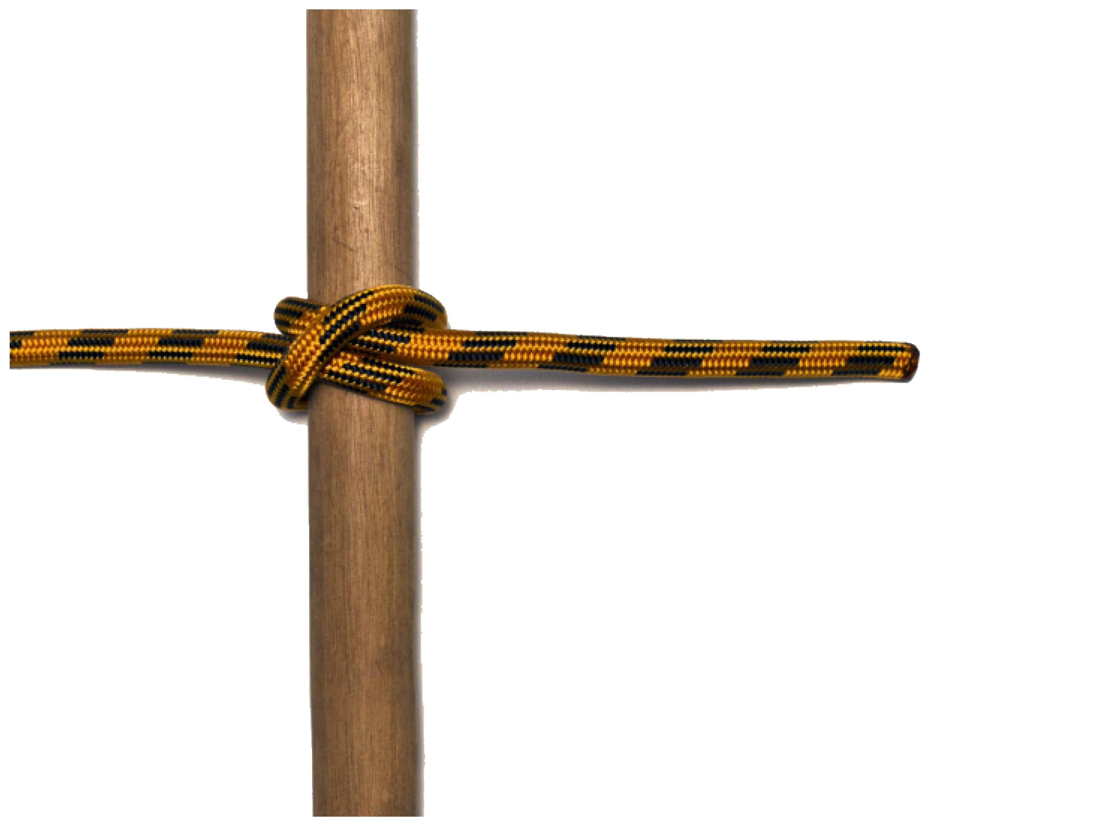
CLOVE HITCH
The clove hitch jams on itself and only holds under load. It can be tied to secure the end of a rope to an object or in the middle of a rope or a triangle sling such as in first aid.
Benefits and uses
• Used for tying a rope at right-angles to a spar or fixed object.
Problems in circumstances where the knot can spill from lack of friction:
• Where the spar is thin (less than twice the diameter of the rope);
• Where the spar is very thick (more than 10 times the diameter of the rope);
• Where the object has flat sides (e.g. a square section post).
Warning
Because of these risks of spillage, the Clove Hitch is not recommended for climbing.

Slide 7
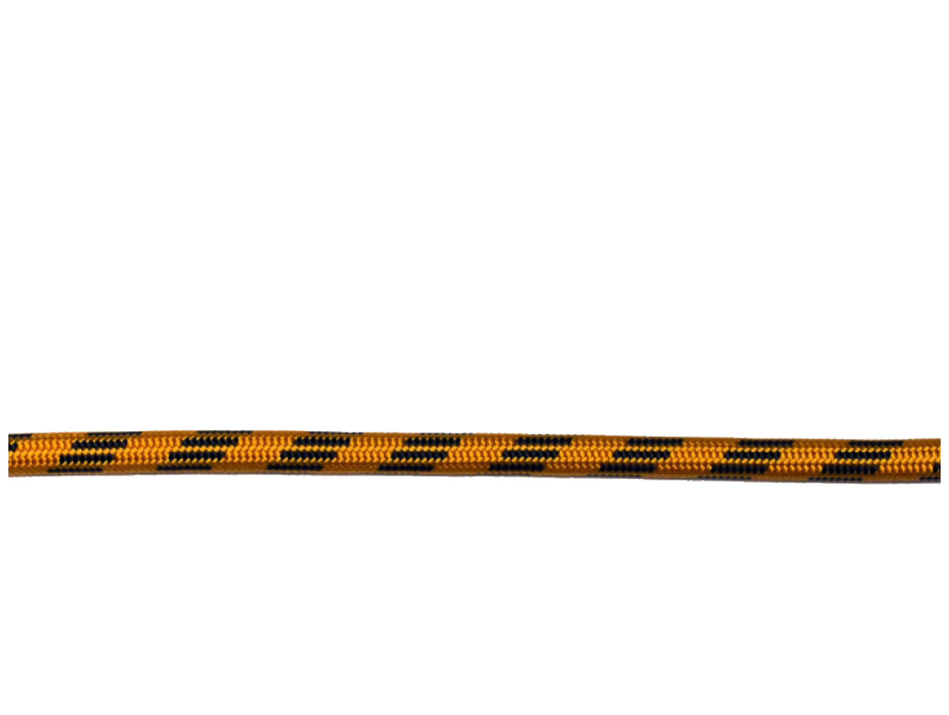
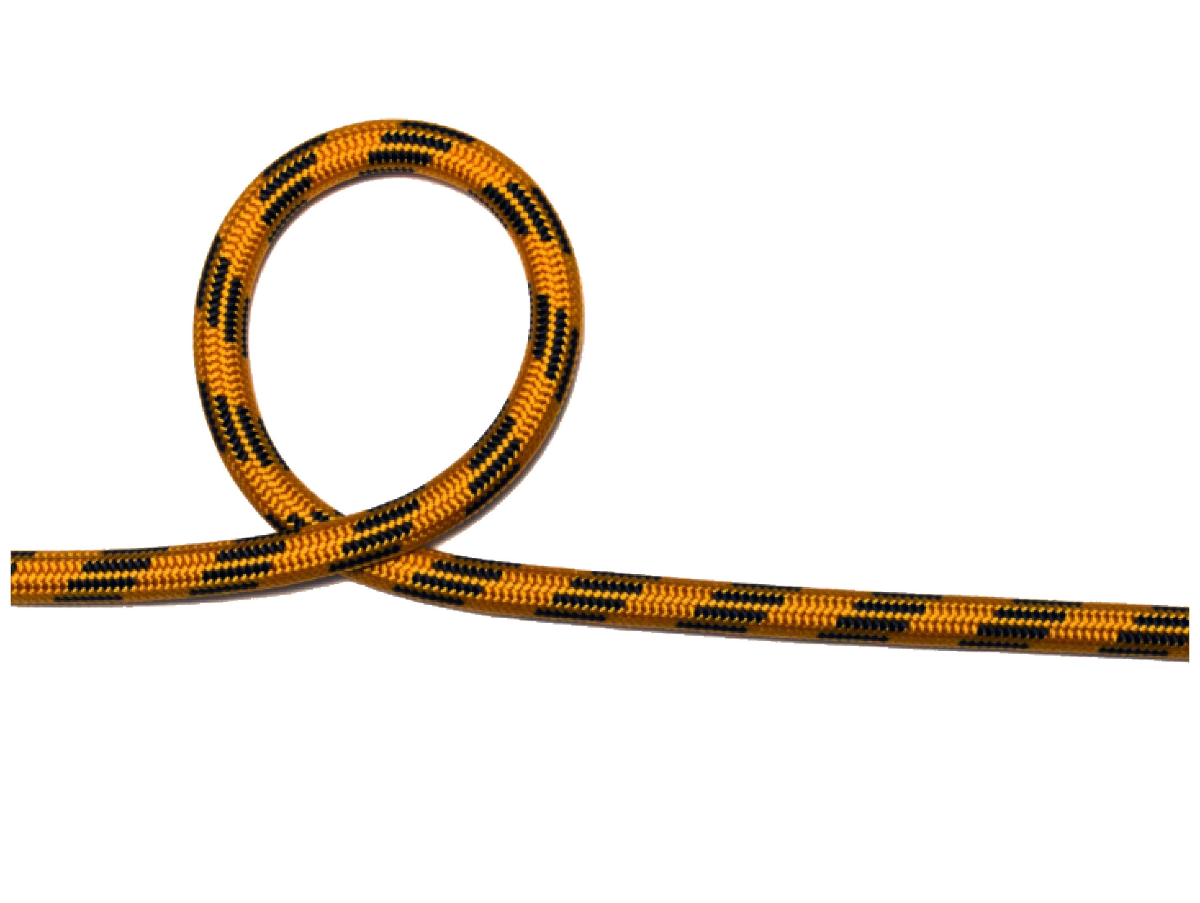
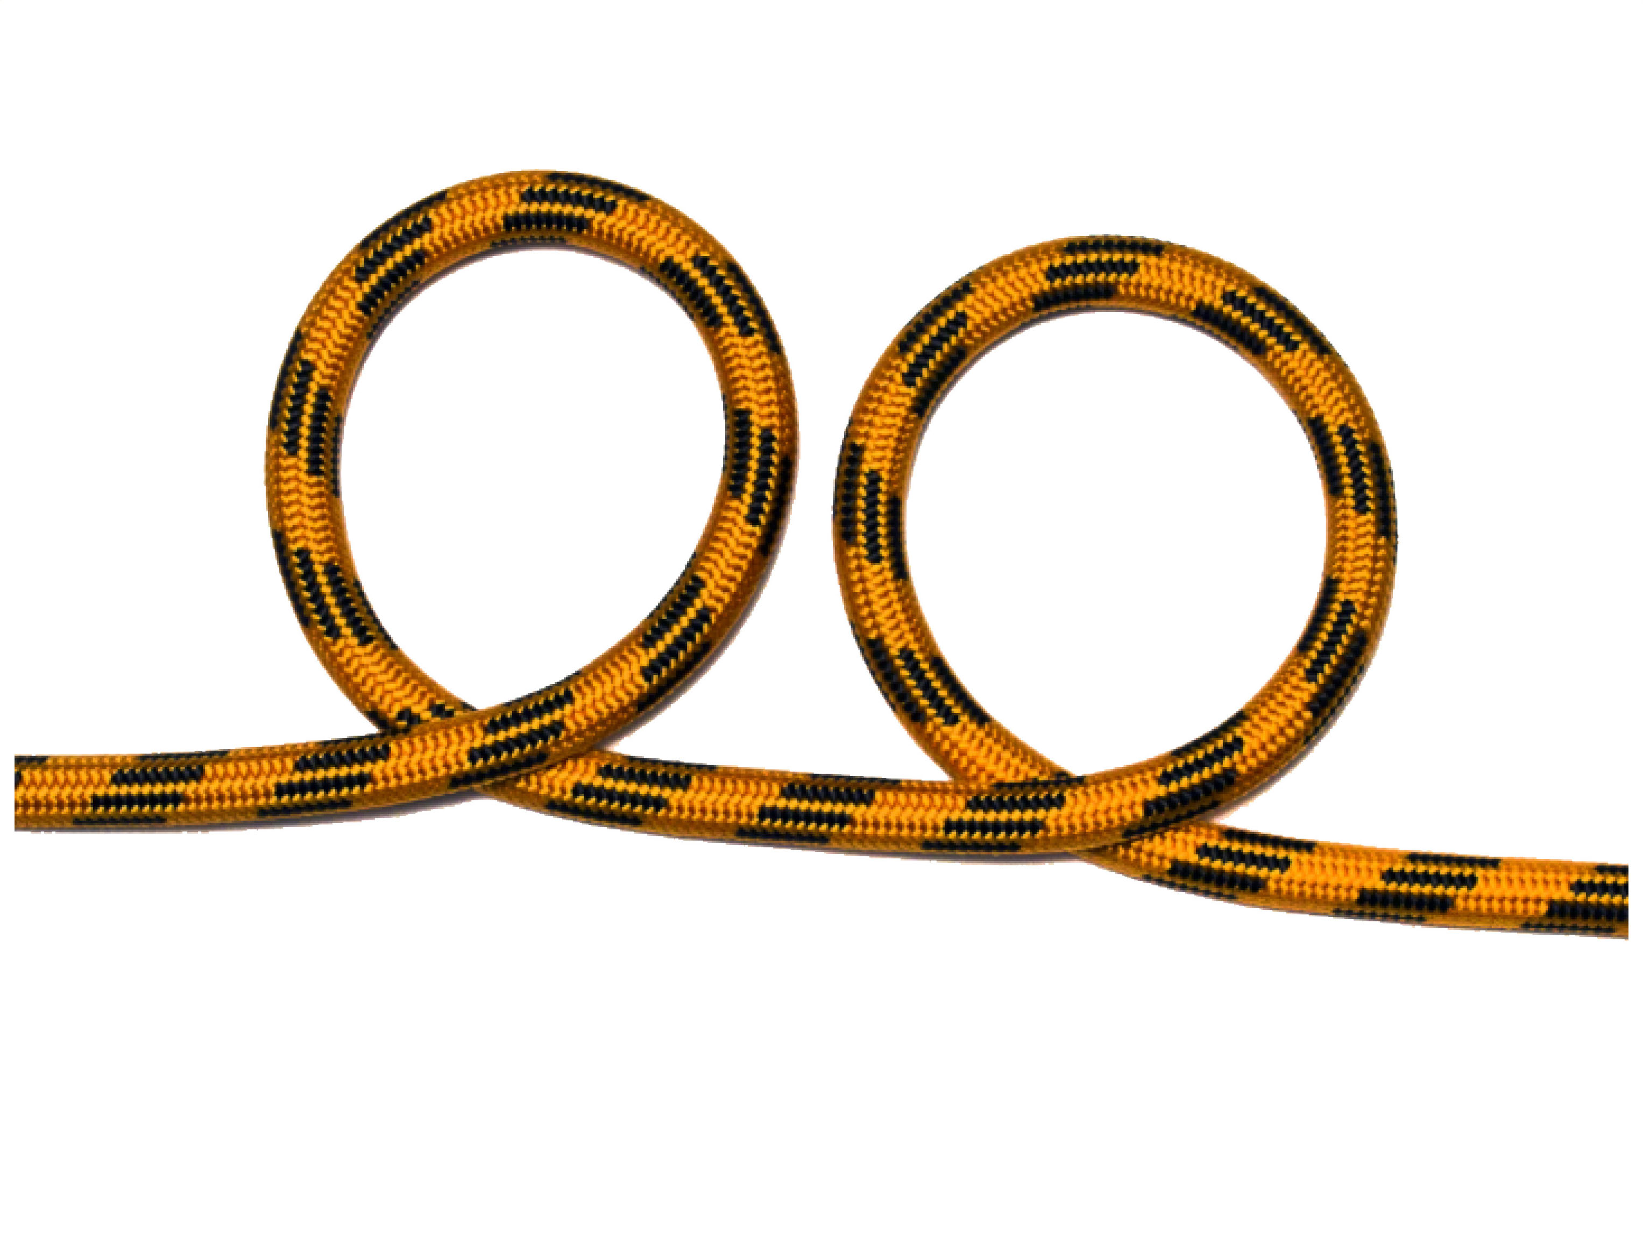
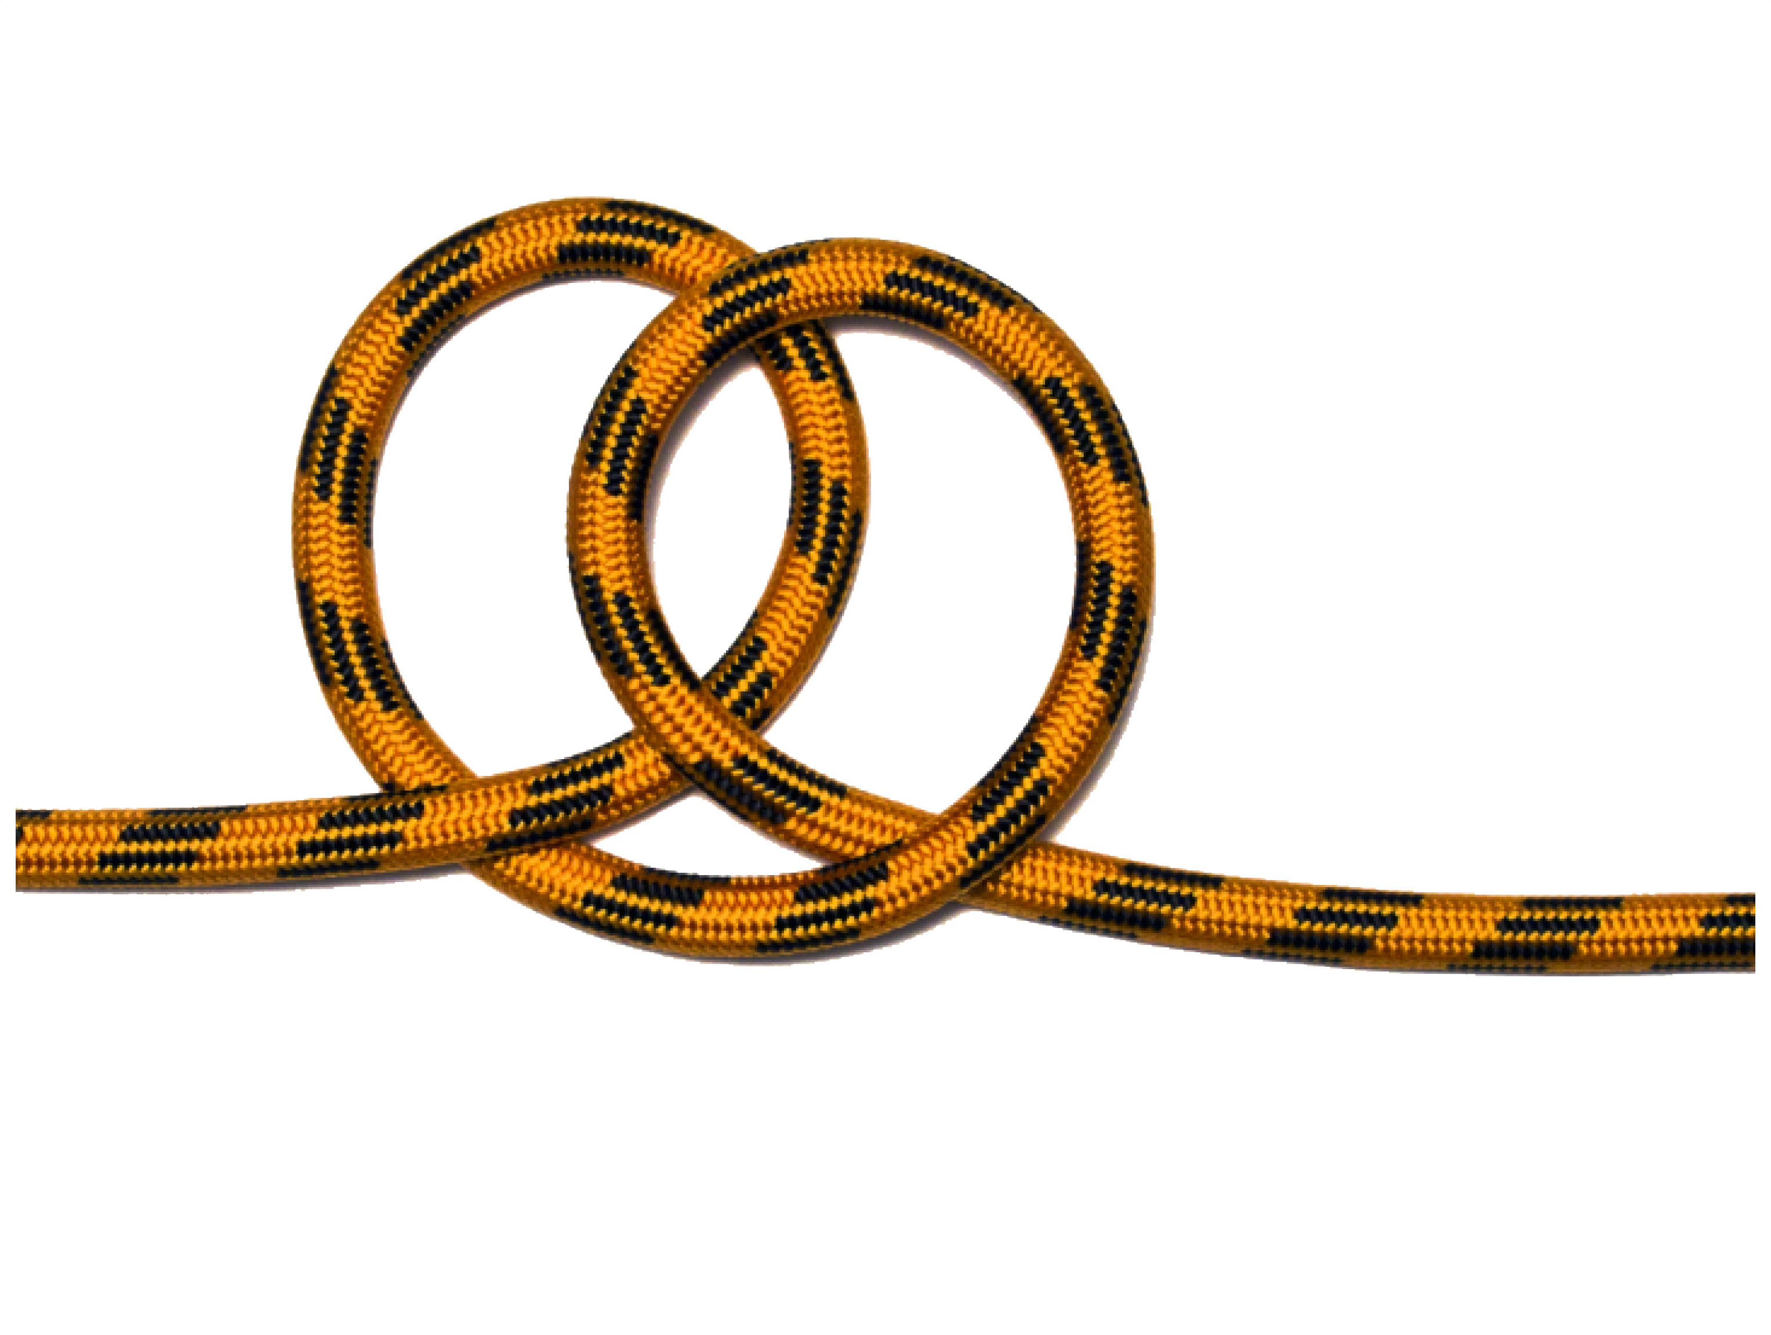
CLOVE HITCH IN MIDDLE
The clove hitch jams on itself and only holds under load. It can be tied to secure the end of a rope to an object or in the middle of a rope or a triangle sling such as in first aid.
Benefits and uses
• Used for tying a rope at right-angles to a spar or fixed object.
Problems in circumstances where the knot can spill from lack of friction:
• Where the spar is thin (less than twice the diameter of the rope);
• Where the spar is very thick (more than 10 times the diameter of the rope);
• Where the object has flat sides (e.g. a square section post).
Warning
Because of these risks of spillage, the Clove Hitch is not recommended for climbing.

Slide 8
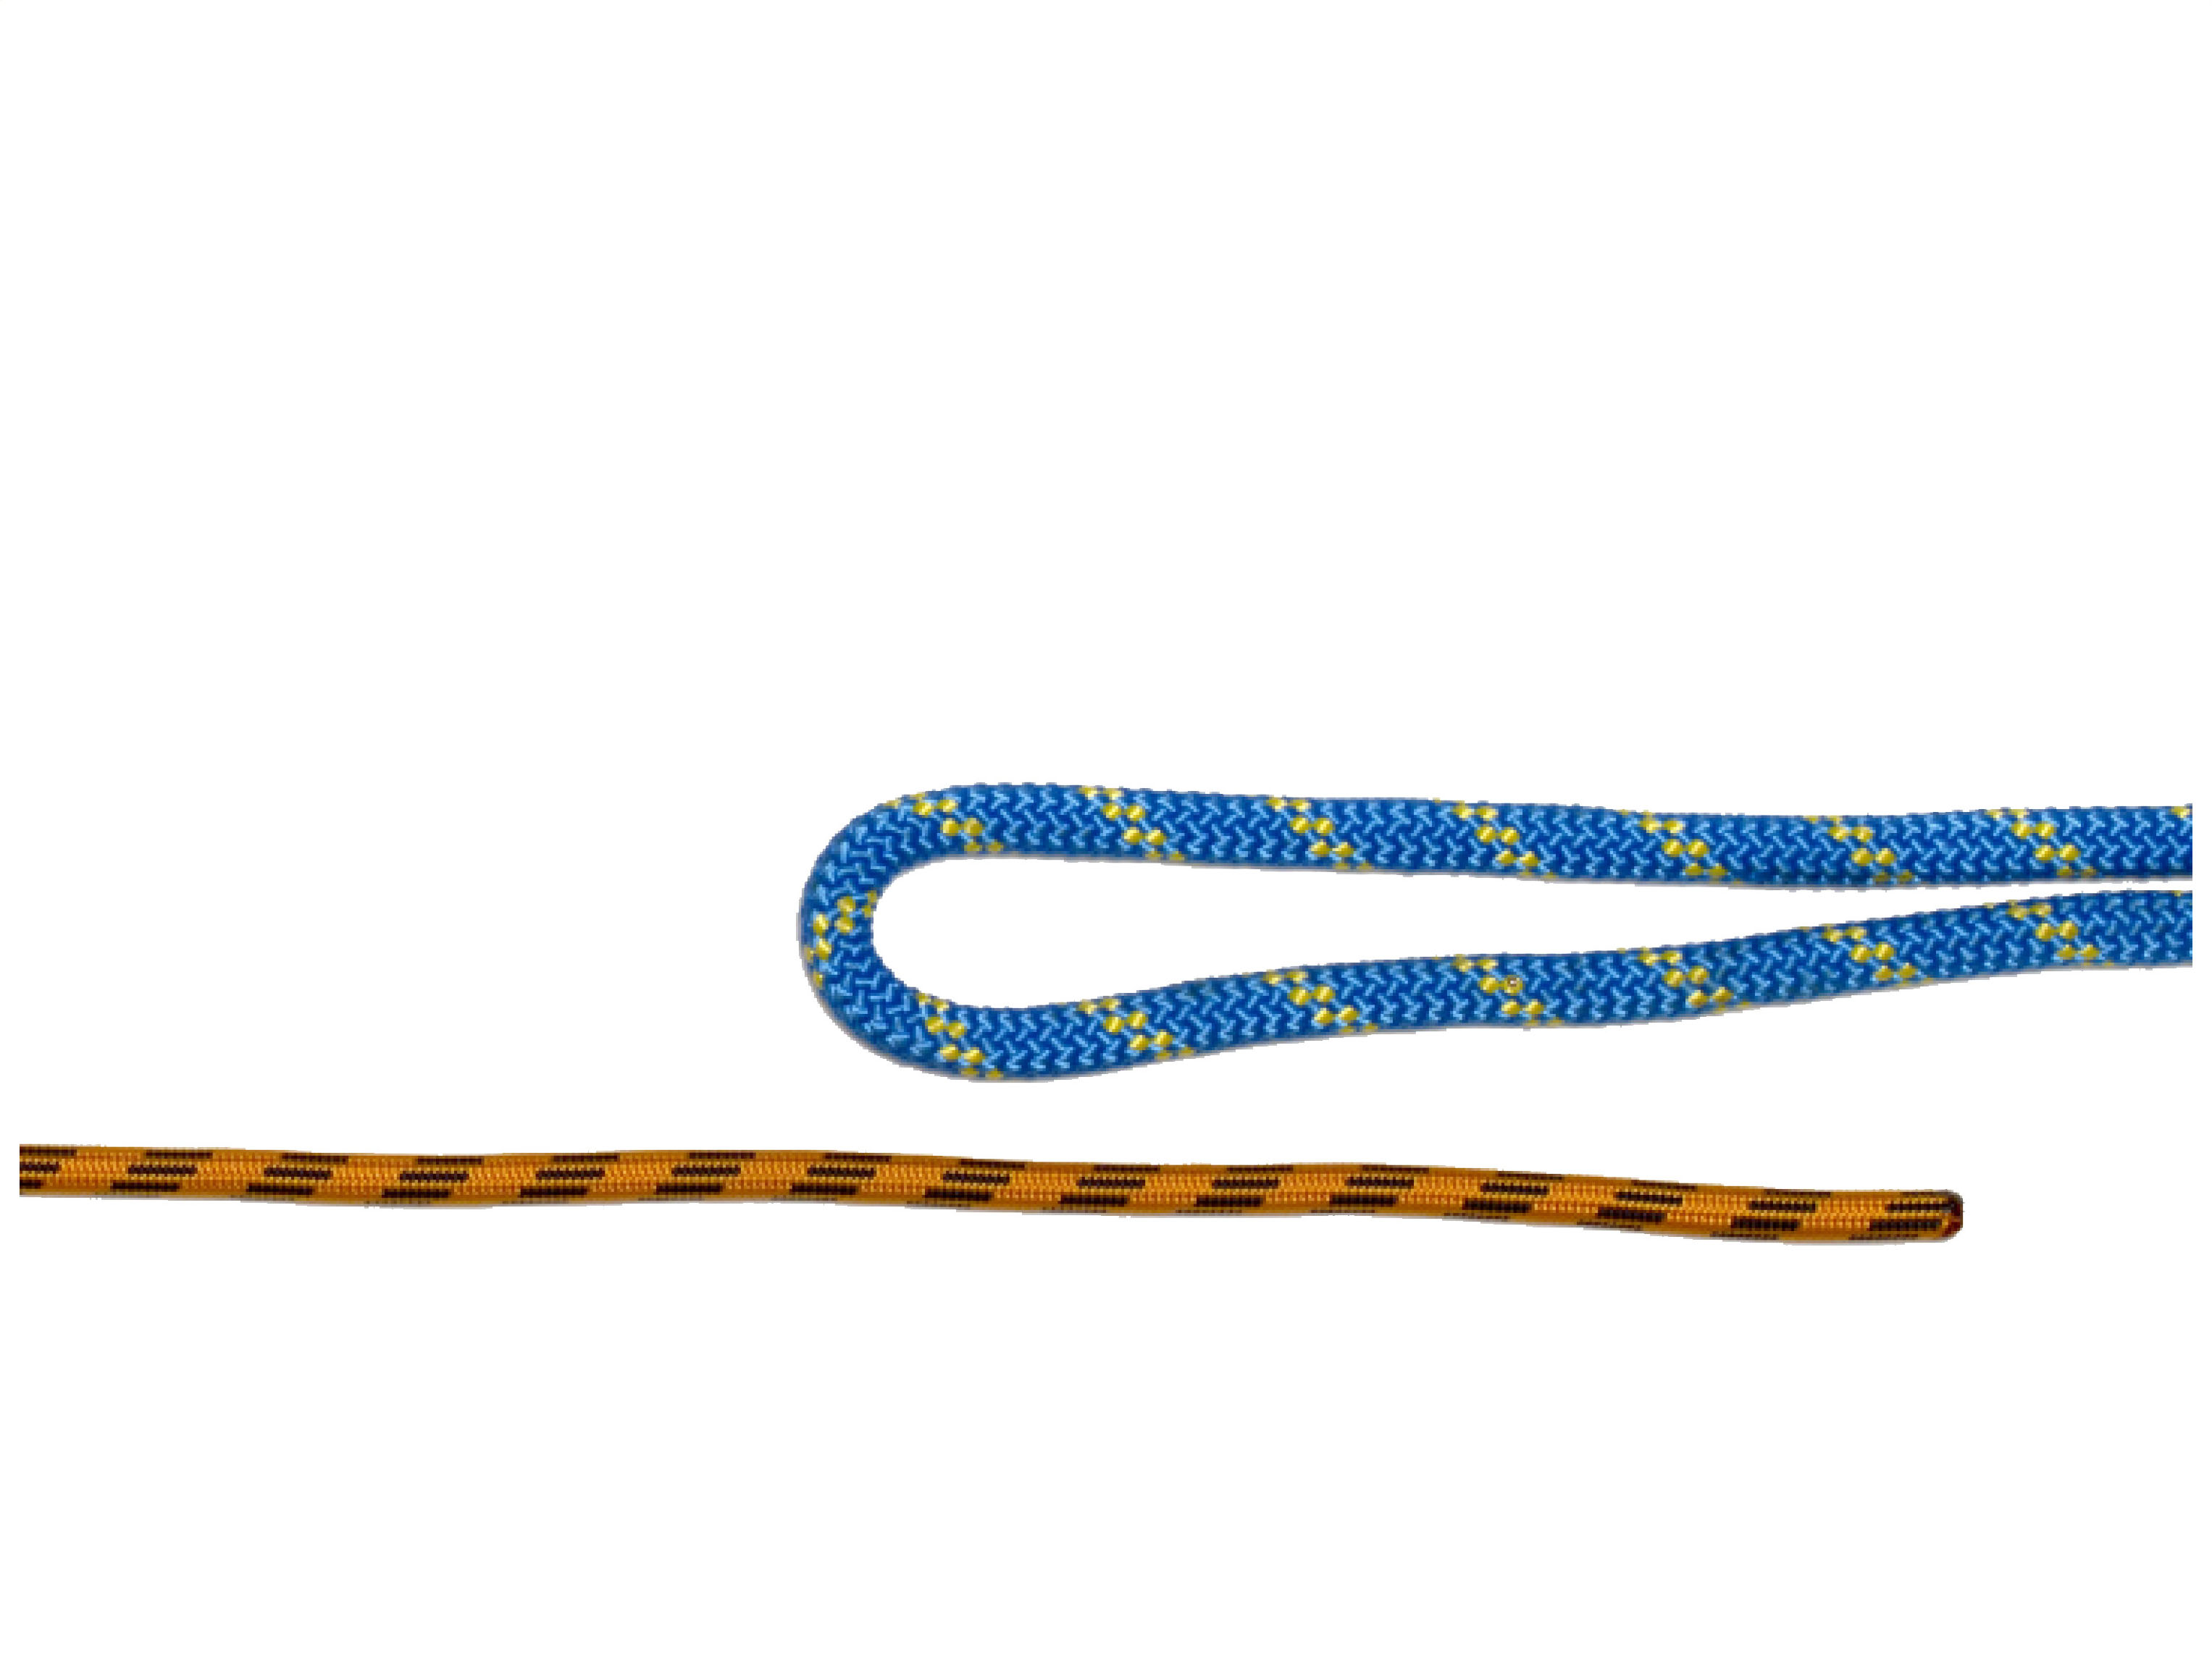
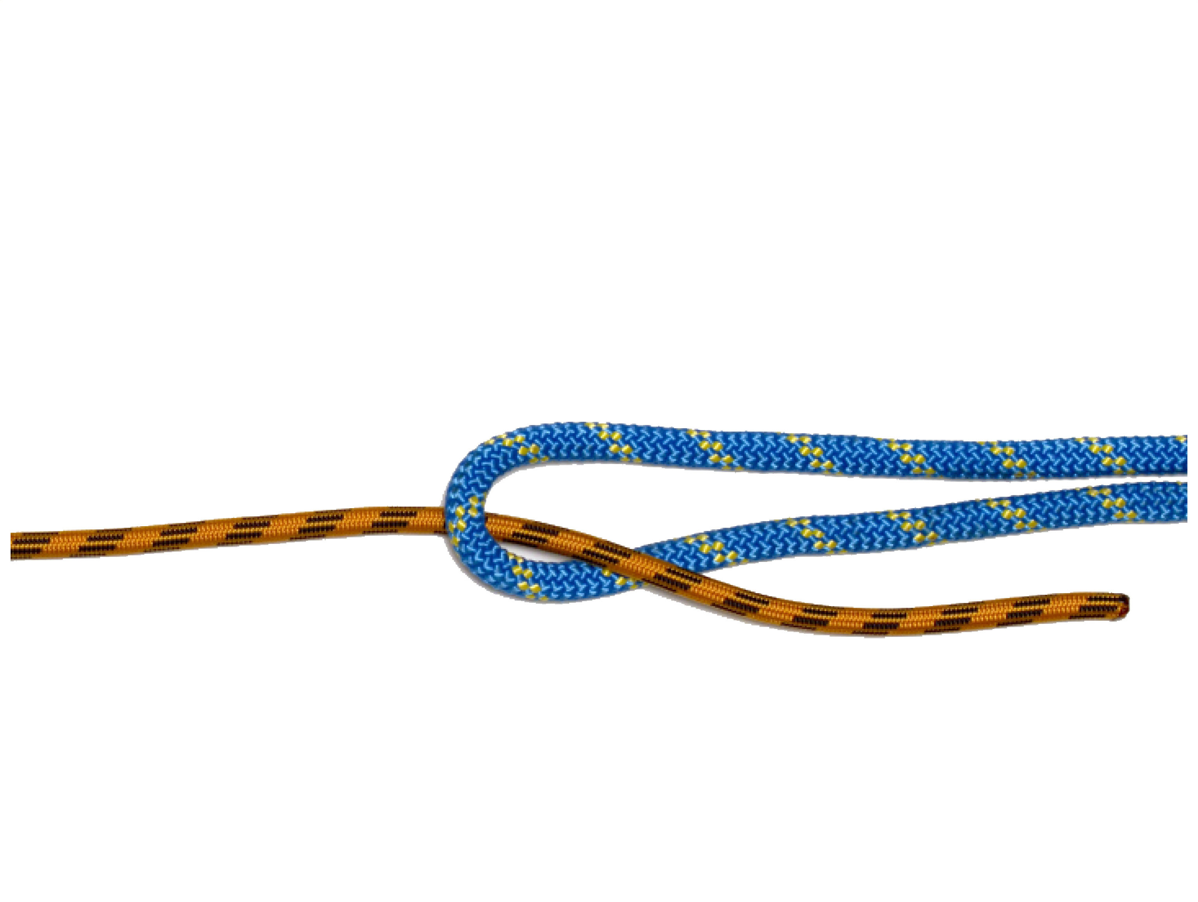
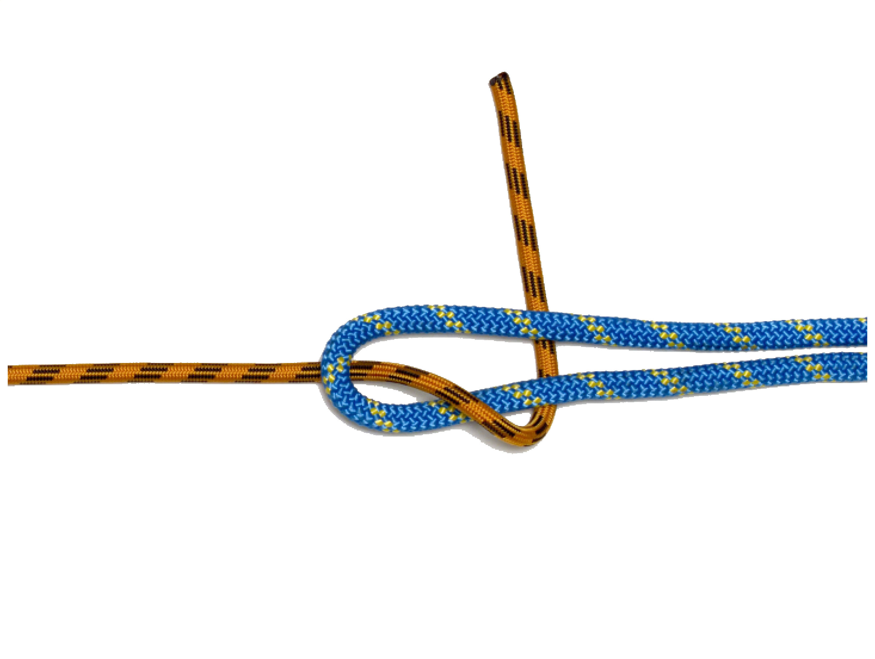
DOUBLE SHEET BEND
Double sheet bend is used to join two ropes temporarily to haul a rope from one point to another and is used most commonly on ropes of different thickness.
Benefits and uses
• double sheet bend has good security
• Will hold in slippery nylon rope
• good for joining different sized ropes.
Problems
• Not for use in climbing
• Place under moderate stress only

Slide 9
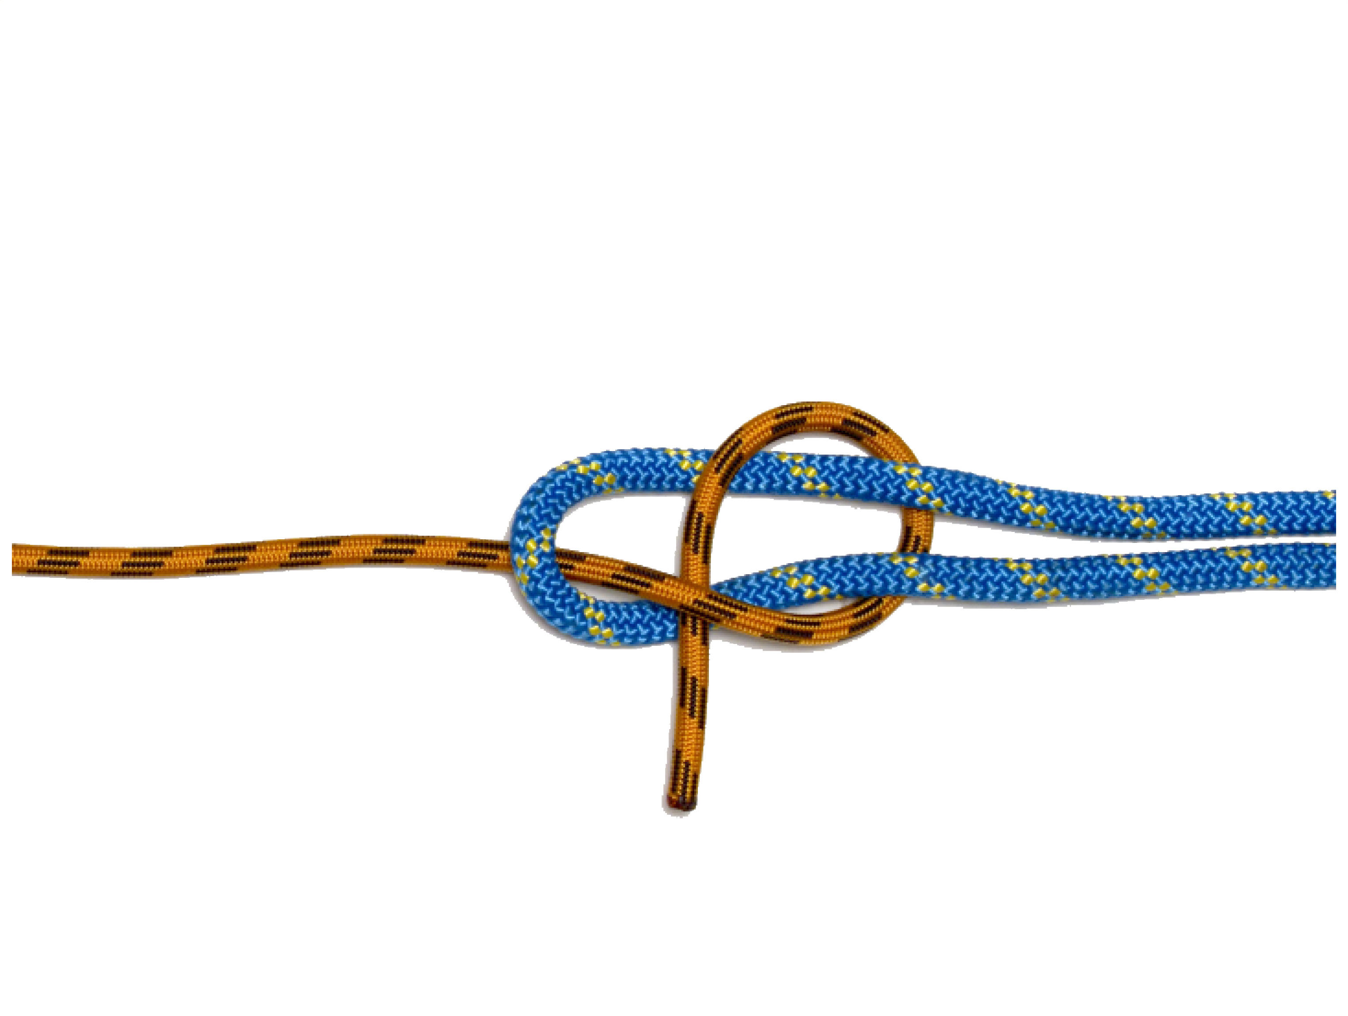
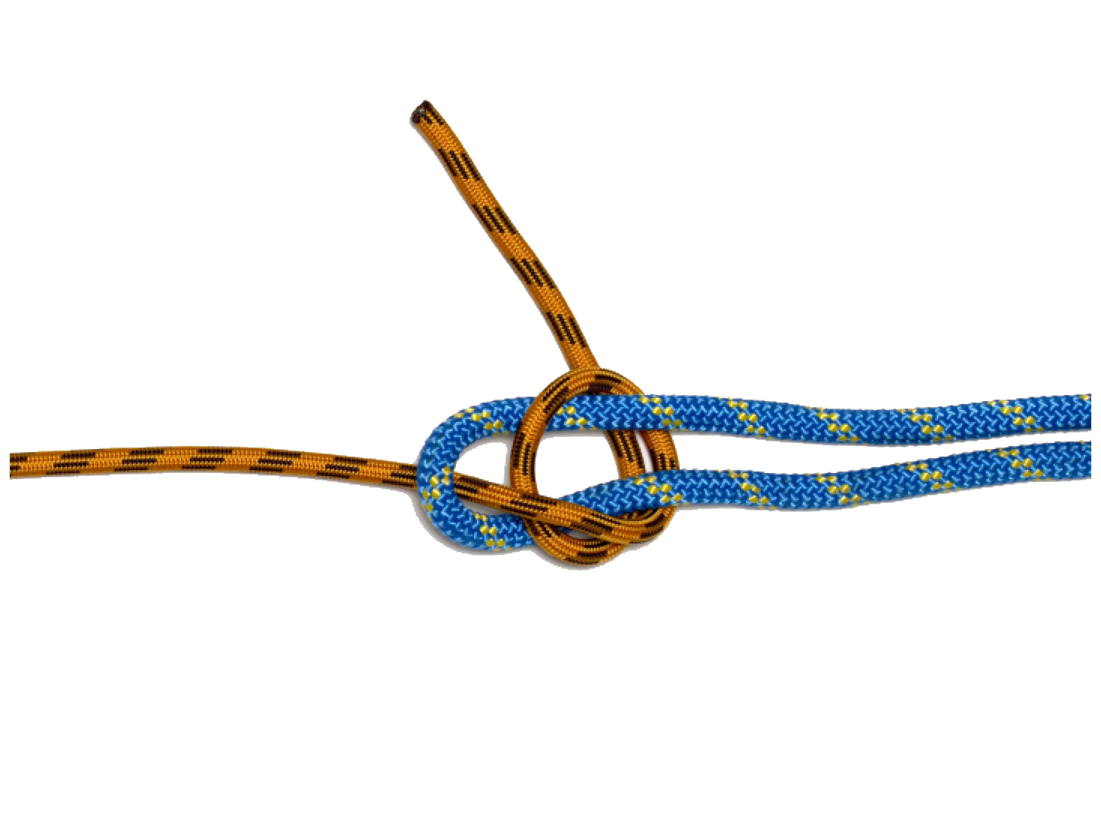
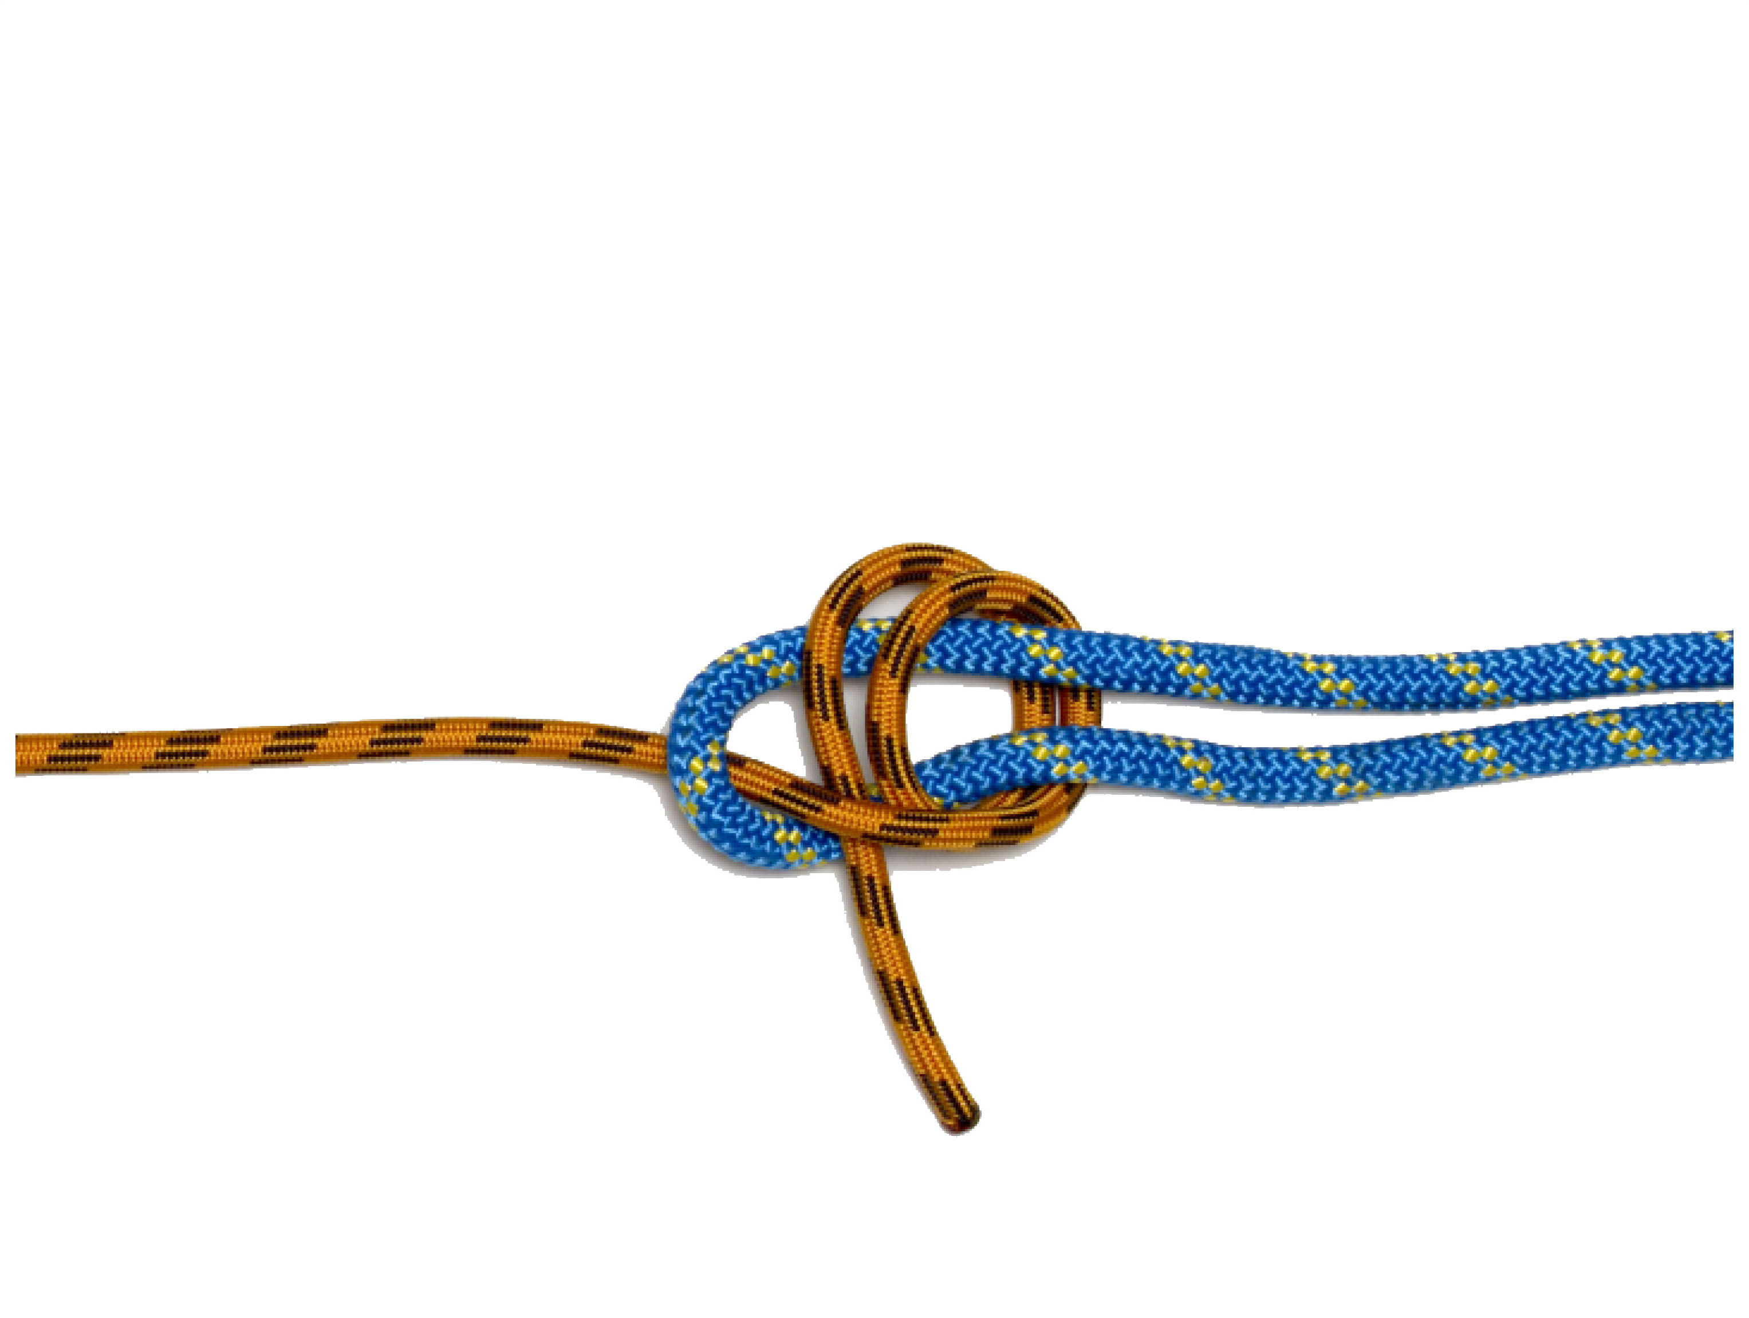
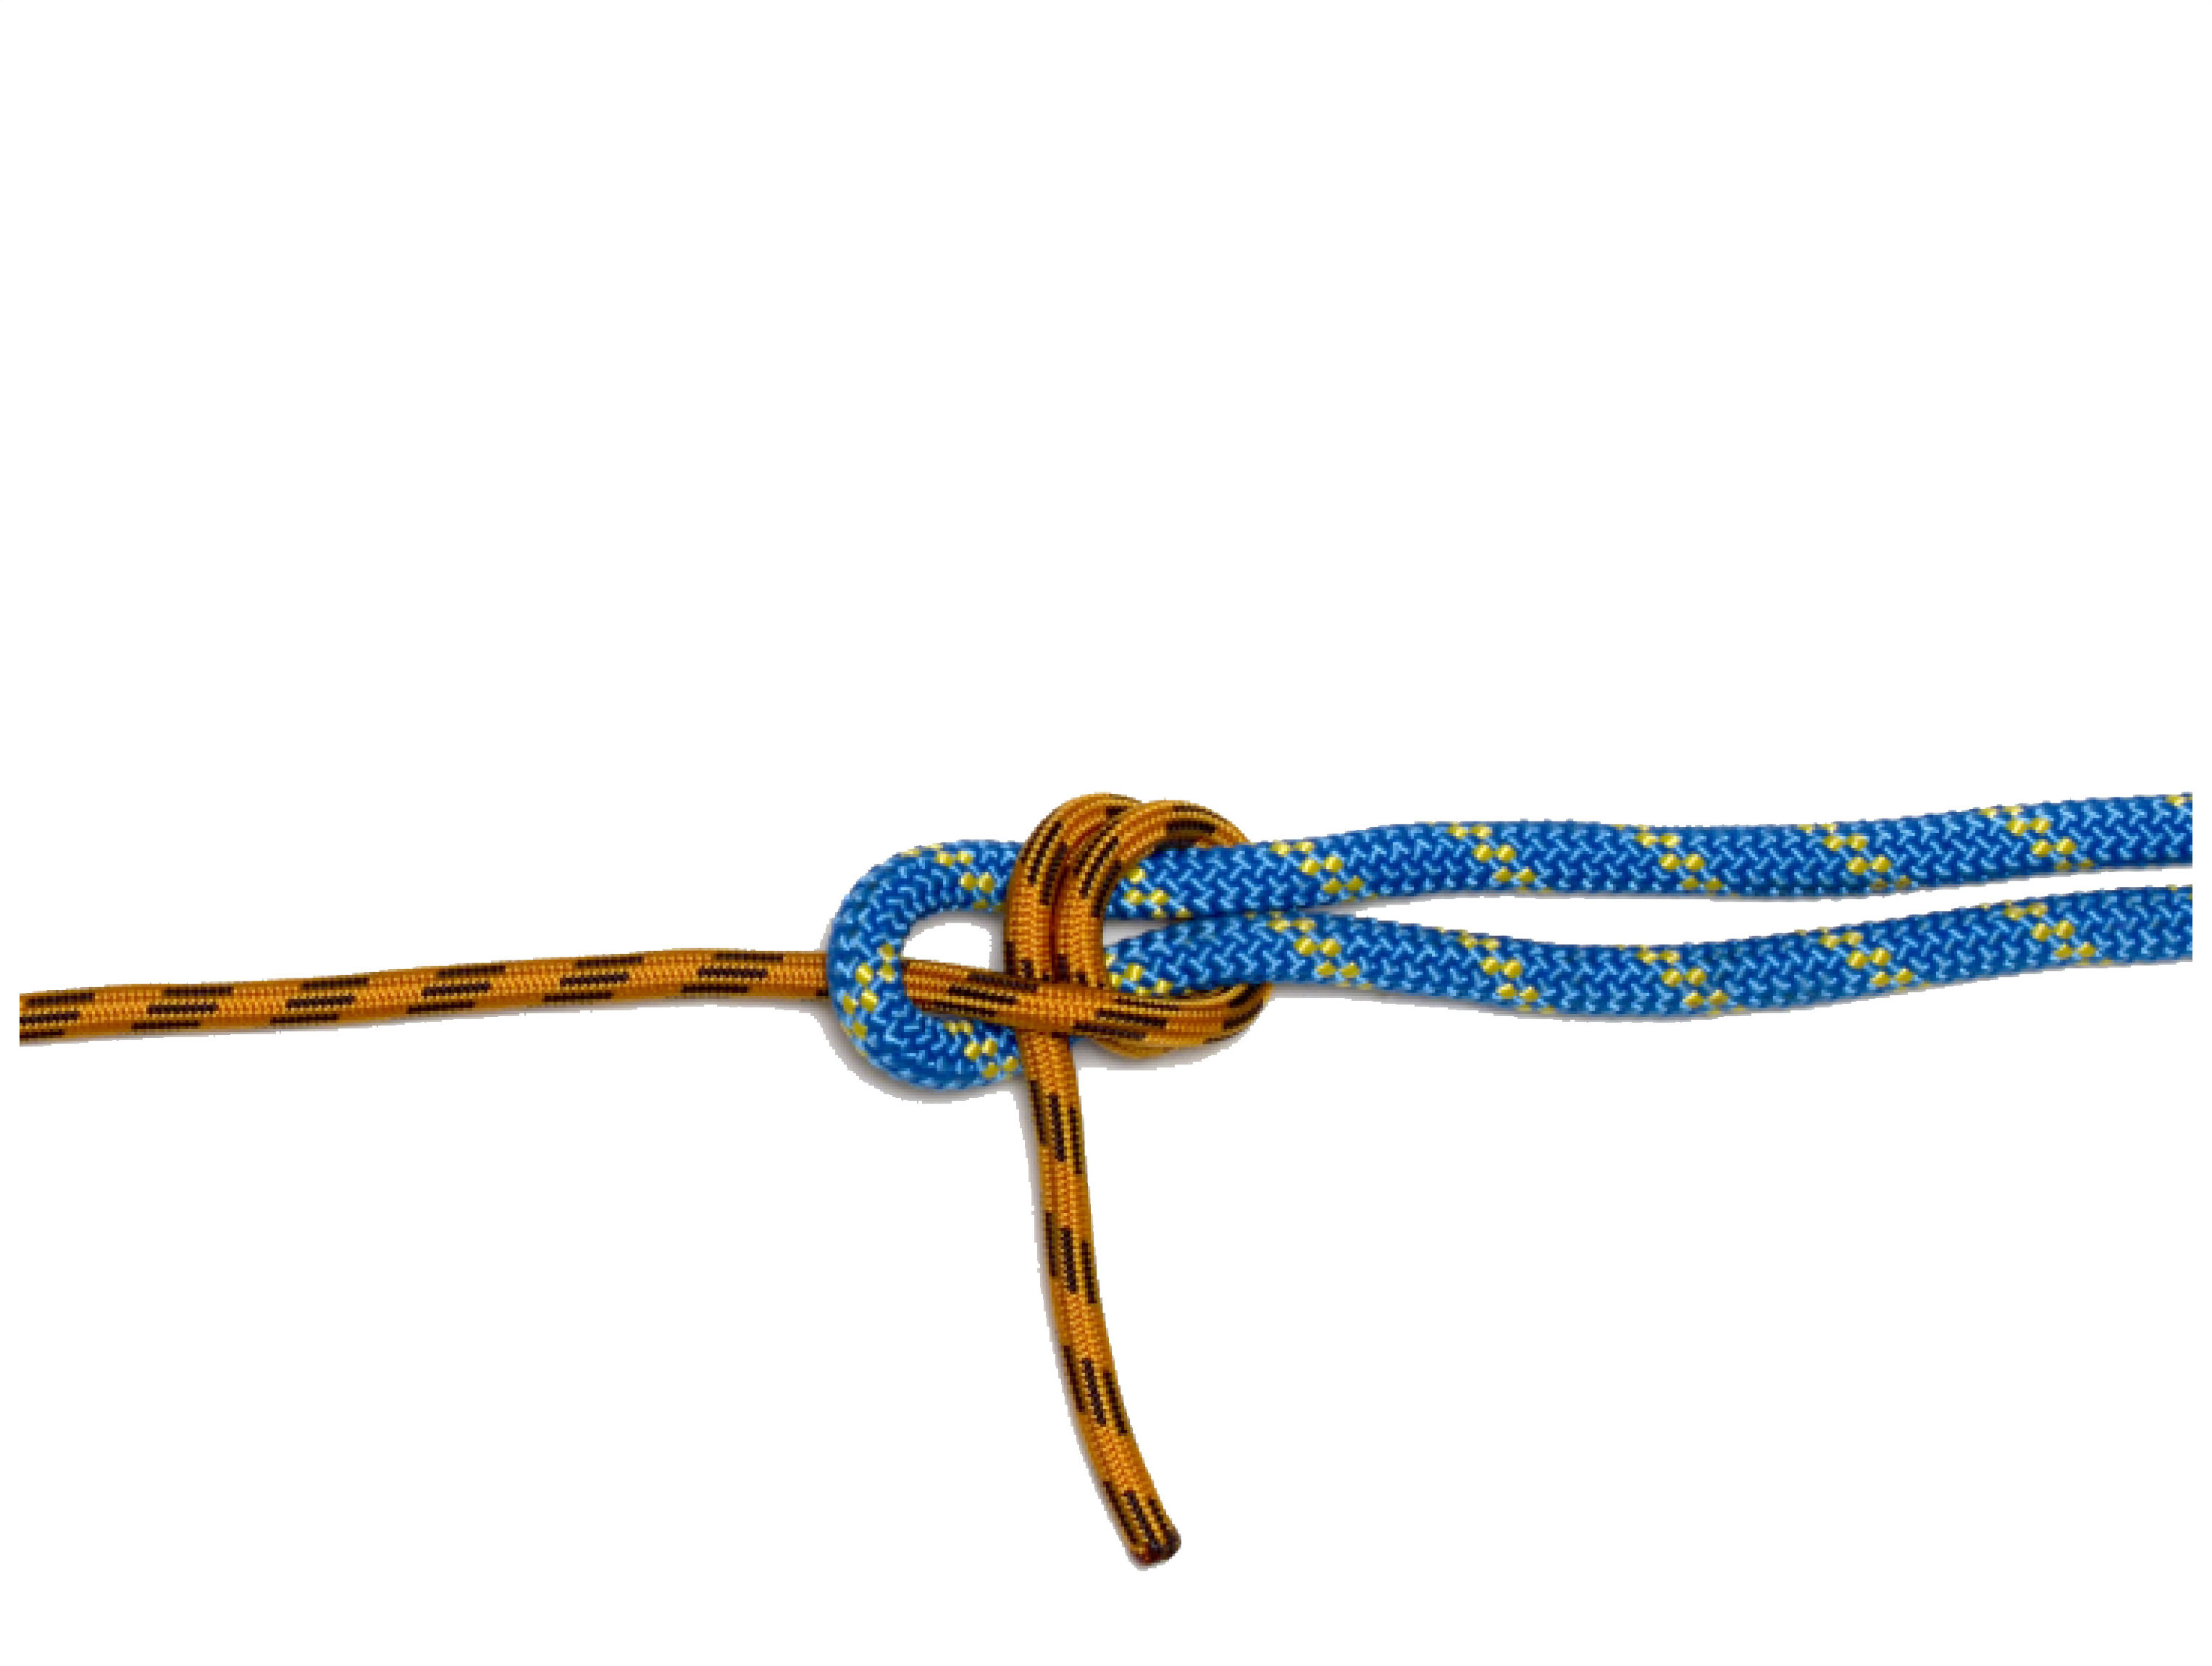
DOUBLE SHEET BEND

Slide 10
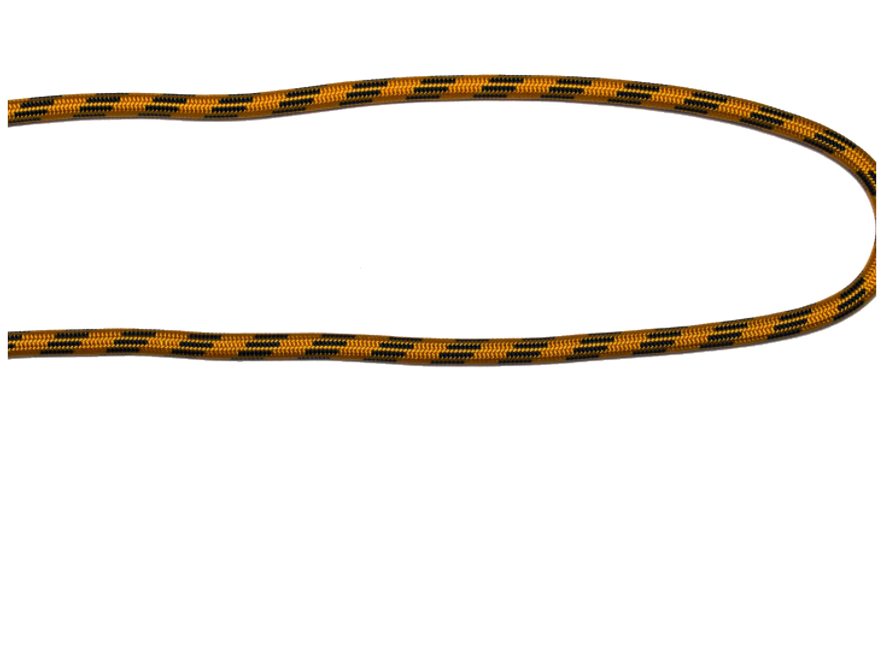
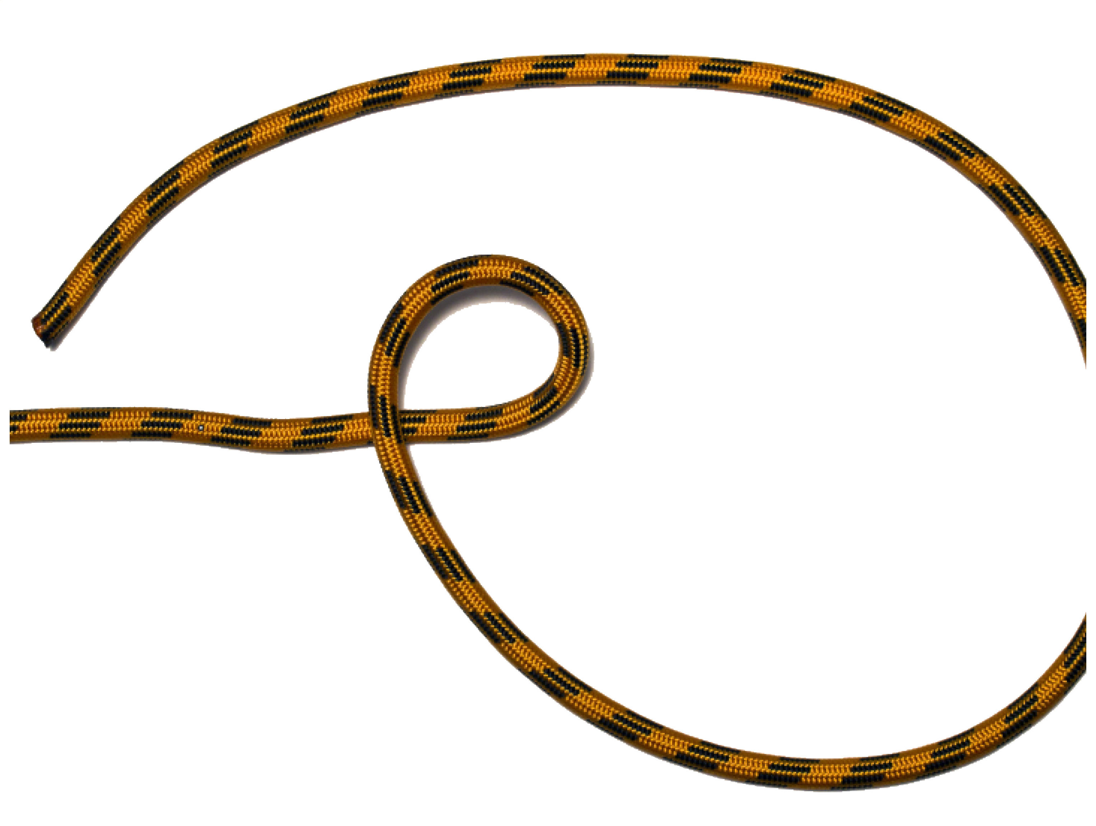
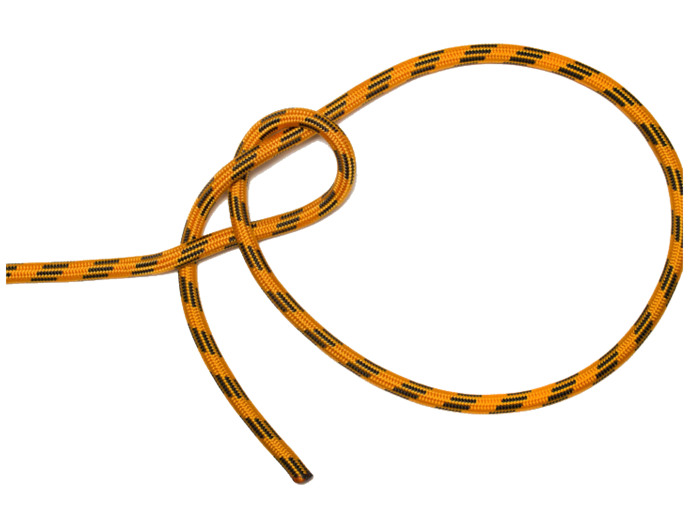
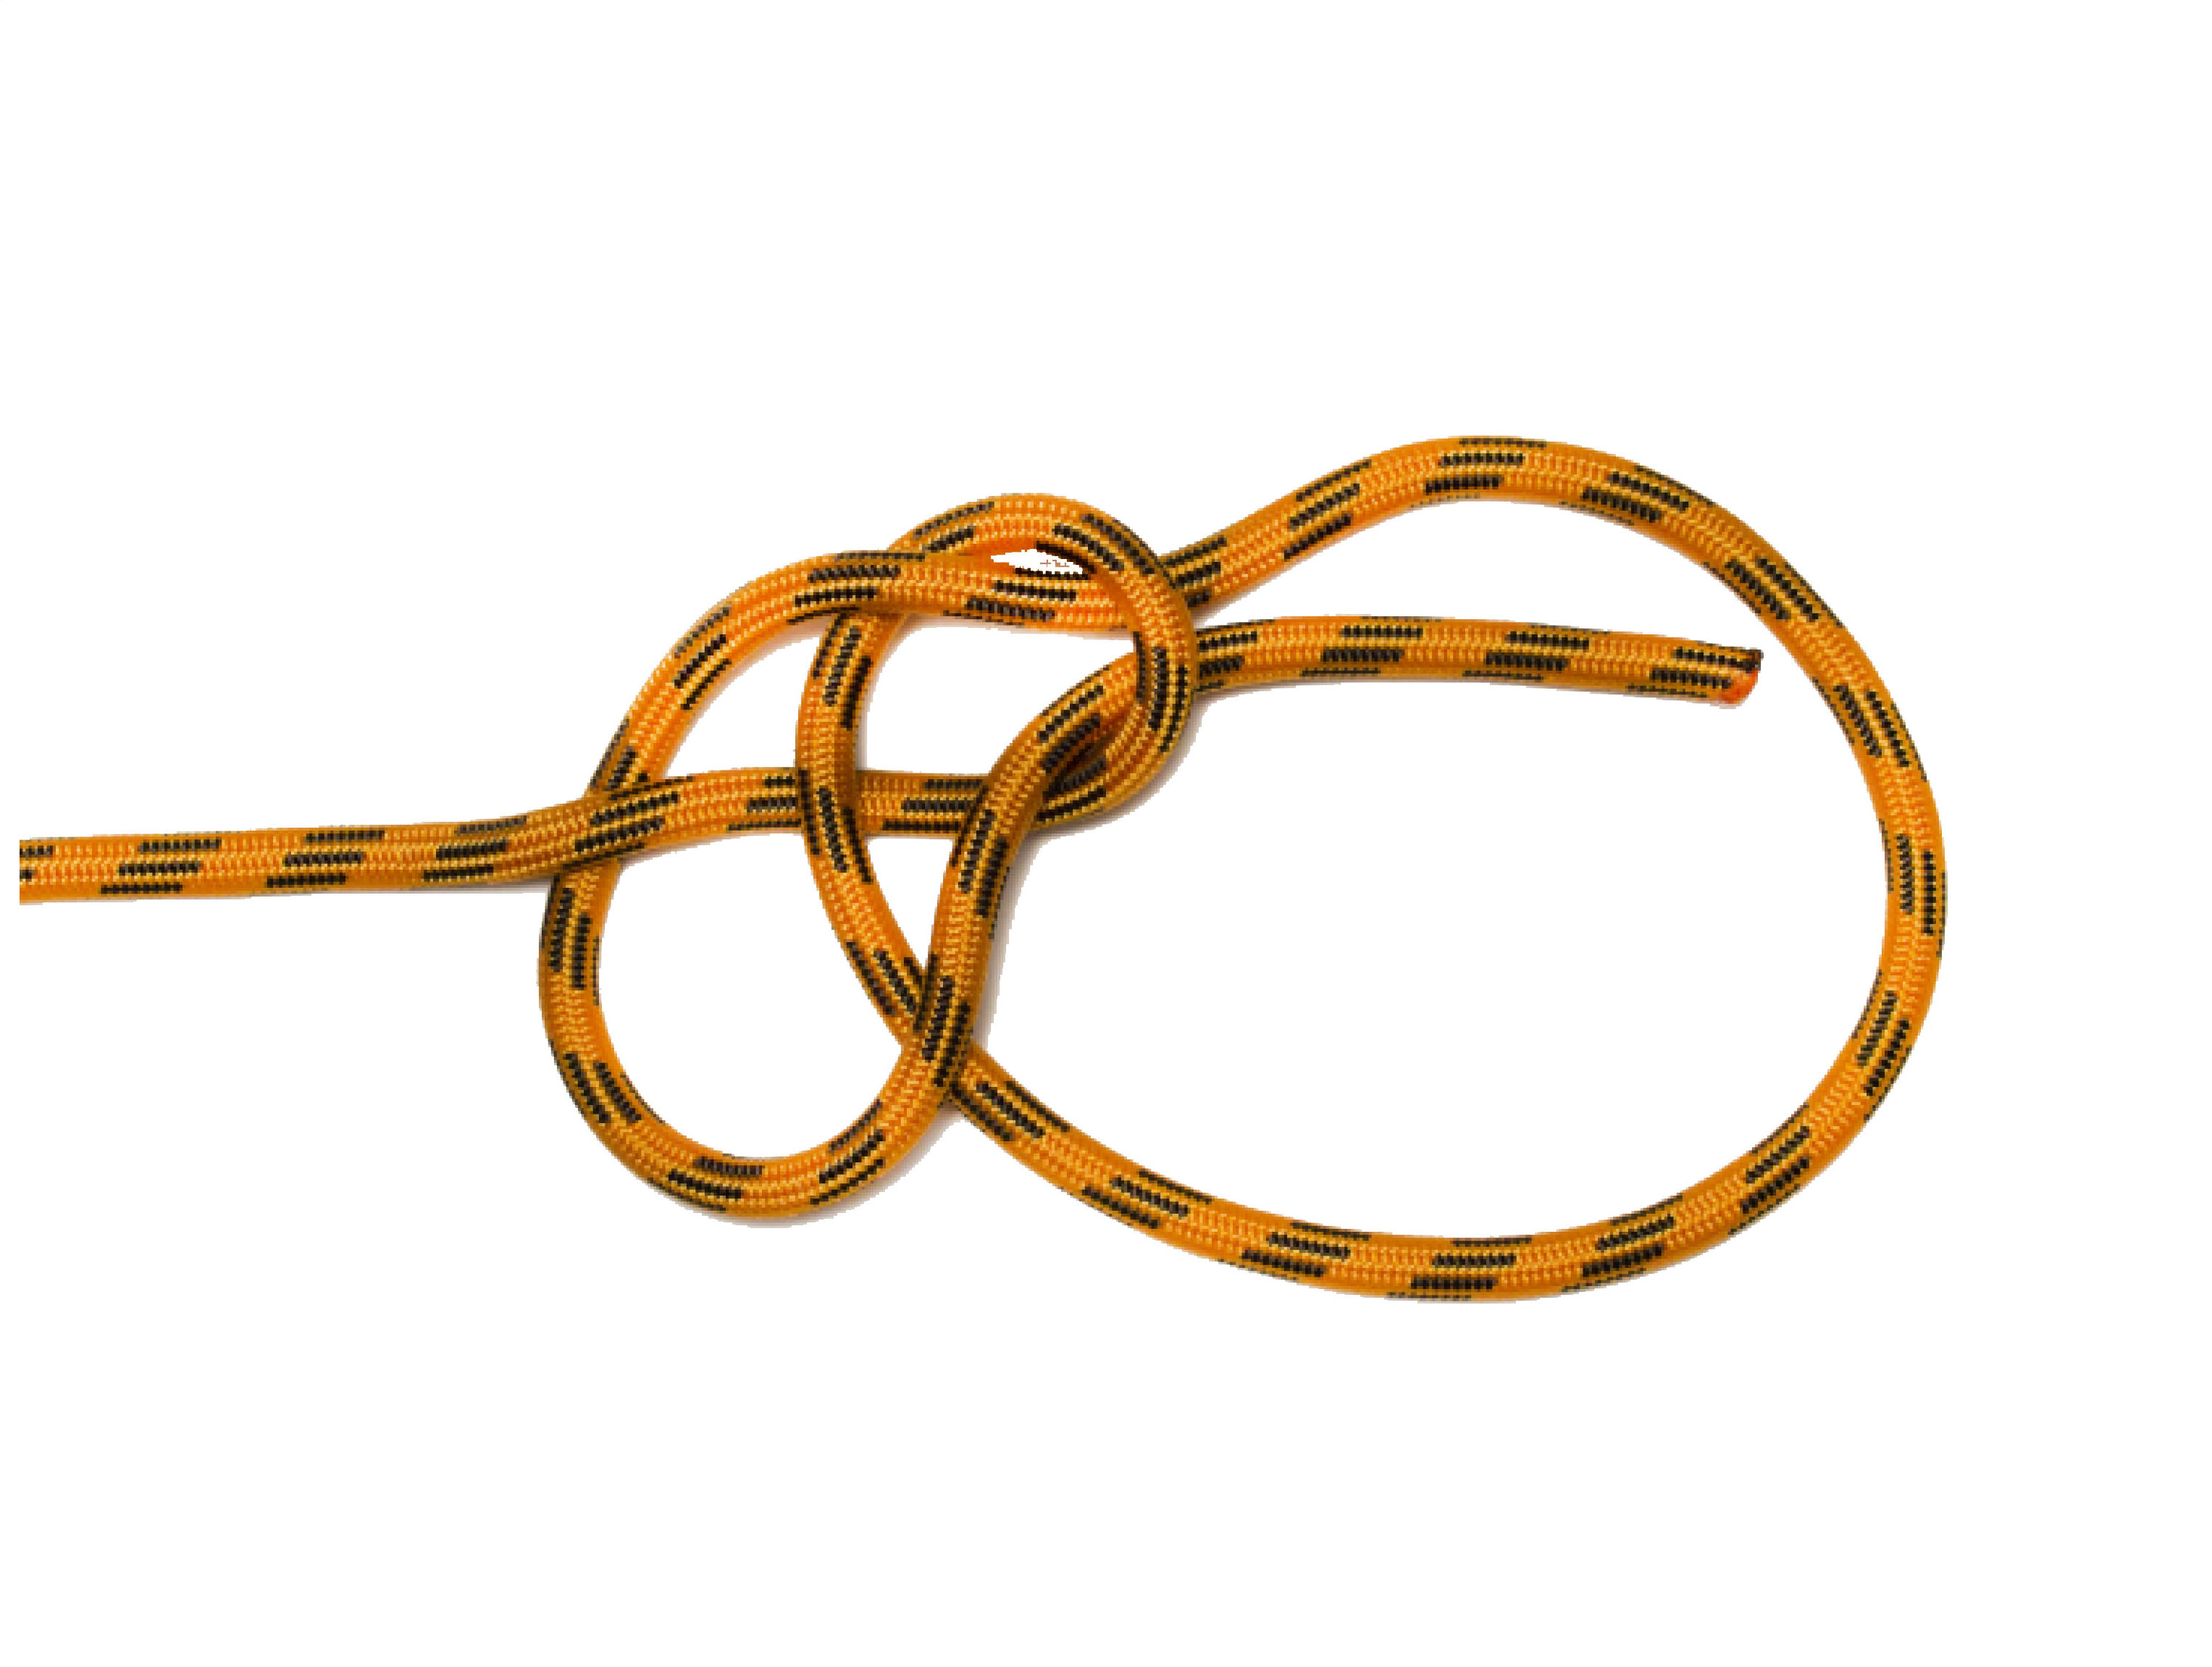
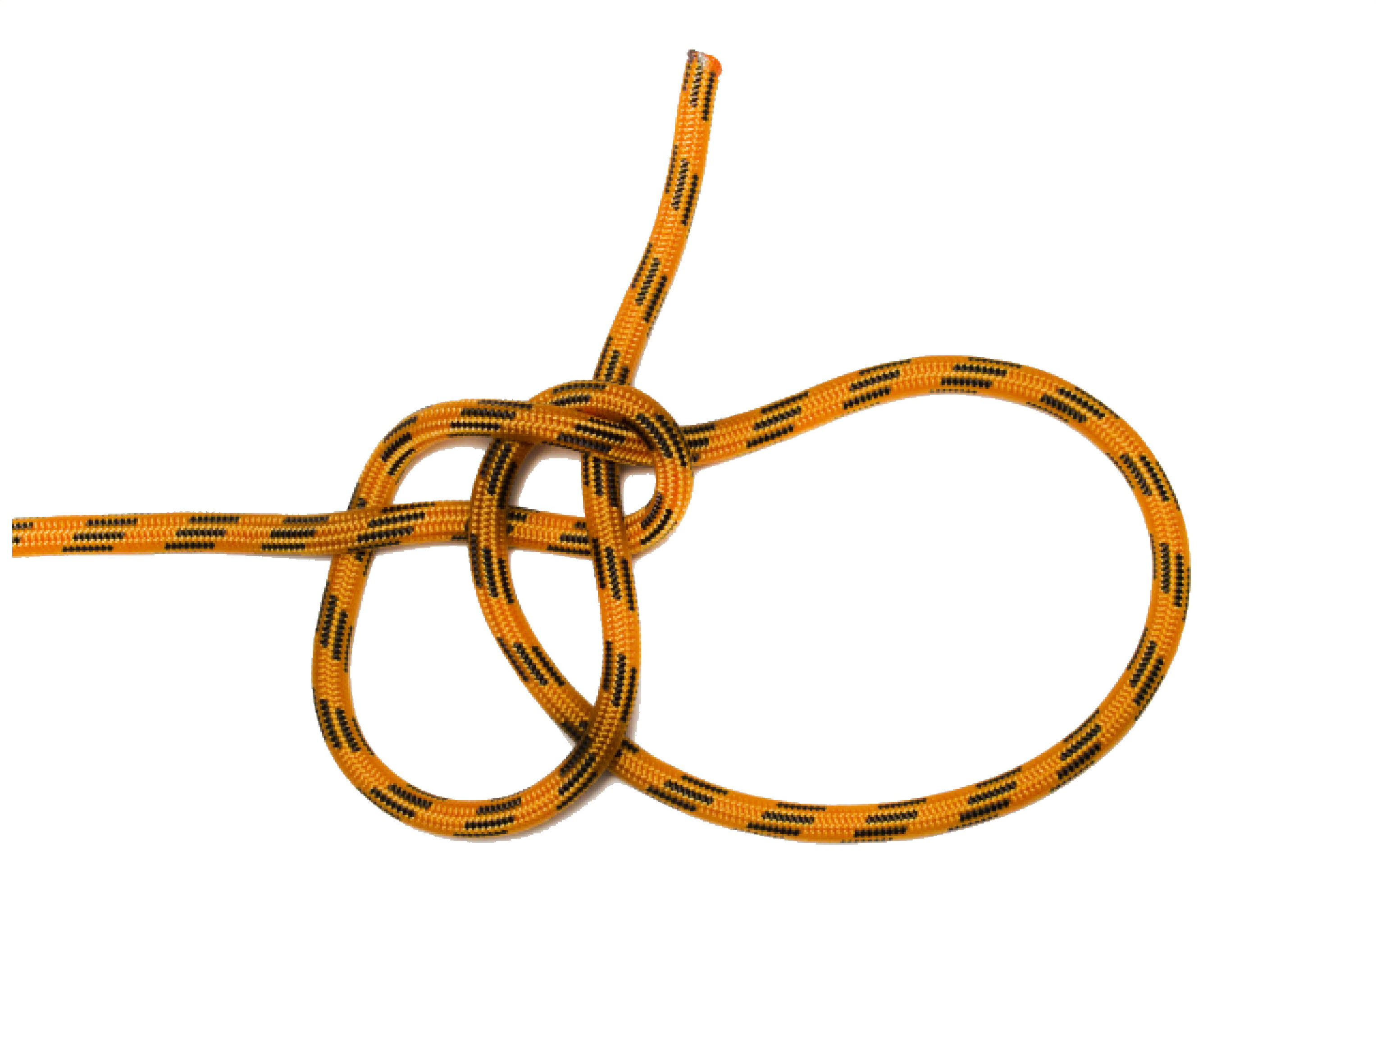
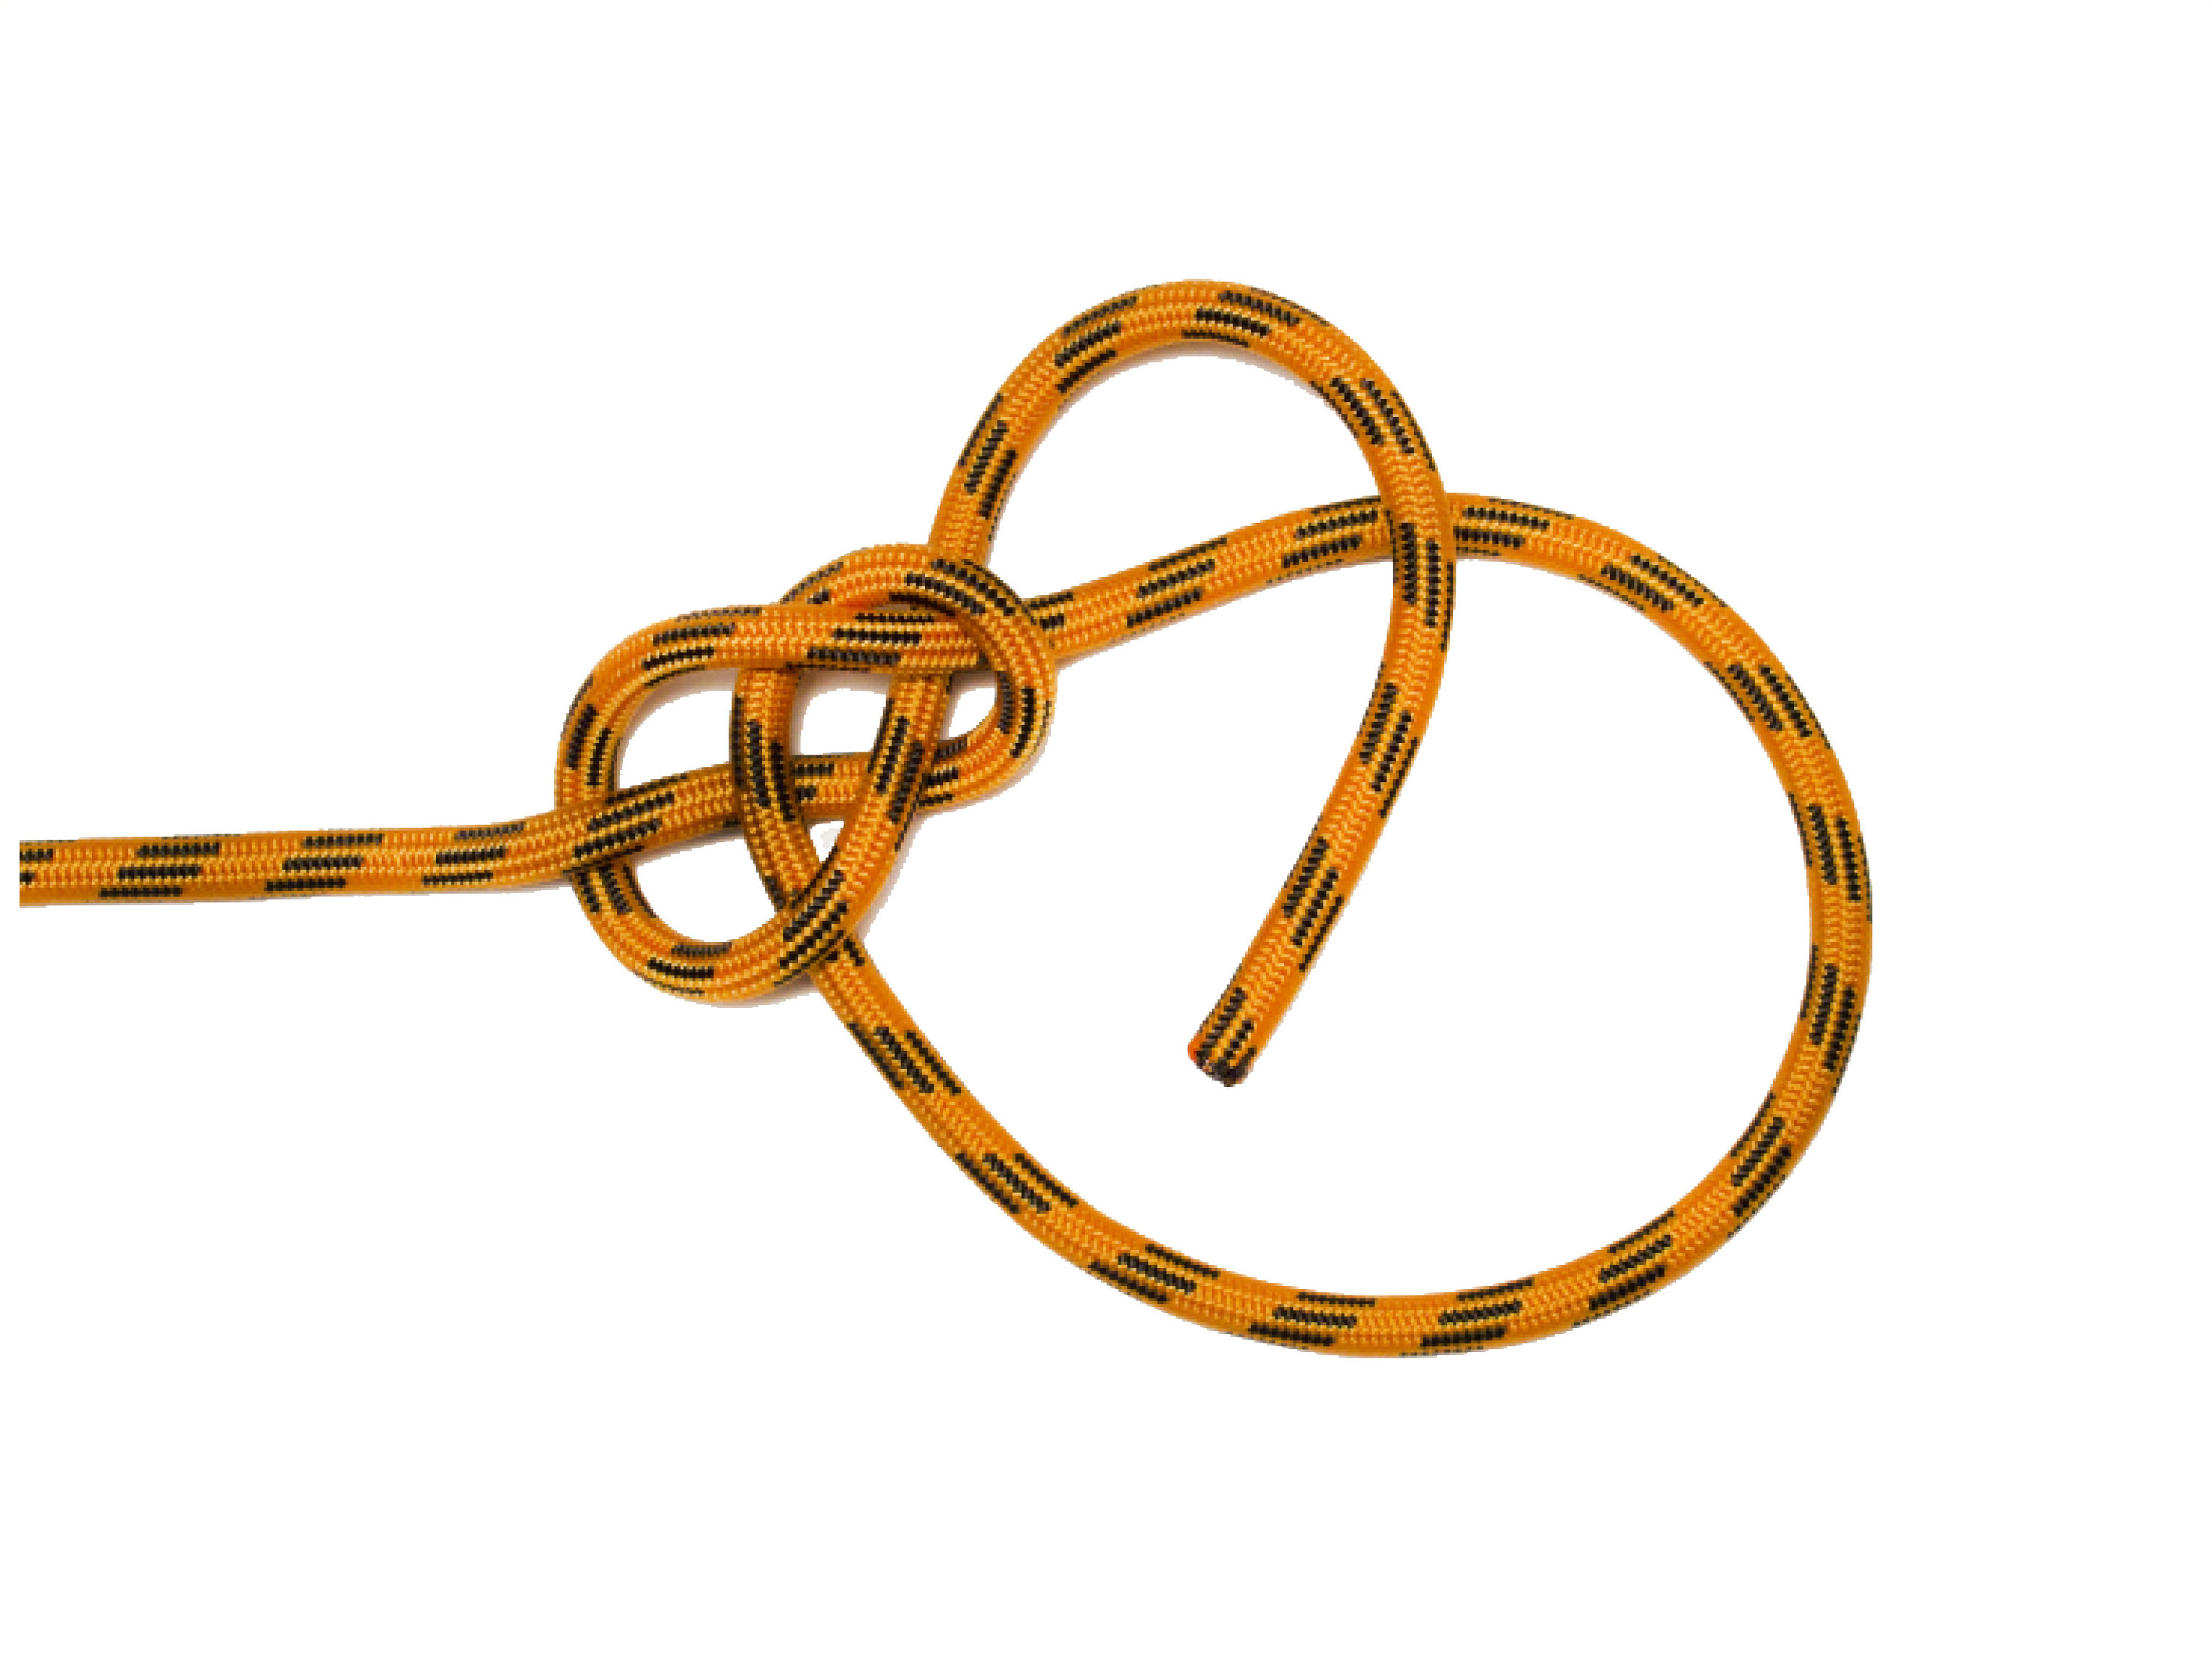
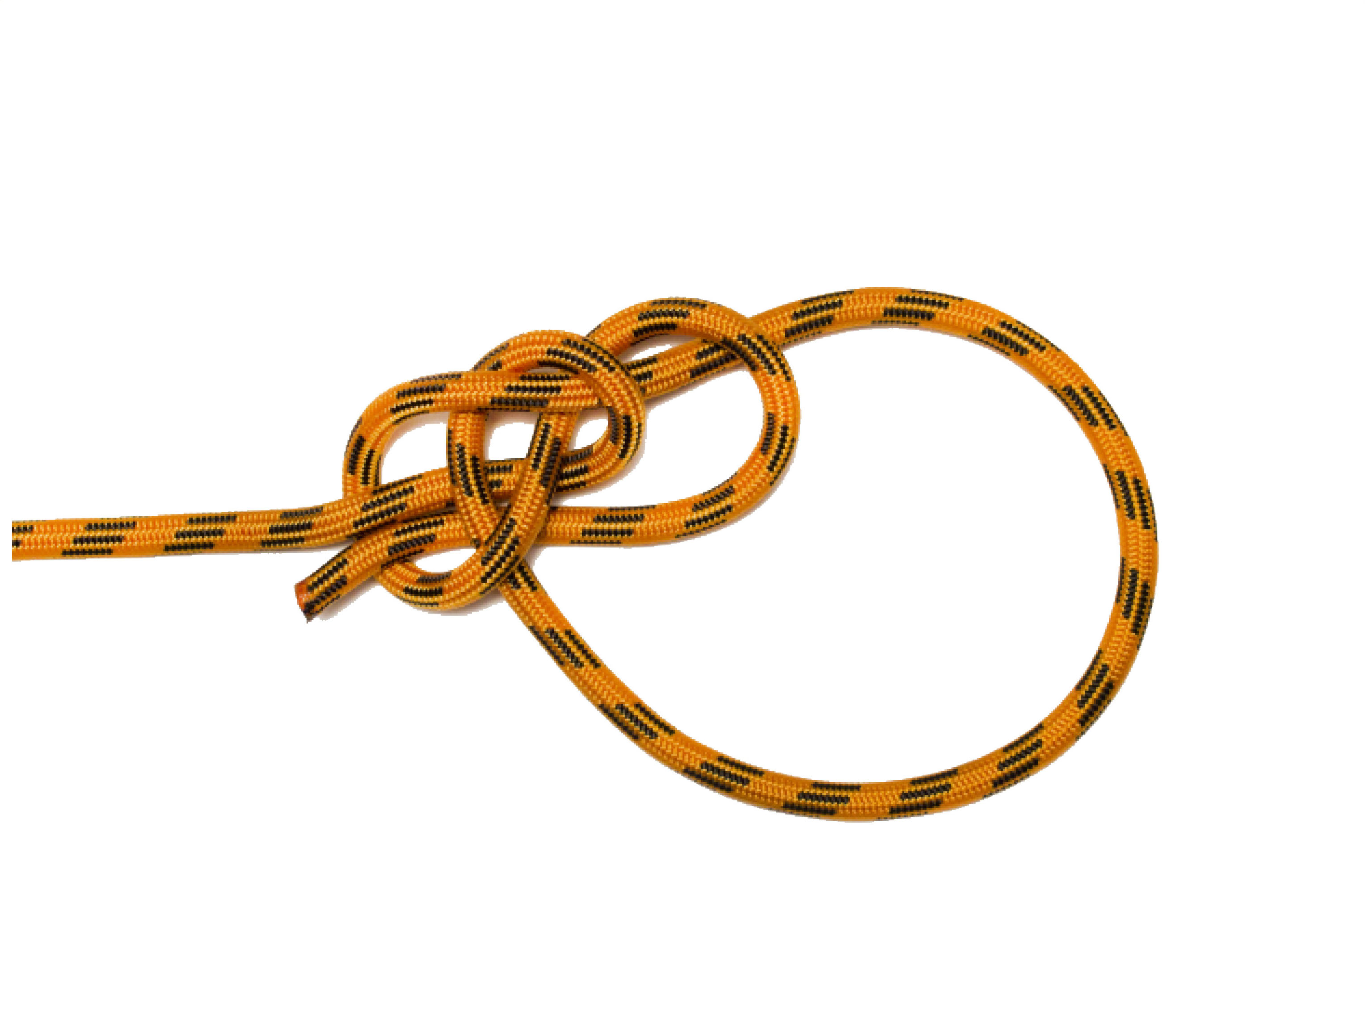
YOSEMITE BOWLINE
It is a bowline with the free end wrapped around one leg of the loop and tucked back through the knot and the end forms a figure eight. This is a more secure knot than a Bowline when used to secure a flapping tarp.
Benefits and uses
• Easy to untie when wet and frozen and is a strong knot
• Able to tie-in with only one hand
• Preferred method for securing tarps during storm damage operations.
Problems
• Must be tied and dressed correctly or it may fail

Slide 11







TIMBER HITCH
Secures a rope around a pole or other object. Pass the end of the rope around the pole and then around the standing end. Wrap the end around itself three times and tighten the knot so that the three turns are gripped against the pole.
Benefits and uses
• It does not jam or slip and is easy to tie and untie
• Most often used to haul tarps onto a roof
Problems
• Falls apart almost instantly when the tension released
• Not recommended for square edged poles
• Add one or two half hitches if hoisting.

Slide 12






FISHERMAN’S BEND
Fisherman’s bend: (is a hitch). This is sometimes called the anchor hitch or anchor bend in some industries. This bend can be used when anchoring lines. Suitable if there is a slackening and tightening motion in the rope.
Benefits and uses
• Easy to tie
• Very secure
Problems
• Ensure standing end is straight out from the side of the item so load is transferred to anchor not to knot.

Slide 13





FIGURE OF EIGHT
The strongest knot for a stopper knot. From the standing end form a loop then pass the running end under and around the standing end. Complete the knot by passing it down through the loop. This knot is a stopper knot to prevent a rope pulling through a smaller hole or pulley.
Benefits and uses
• Used at the end of the rope and easy to tie.
Problem
• Dress correctly or the knot can slip.

Slide 14





FIGURE OF EIGHT LOOP
This knot forms a non-slip loop that is easy to undo.
Benefits and uses
• Used to make a single loop in the end of a rope
• Good for synthetic fibre rope; strong and easy to untie, even when wet and tight
• Knot performs best under continuous load.
Problems
• The Double Figure Eight can loosen and spill if the rope is slack. • Not appropriate for situations where a 3- way pull is possible. (The Alpine Butterfly Knot is best for this) • Can be hard to untie when an excessive load is applied.

Slide 15






FIGURE OF EIGHT ON THE BIGHT
An alternative method where a free loop is required at the end of the rope is to take a bight of the rope about 500 mm. Tie off this bight of rope in the same manner as the figure of eight knot to form a locked bight.
Benefits and uses
• Relatively easy to tie, secure and is used on the safety line in height safety.
Problems
• Dress the knot correctly and hard to untie when excessively loaded.

Slide 16



ALPINE BUTTERFLY
Benefits and uses
• Used to make a single loop along a rope, particularly when the loop and the ends could each be pulled in different directions.
• Good for climbing with kernmantle rope; strong and easy to untie, even when wet and tight.
Fixed loop in the middle of the rope that handles multi direction loads, while the rope is under tension throughout its length. Wrap the rope around your hand twice. At the end of turn one, position the rope close to your fingertips. Continue around and complete turn two back near your thumb. Pick up the turn near your fingertips. Wrap it over and around the other two turns. Slide the knot off your hand and tighten by pulling on the loop and the ends.
Problems
• Can be hard to untie in natural-fibre rope.

Slide 17






ALPINE BUTTERFLY

Slide 18





DOUBLE FISHERMAN’S KNOT
Benefits and uses
• Suitable to join ropes of same or uneven thickness and will never spill.
• Excellent for both natural and synthetic fibre ropes, whether smoothwoven or laid, wet or dry.
• Can be used to create a loop of cord for use as a prusik
Problems
• During tightening the ends can pull through the knot, so generous ends should be left protruding when tied.
• Relatively bulky and uses lots of rope.
• When joining smooth (kernmantle) ropes, it can be very difficult untie.

Slide 19








DOUBLE FISHERMAN’S KNOT

Slide 20



TAPE KNOT
Structurally, it is simply two interlaced overhand knots. Tie a loose overhand knot in the end of the strap. Thread the other strap in the reverse direction following the exact path of the first overhand knot. Pull the knot tight.
Benefits and uses
• Used for joining two artificial-fibre webbing tapes or belts together, particularly for joining slings when climbing.
Problems
• When tying, the tapes should not be twisted; their surfaces should be kept flat against one another for maximum friction.
The tape knot is the only safe method of joining rescue tape. To tie this knot tie one thumb knot near one tape end. Then take the second tape end through the original knot in the opposite direction and dress the knot. Leave a minimum tail of 100 mm protruding from each end of the knot.

Slide 21





TAPE KNOT

Slide 24
Created for the members of the
Deception Bay
State Emergency Service
Group

Slide 25
FOUR

Slide 26
SIX

Slide 27
NINE

